Slide 1
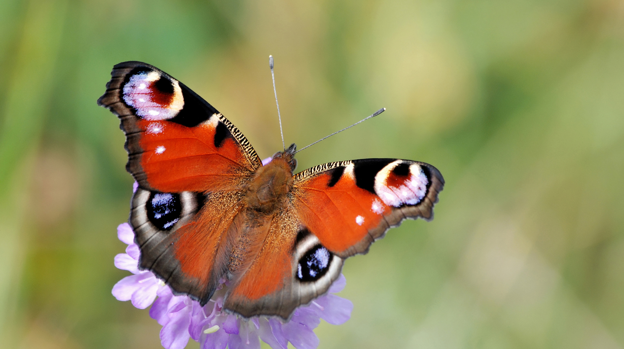

Butterflies

Slide 2
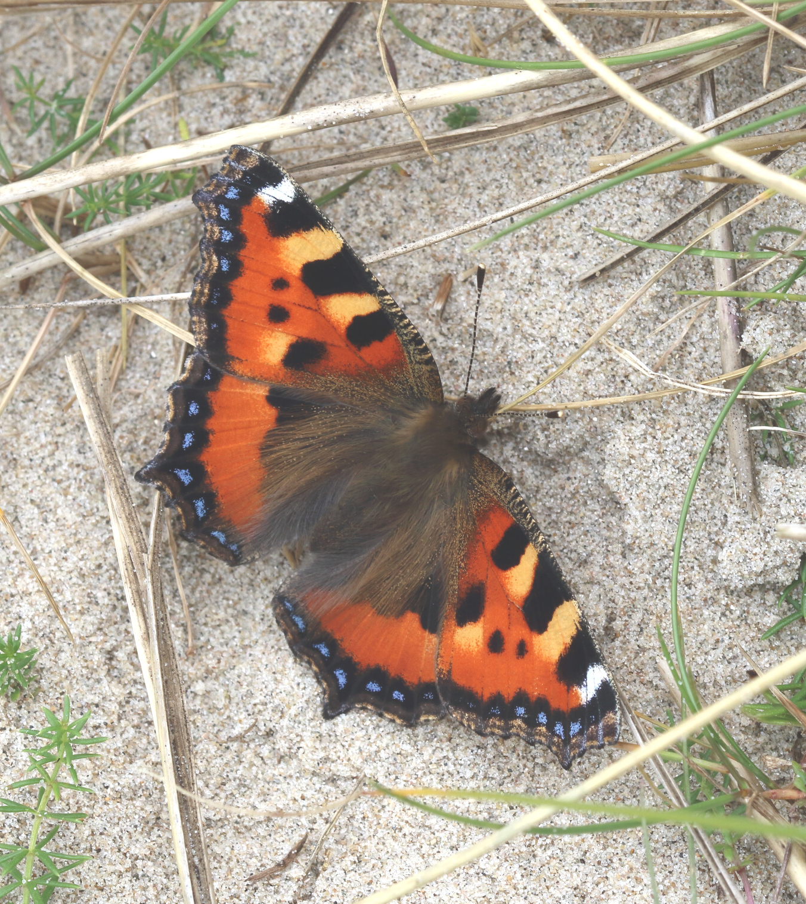
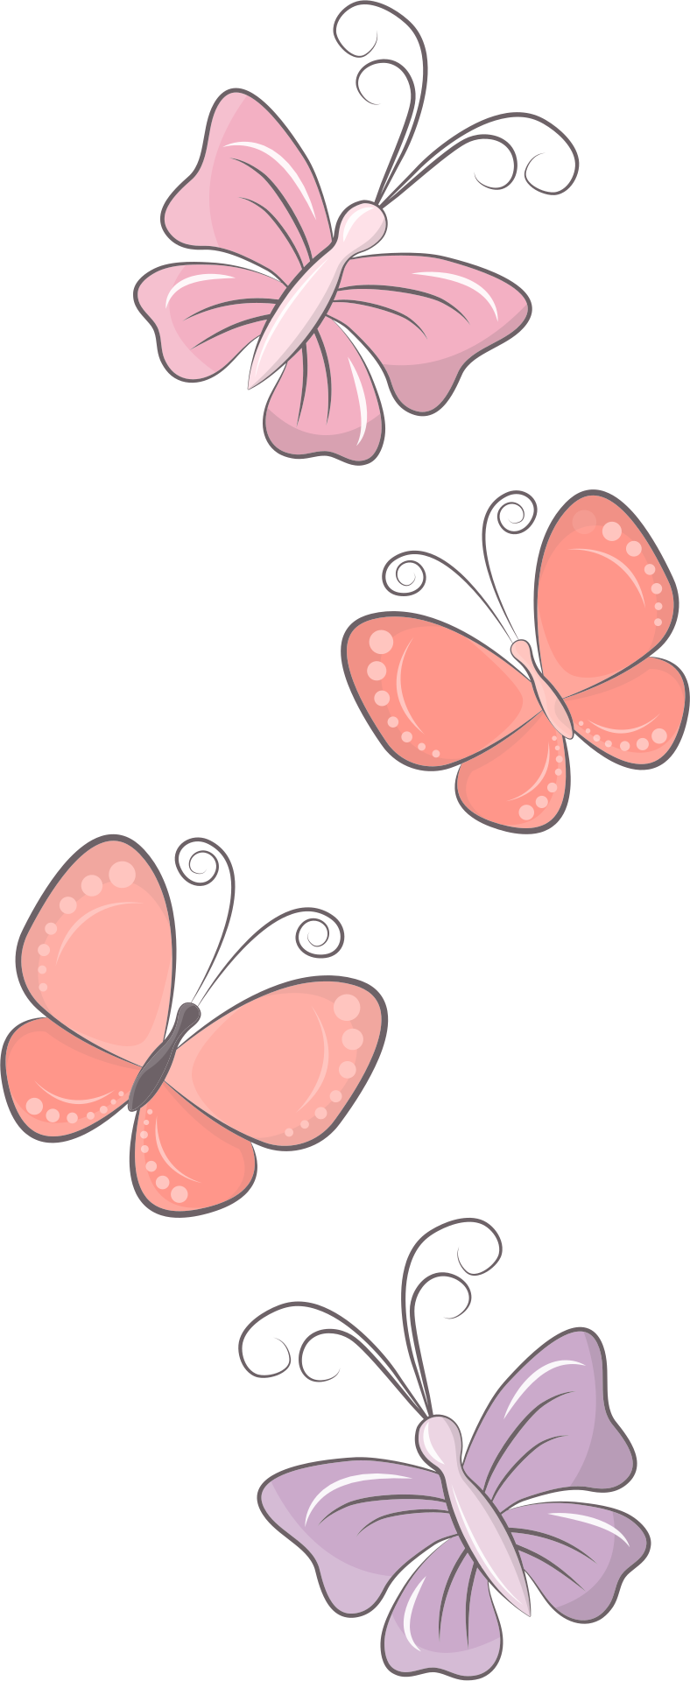
Small Tortoiseshell
Ruán Beag
This is one of our most common butterflies.

Slide 3
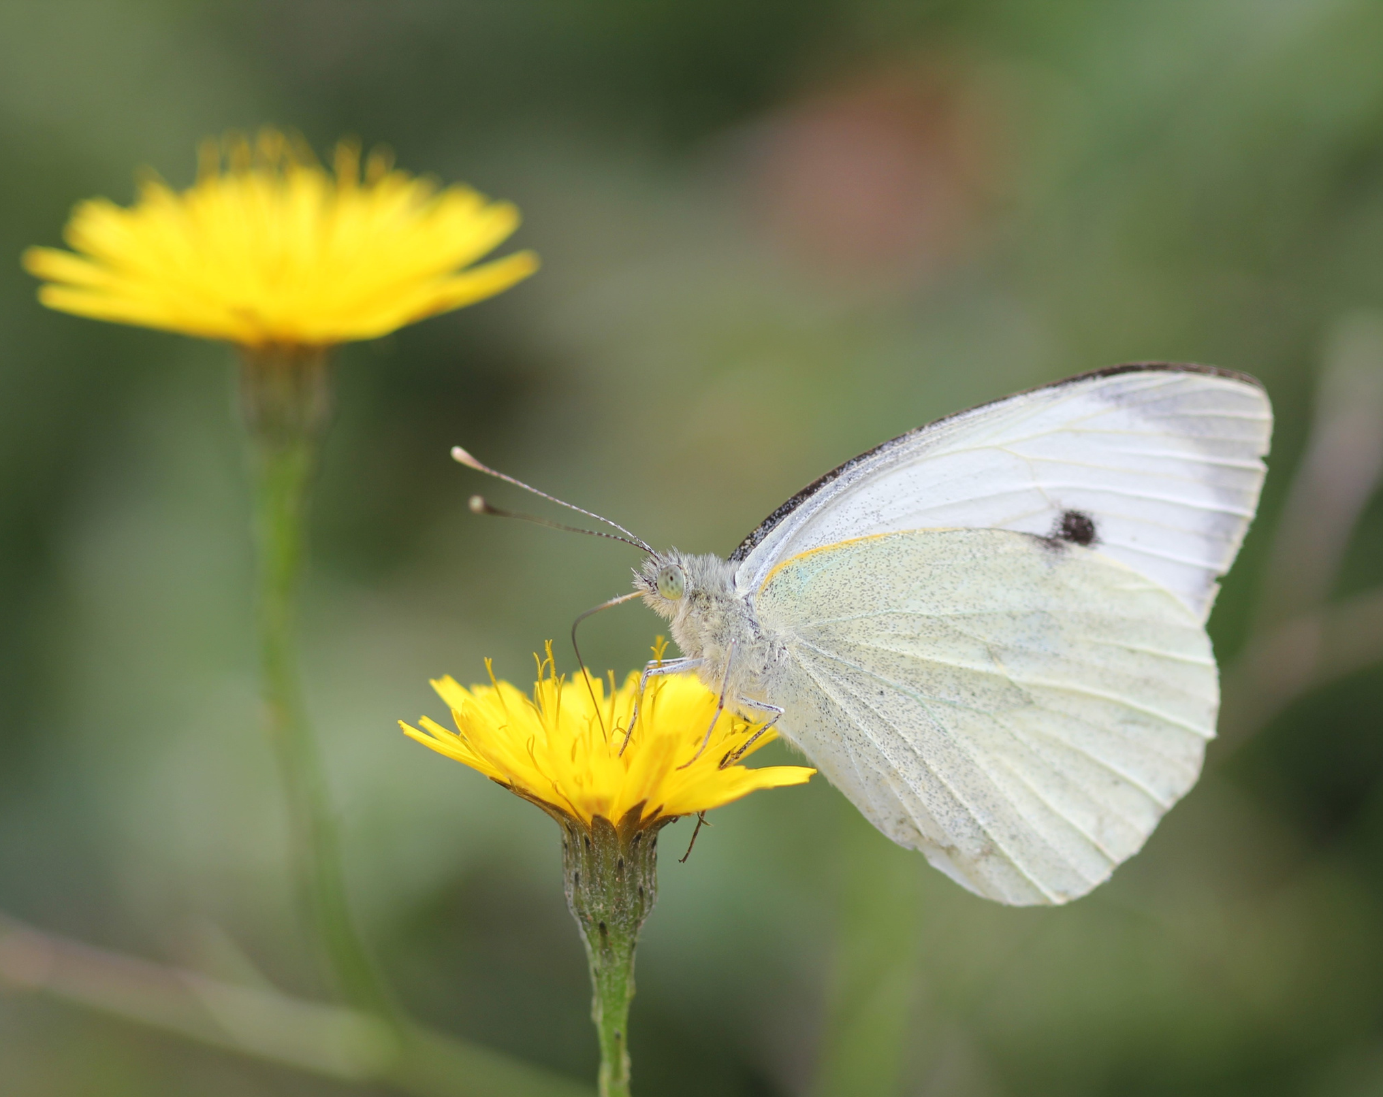
Large White
Bánóg Mhór
Butterflies feed on flowers. They drink nectar using a special tongue called a proboscis.

Slide 4
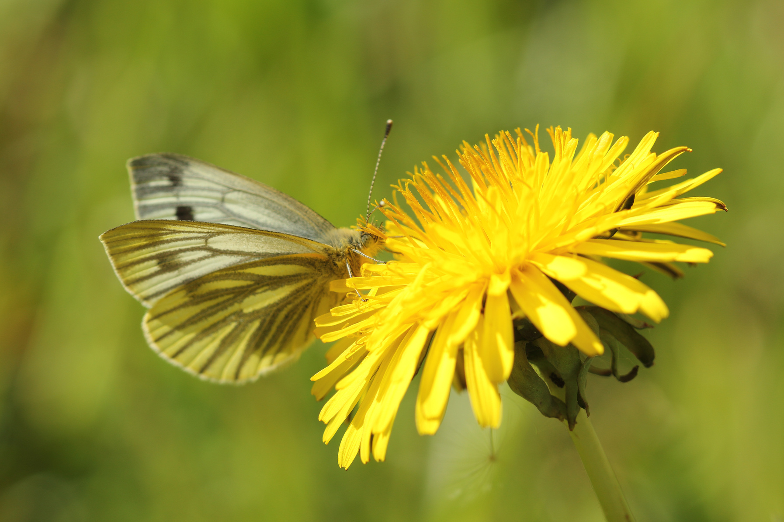
Green-Veined White
Bánóg Uaine
In spring, dandelions are a very important food for butterflies and other insects.

Slide 5
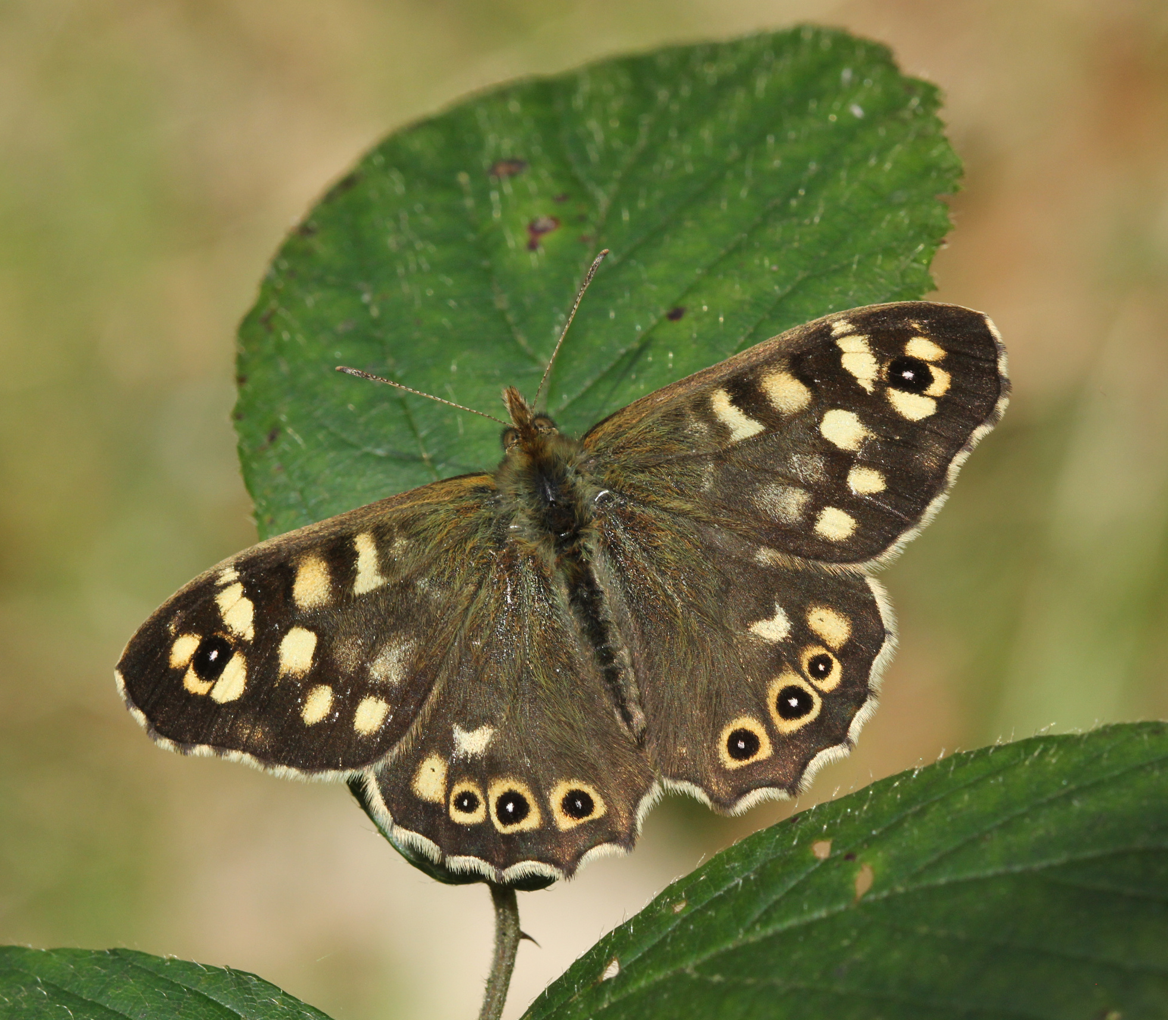
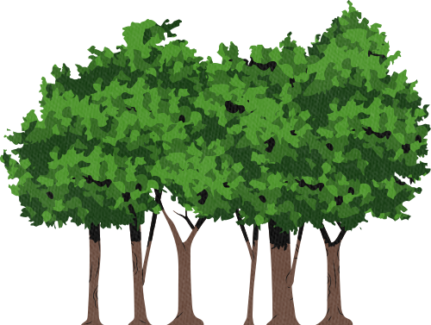
Speckled Wood
Breacfhéileacán Coille
Most butterflies live in sunny, flower-filled places.
Speckled Woods are unusual. They like woods and hedgerows.

Slide 6
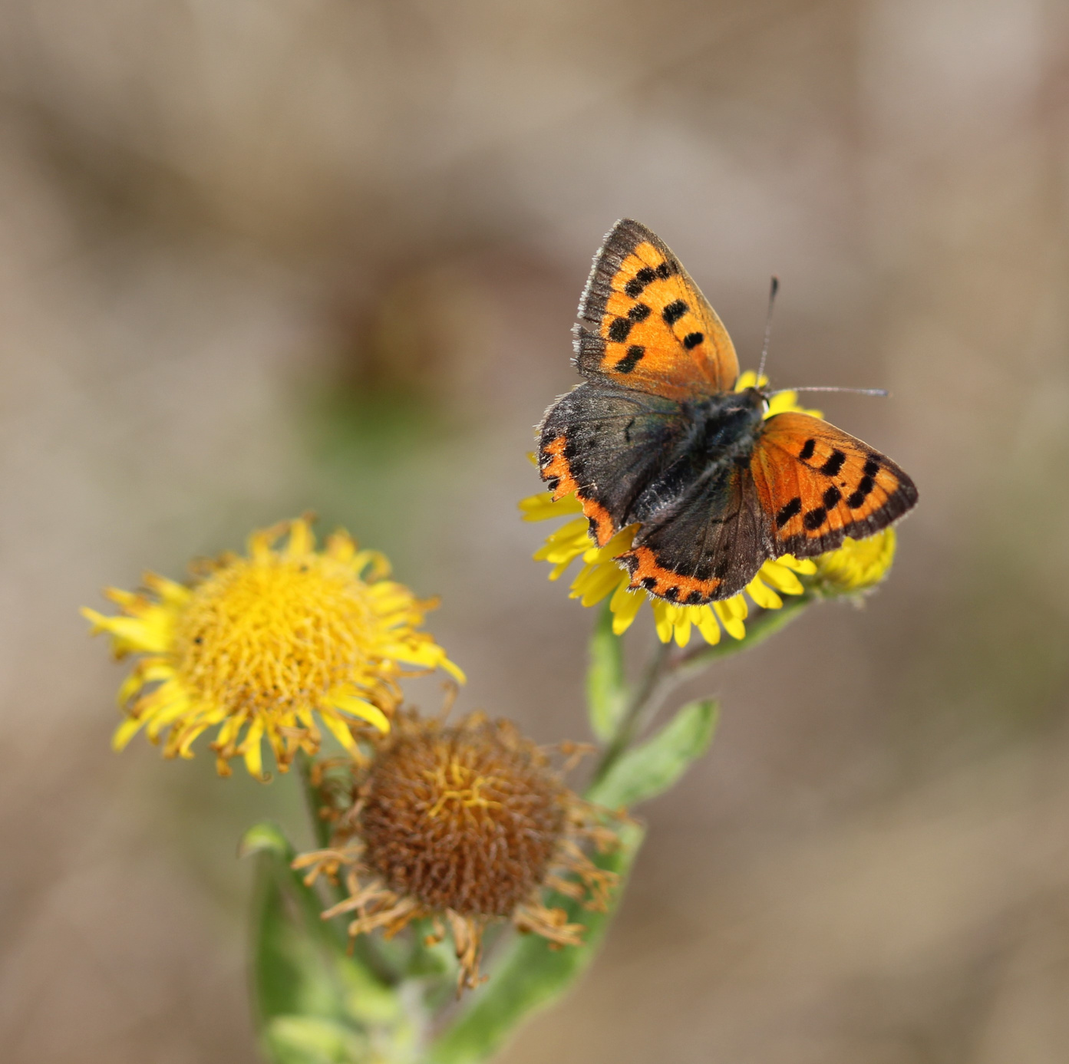

Small Copper
Copróg Bheag
Butterflies need to warm up in the sun before they can fly.
They hold their wings wide when they want to heat up.

Slide 7
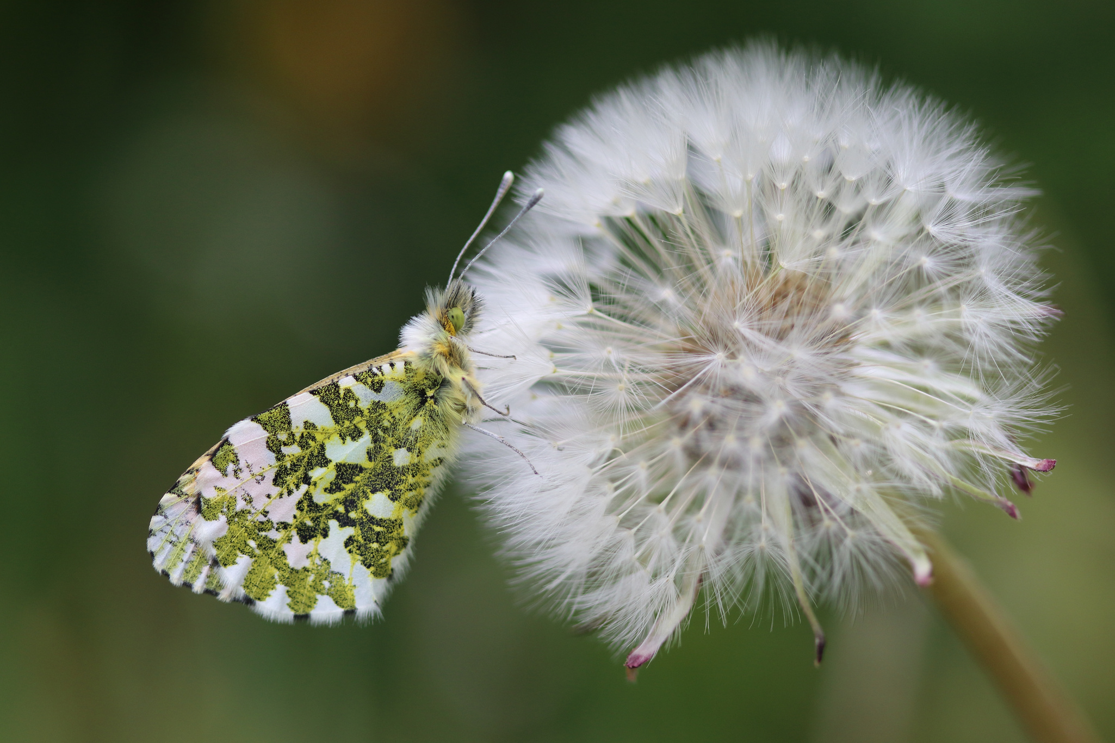
Orange Tip
Barr Buí
When too hot, butterflies close their wings.
In fact, this one is resting. It looks very different when it opens its wings.

Slide 8
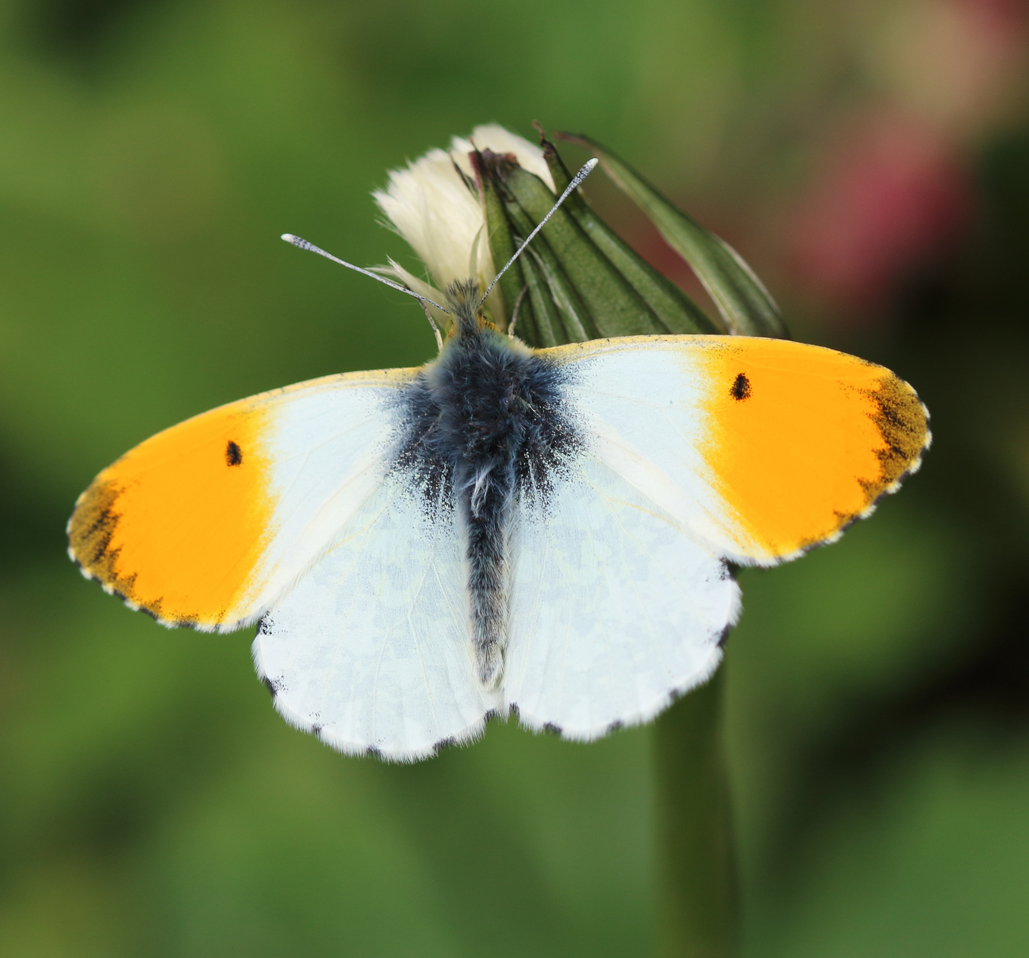
Orange Tip
Barr Buí
Only male Orange Tips have orange patches.
The female is white.
This butterfly is only seen in Spring.

Slide 9
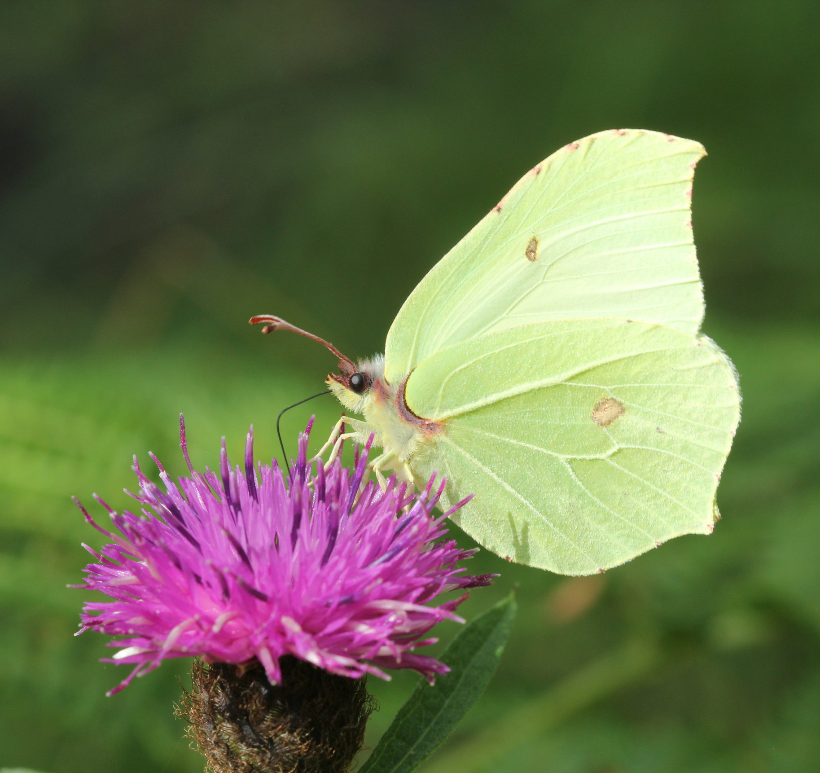
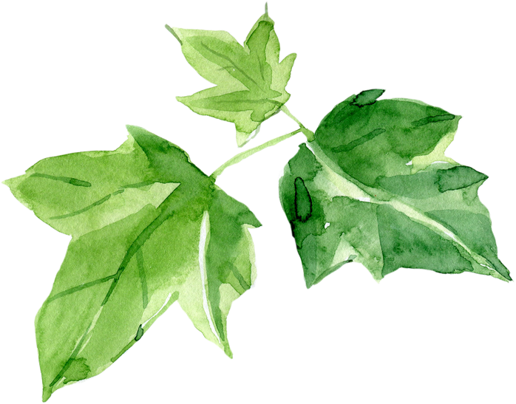
Brimstone
Buíóg Ruibheach
The Brimstone looks like a leaf when it is resting.
Hopefully this camouflage will keep it safe.
What might eat a butterfly?

Slide 10
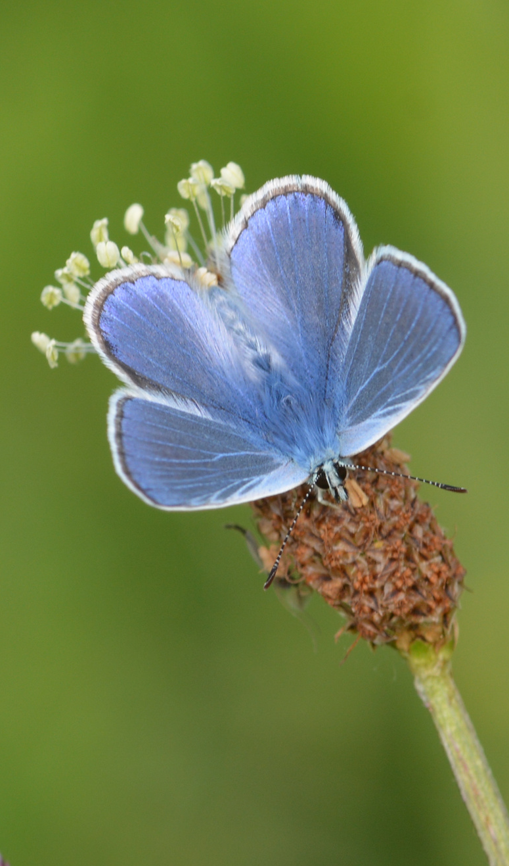
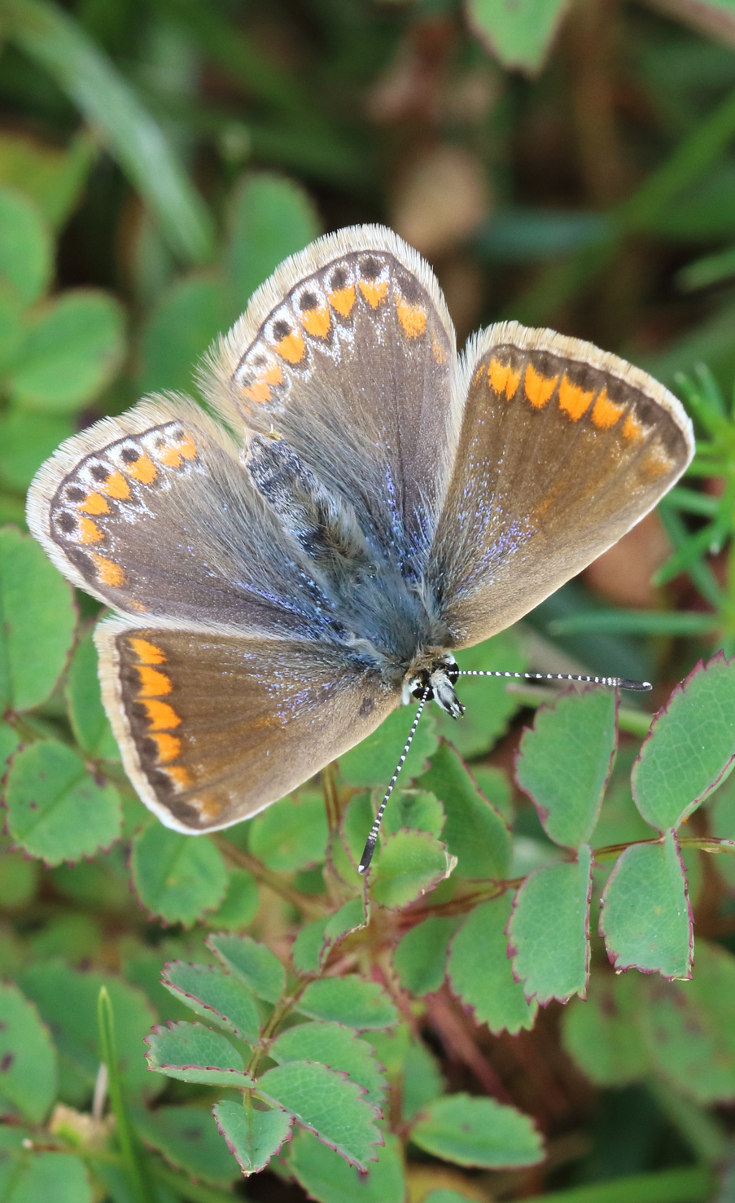
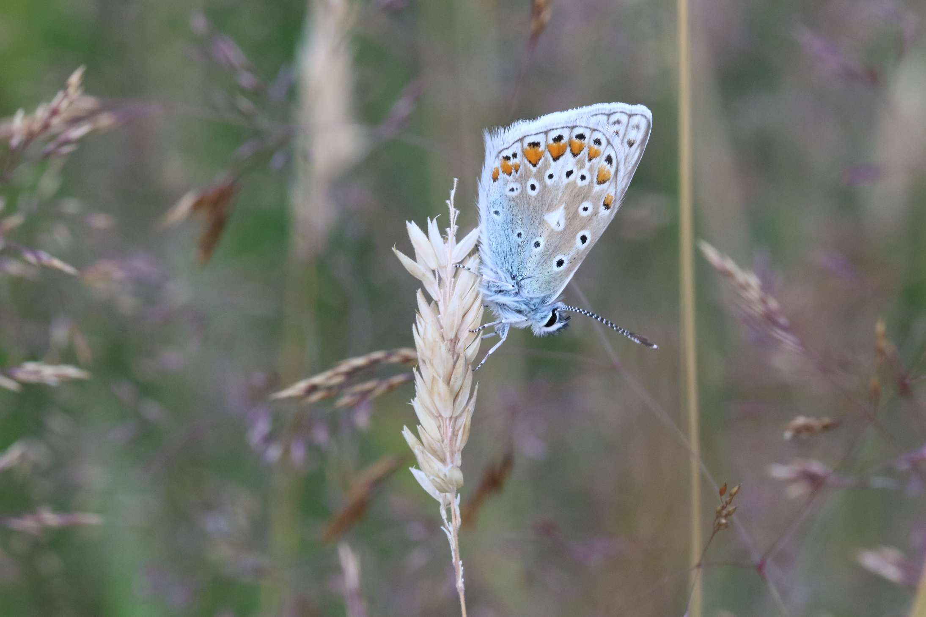
Common Blue
Gormán Coiteann
The male is blue.
The female is brown.

Slide 11
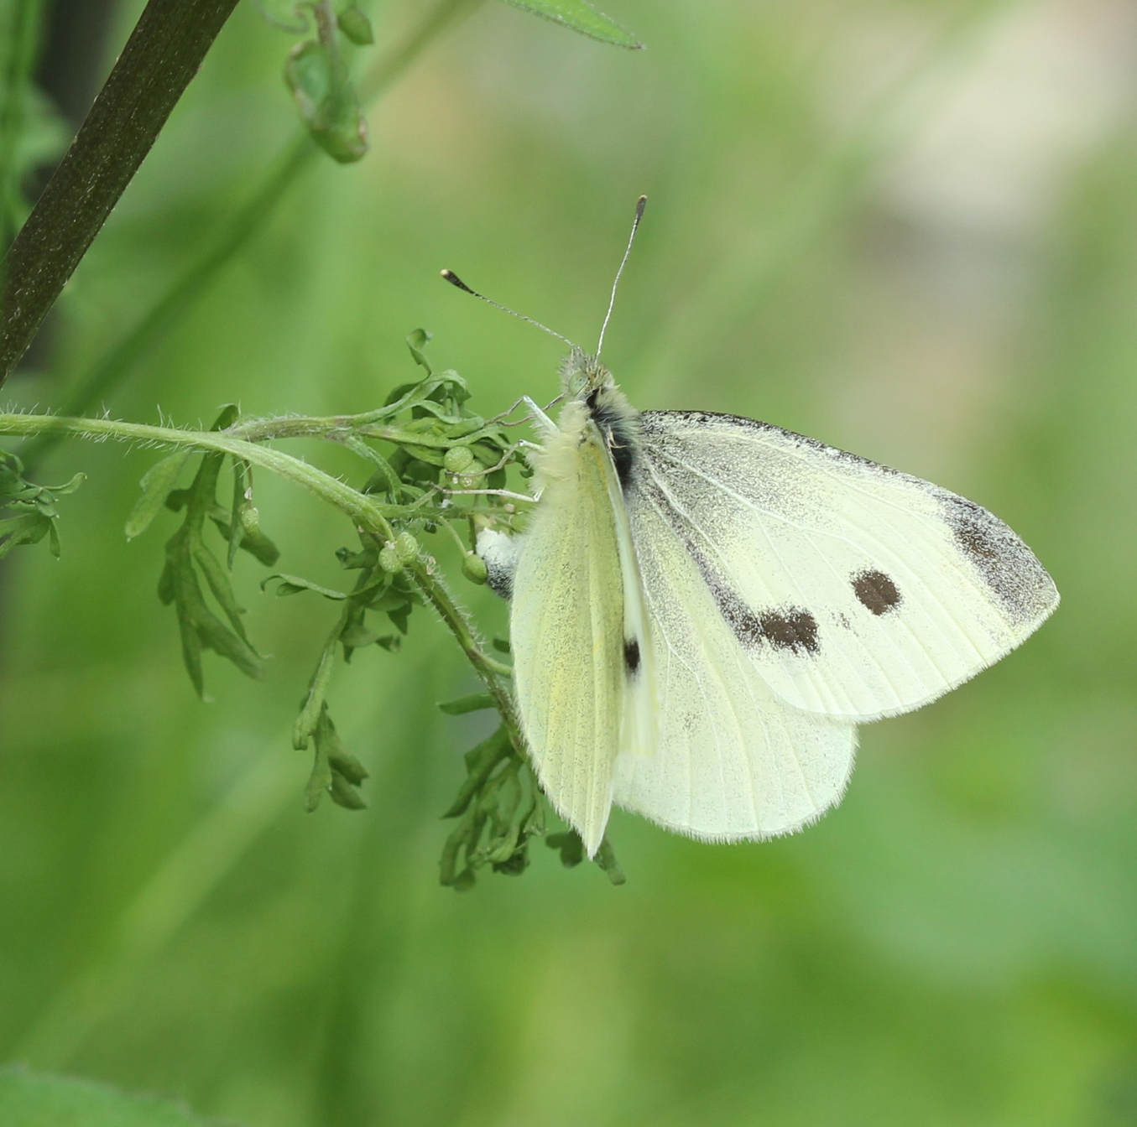
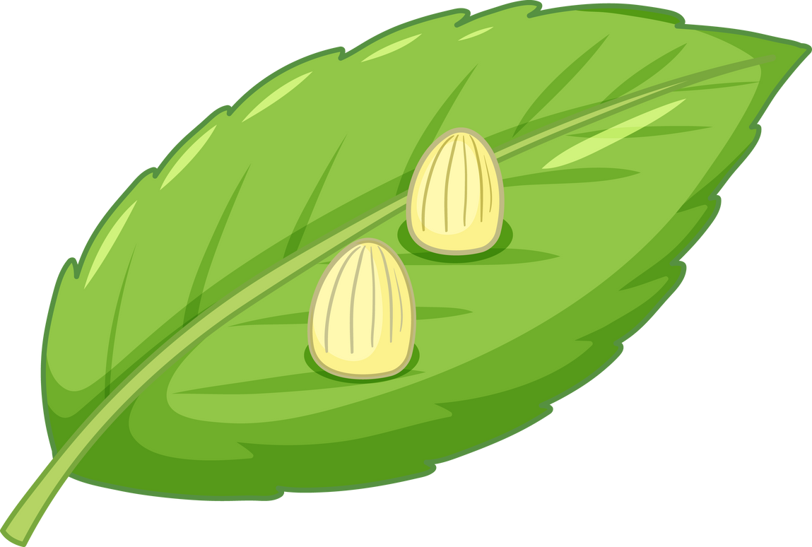
Small White
Bánóg Bheag
This Small White is laying an egg.
She only lays on a plant that her caterpillars will eat.

Slide 12
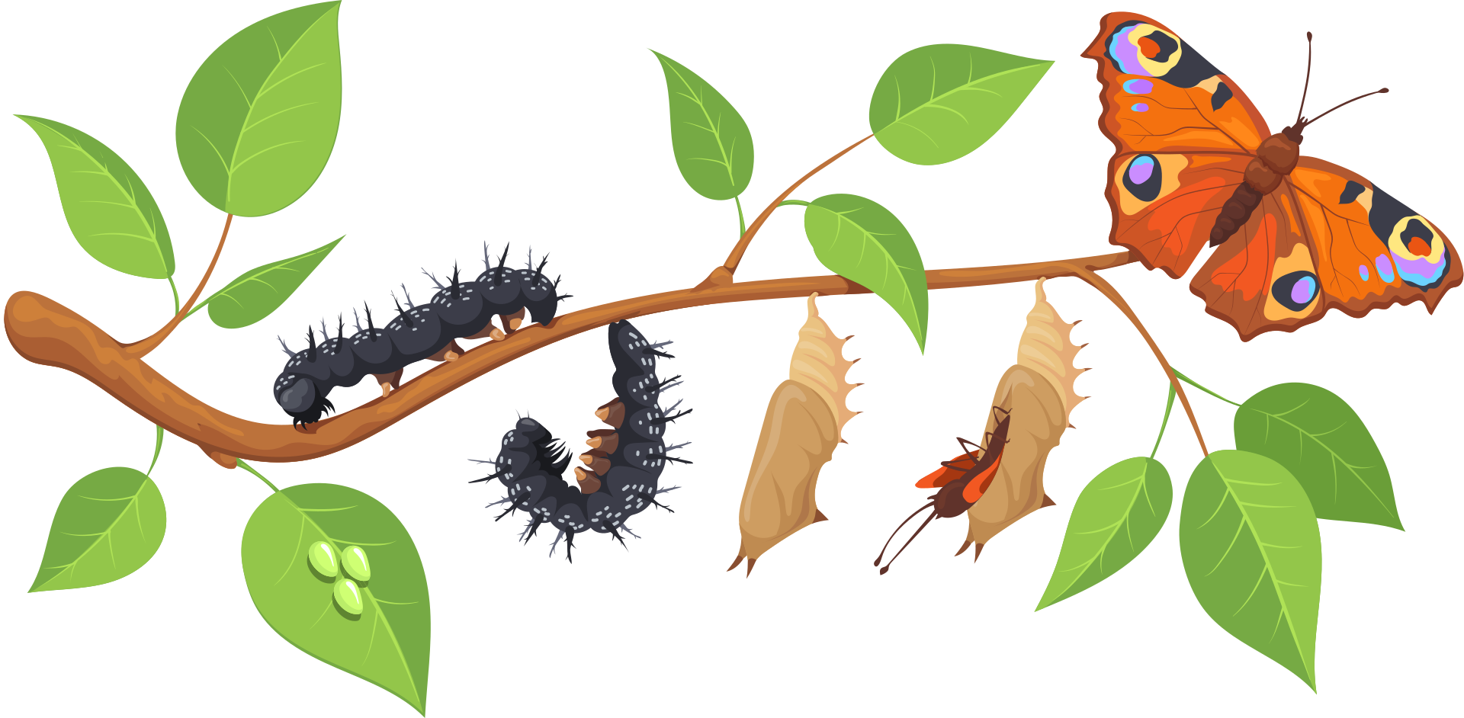


Life Cycle of a Butterfly
Caterpillar
(larva)
Chrysalis
(pupa)
Butterfly
(adult)
Egg

Slide 13
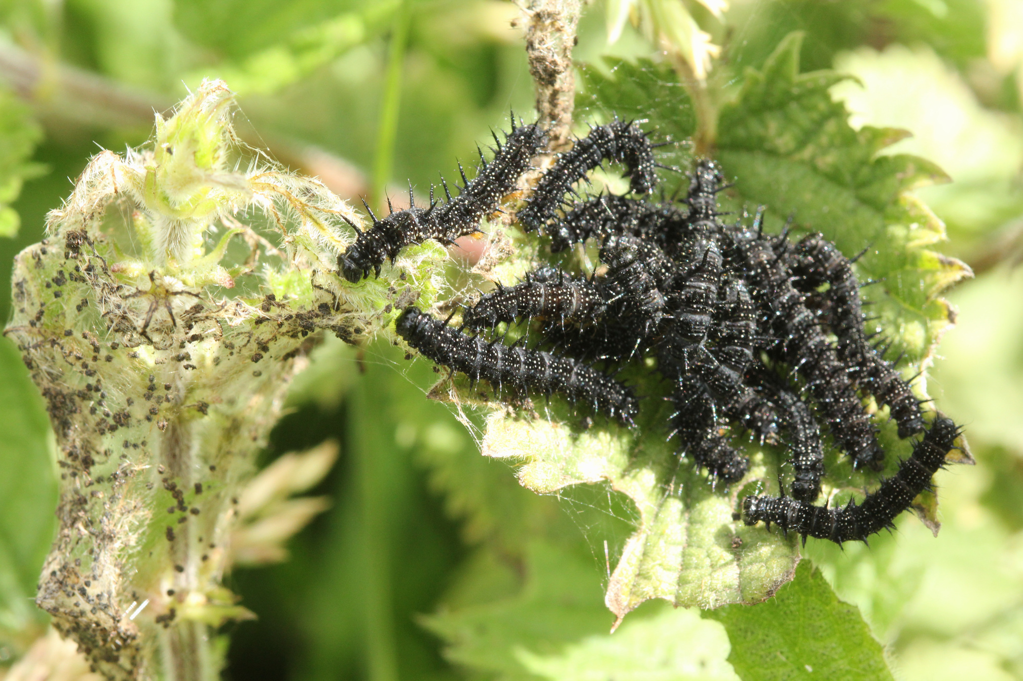
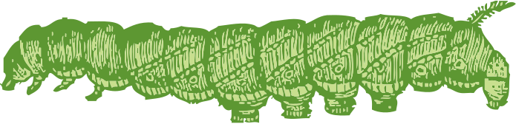
Peacock
caterpillars
These are the caterpillars of the Peacock. They are eating nettles.
They have spines on their body to help protect them from predators.

Slide 14
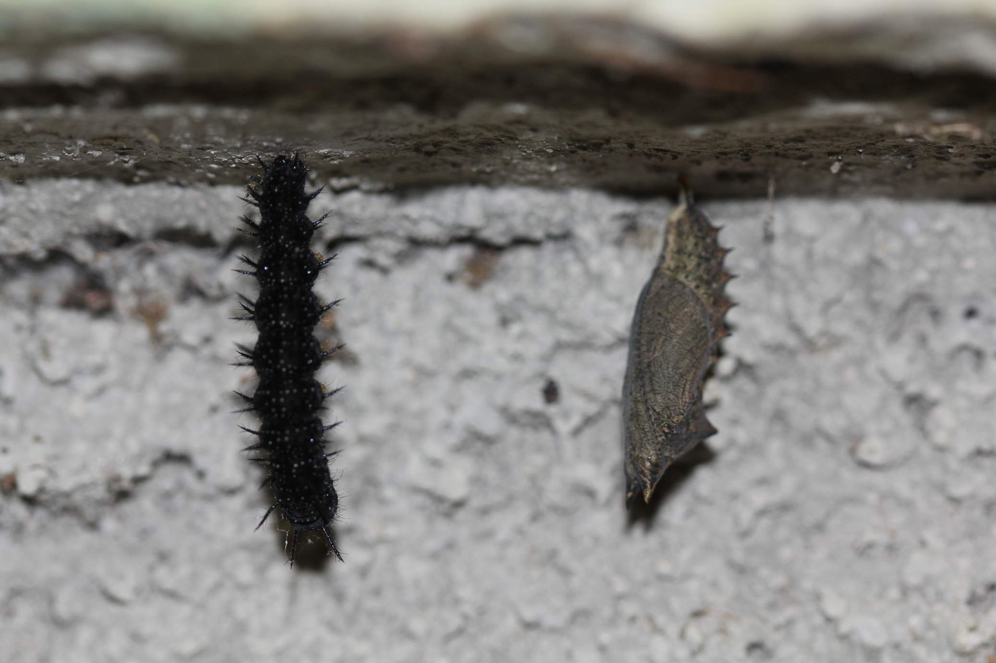
Chrysalises
When the caterpillars are fully grown, they find a quiet place.
They hang upside down and turn into a chrysalis.
Inside, amazing changes are happening.

Slide 15
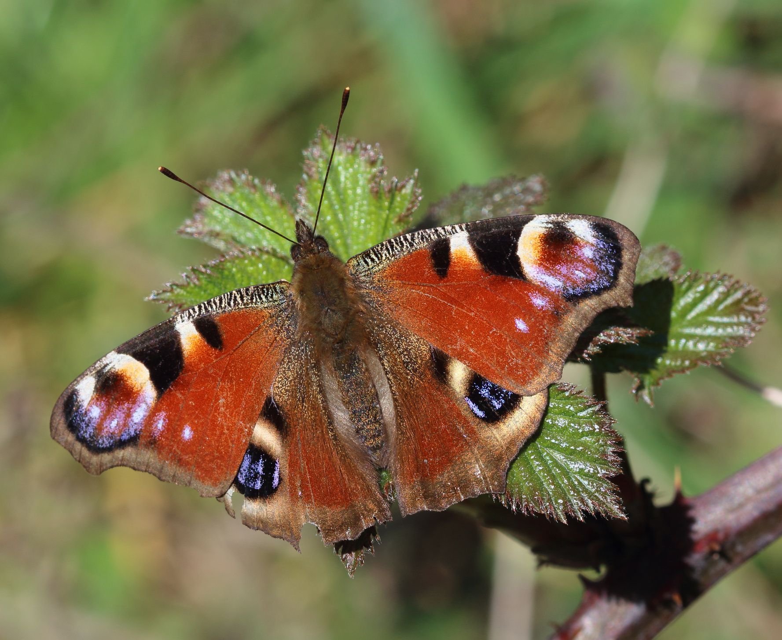
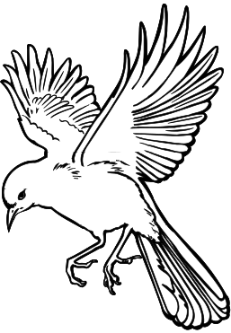
Peacock
Péacóg
Many butterflies have 'eye spots' on their wings.
These big eyes can scare predators away.

Slide 16
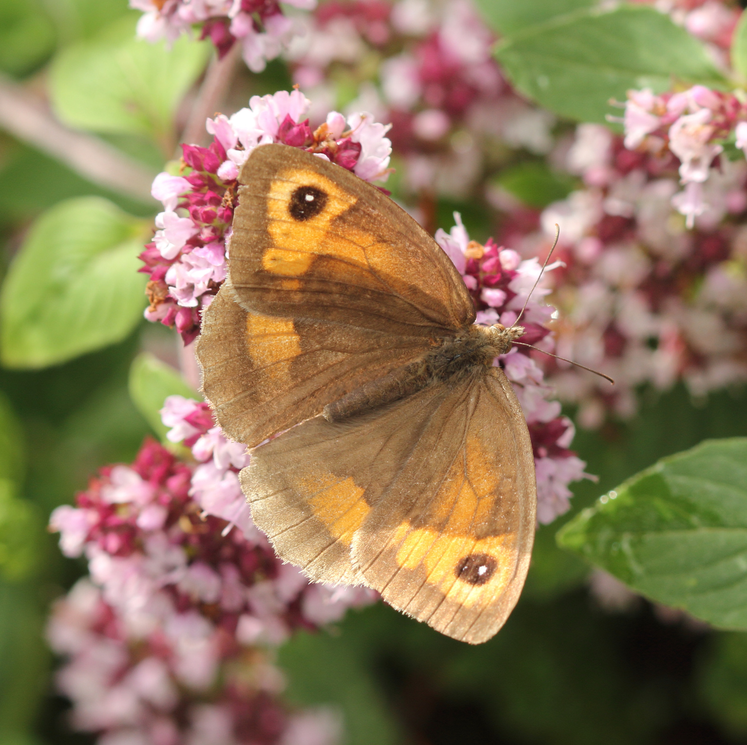
Meadow Brown
Donnóg Fhéir
This butterfly also has eye spots.

Slide 17
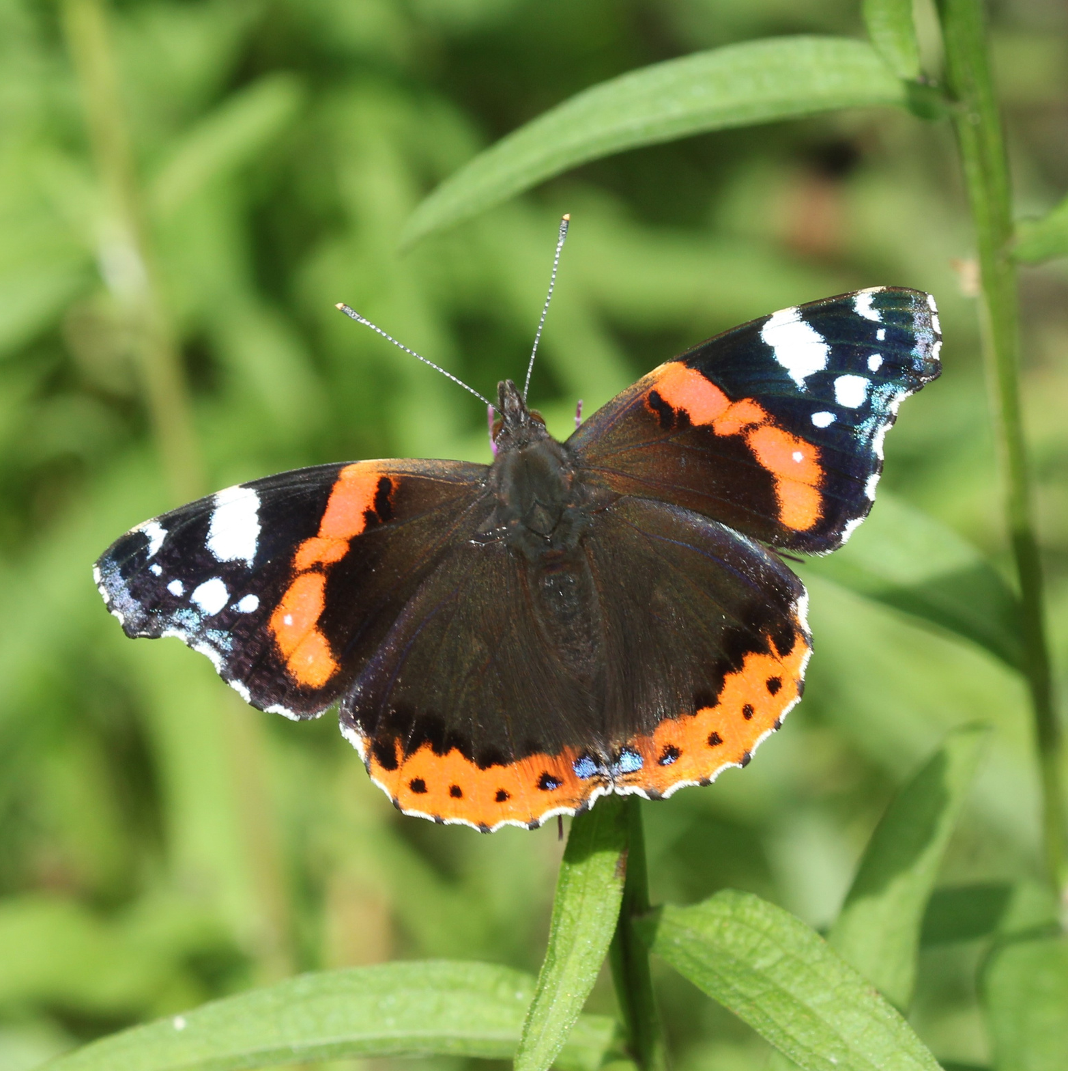
Red Admiral
Aimiréal Dearg
The Red Admiral hibernates as an adult.
Most butterflies hibernate as an egg, a caterpillar or
a chrysalis.

Slide 18
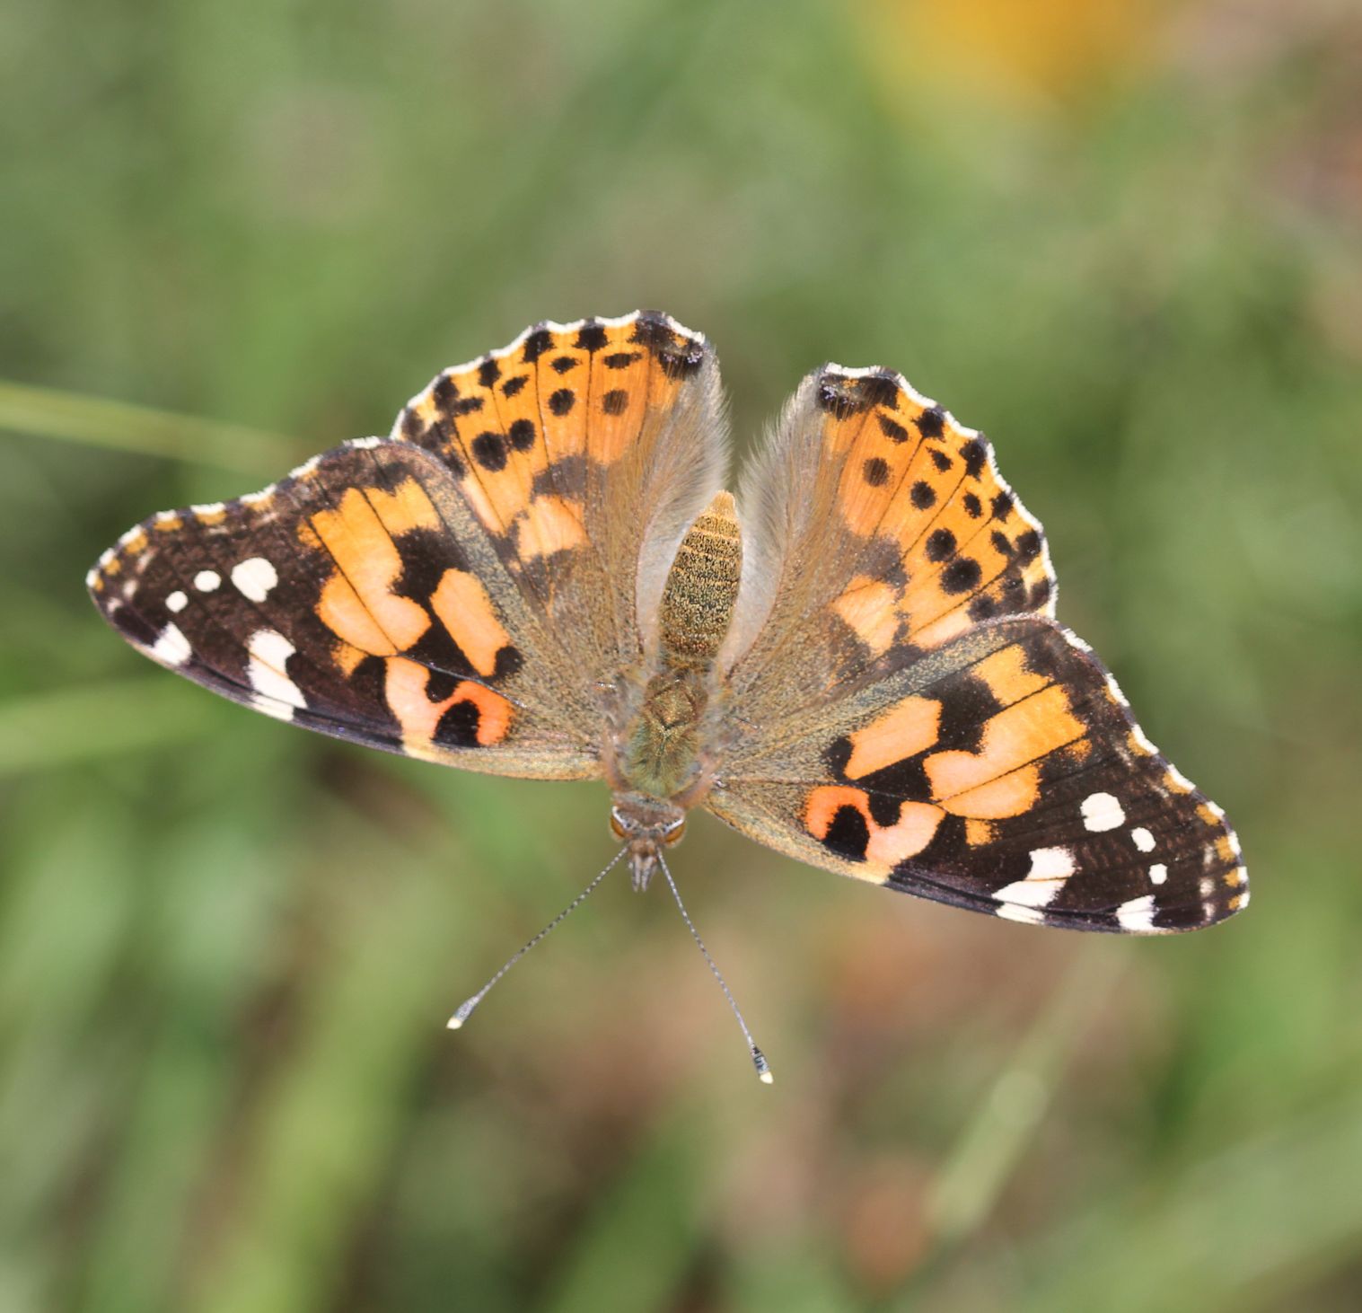



Painted Lady
Áilleán
Painted Ladies are summer visitors to Ireland. They fly here from Europe and Africa.

Slide 19
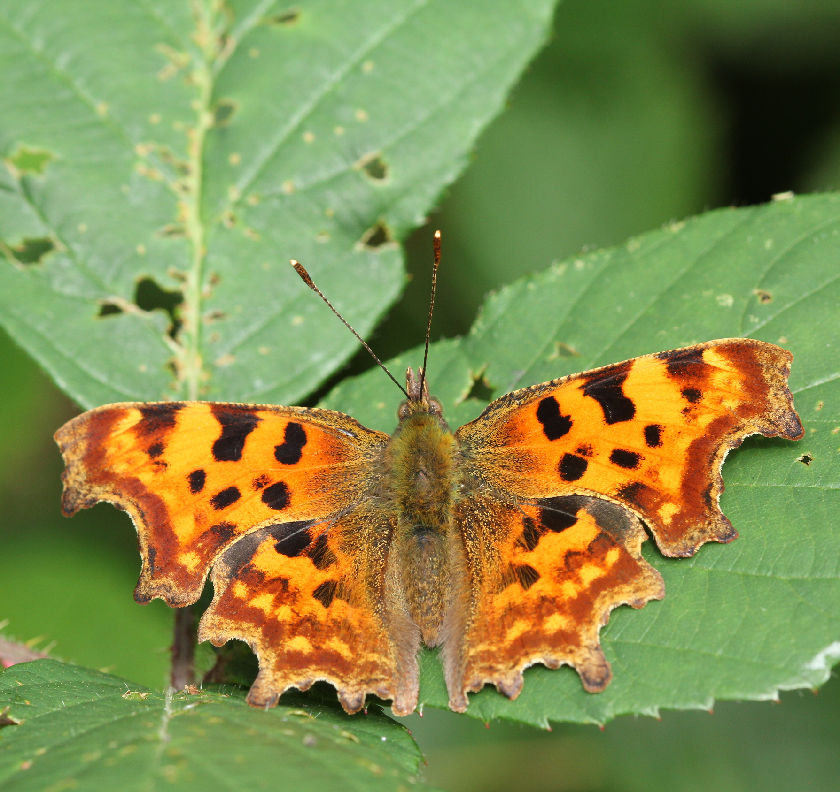
Comma
Camóg
This is a new butterfly to Ireland. As our climate warms, more species are moving in from Britain and Europe.

Slide 20
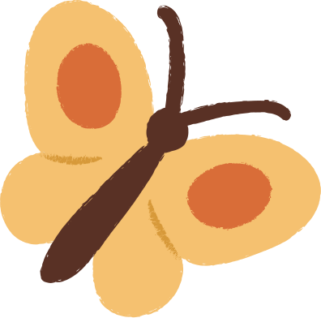
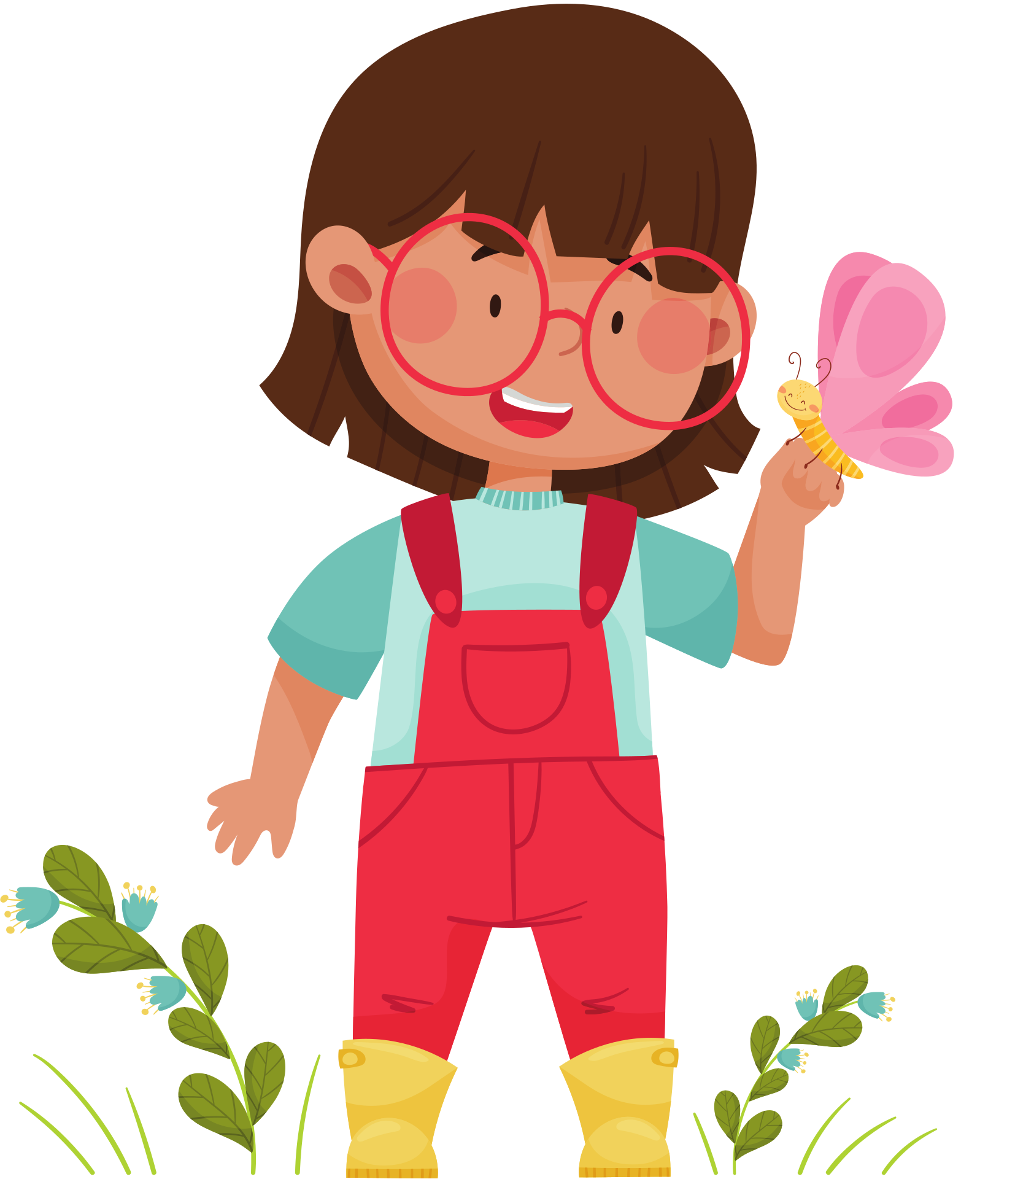


Explore!
Next sunny day, why not see how many butterflies you can spot.
Can you name them?
What are they doing?
What flowers are they visiting?

Slide 21
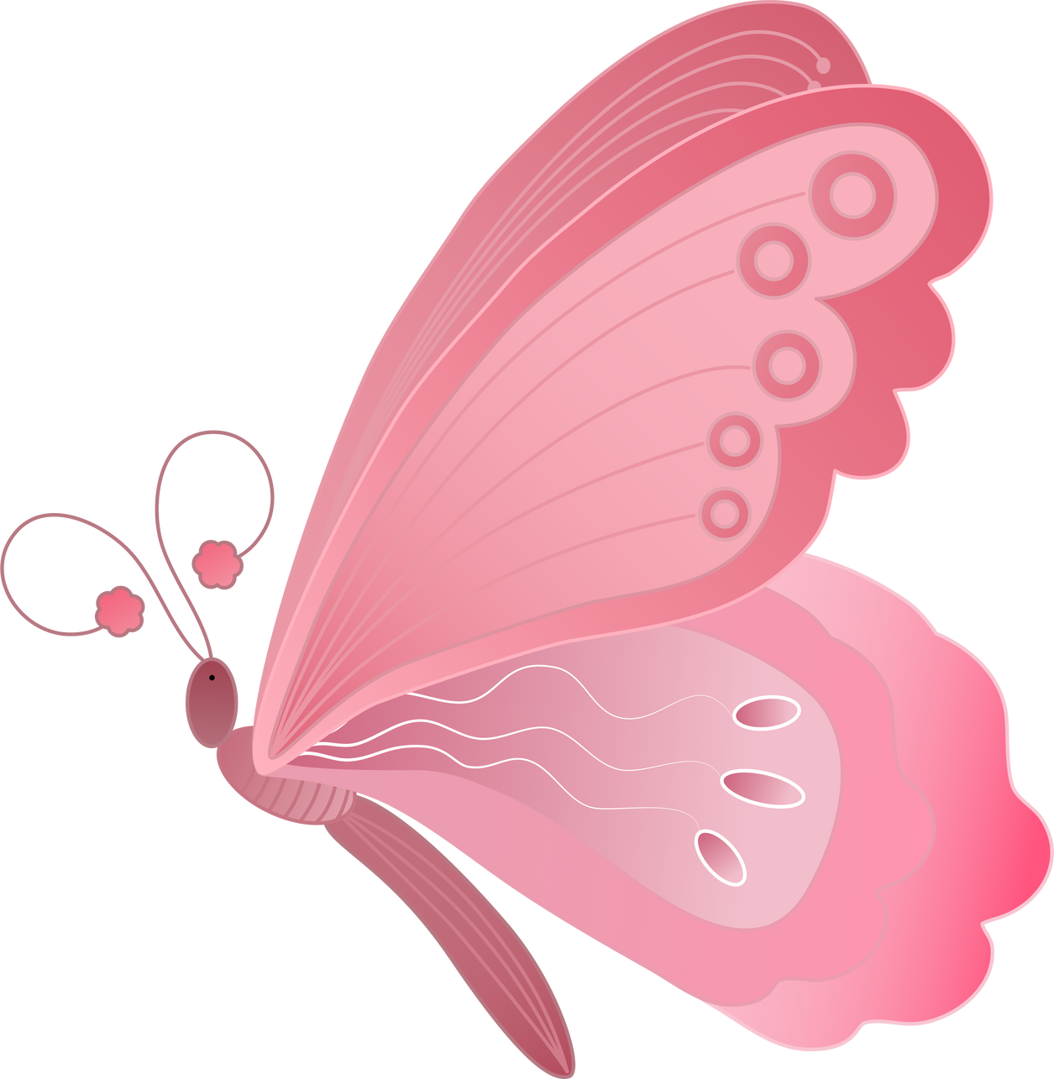
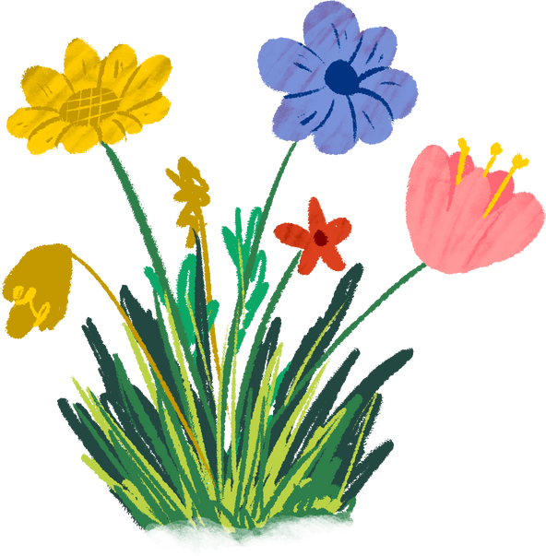


How can you help Butterflies?
Let wildflowers grow (to supply nectar).
Let nettles and rough grass grow (for caterpillars to eat).
Plant nectar-rich flowers in your garden.
Avoid using chemicals in your garden.

Slide 22
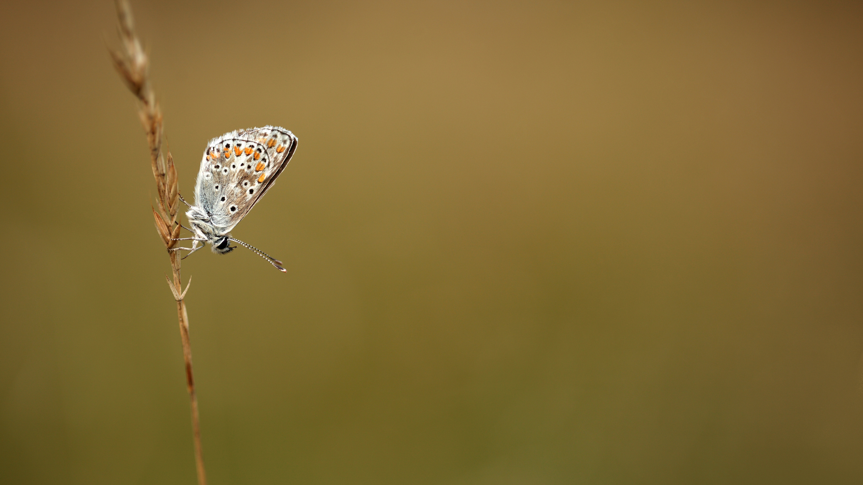

Thank you

