Slide 1


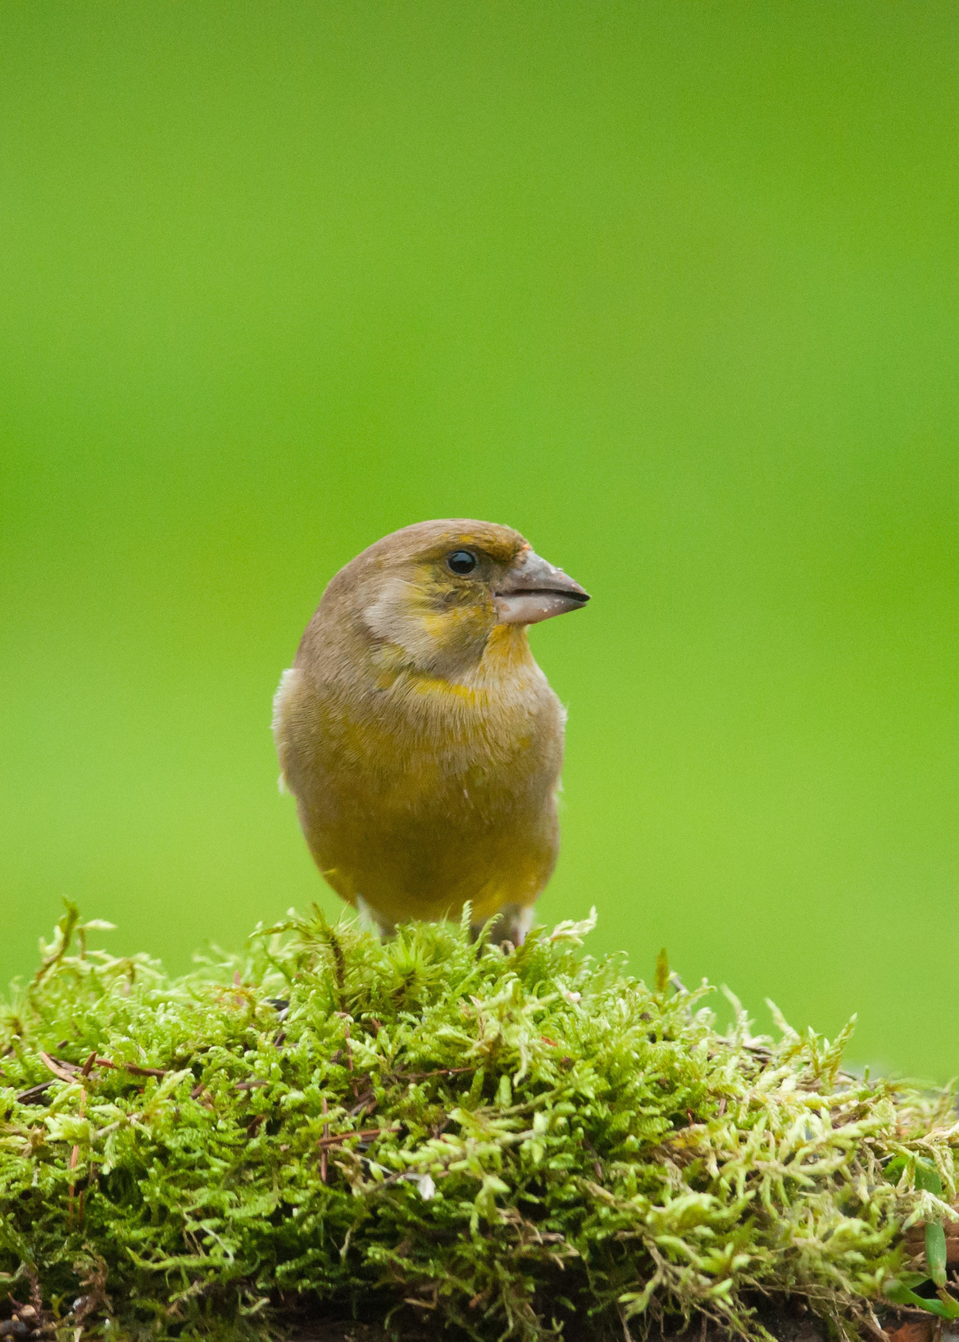
GARDEN BIRDS
Learn 12 birds

Slide 2
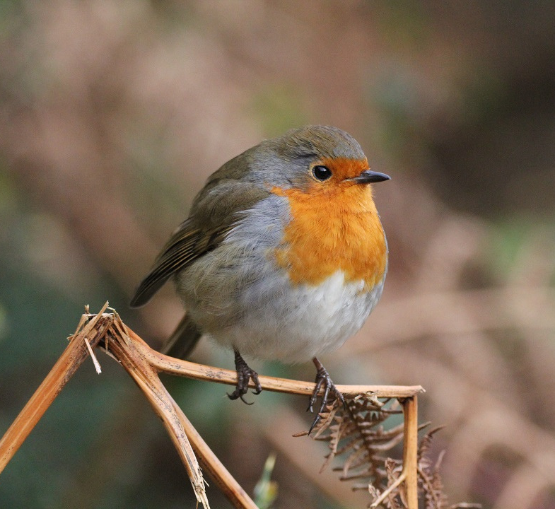
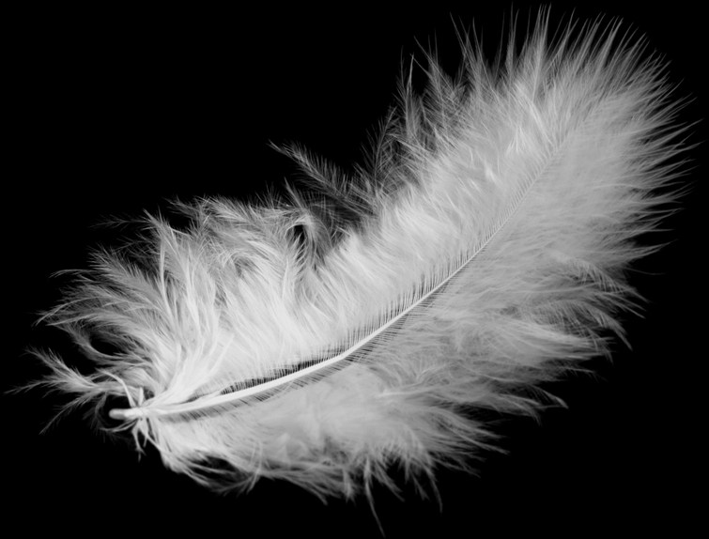
Robin
Spideog
Erithacus rubecula
Feathers keep a bird warm.
Birds puff up their feathers when the weather is cold.

Slide 3
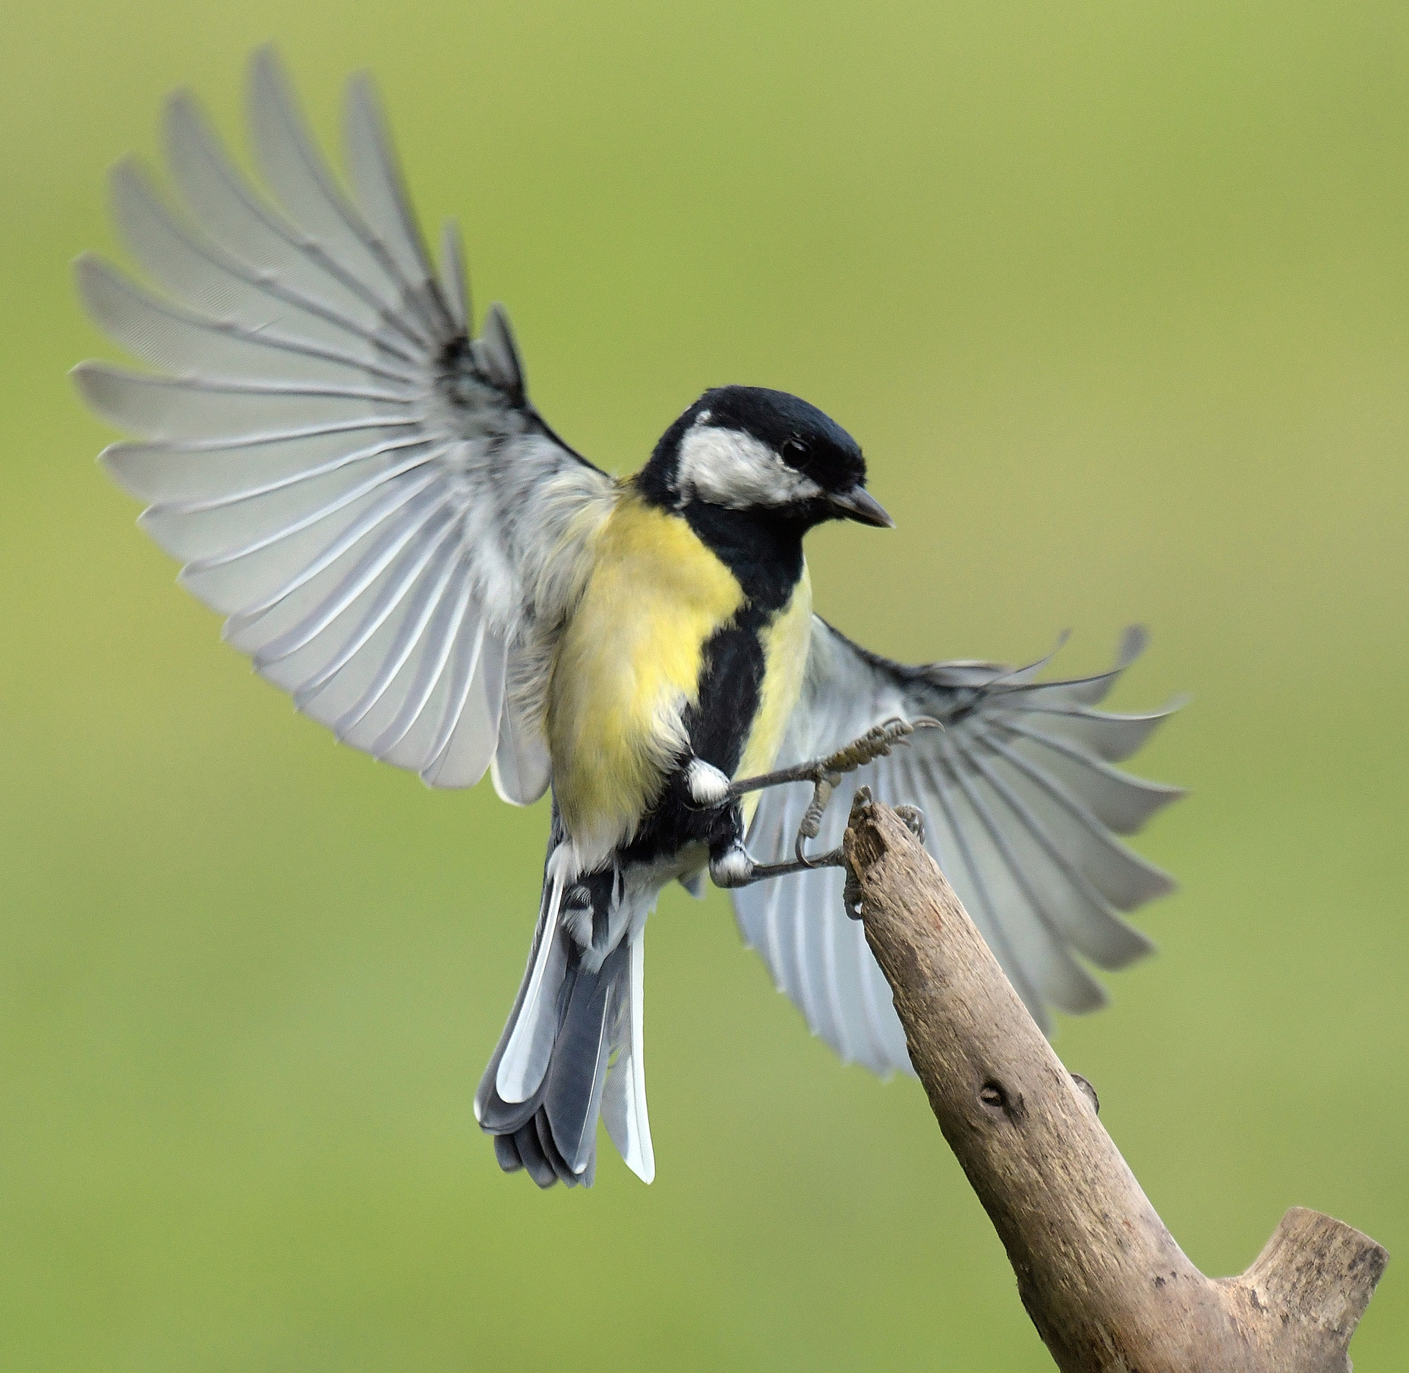

Great Tit
Meantán Mór
Parus major
The feathers in the wings and tail are bigger and stronger than body feathers.
These flight feathers are used to fly.

Slide 4
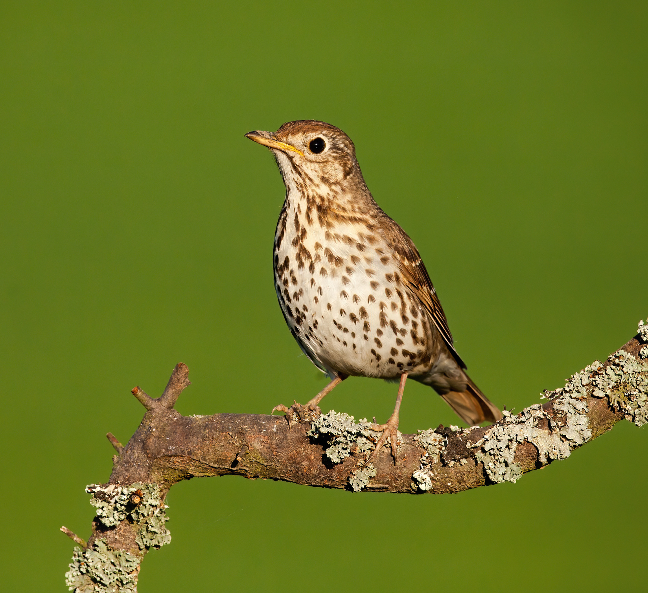

Song Thrush
Smólach Ceoil
Turdus philomelos
Thrushes eat worms, insects and fruit.
Insect eaters have thin pointy beaks. They use their beak to pick insects out of holes and soil.

Slide 5
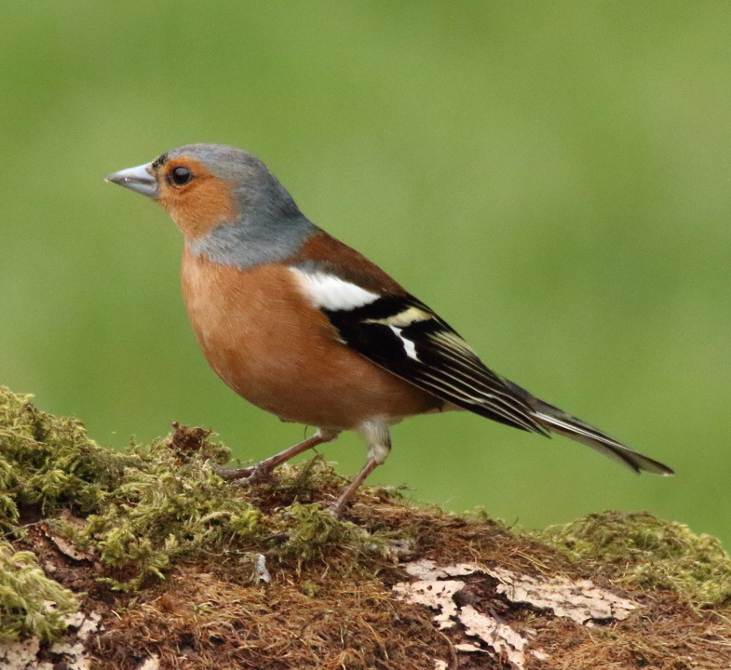

Chaffinch
Rí Rua
Fringilla coelebs
Chaffinches eat seeds.
Seedeaters have triangle-shaped beaks. They use their beak to crack open seeds.

Slide 6
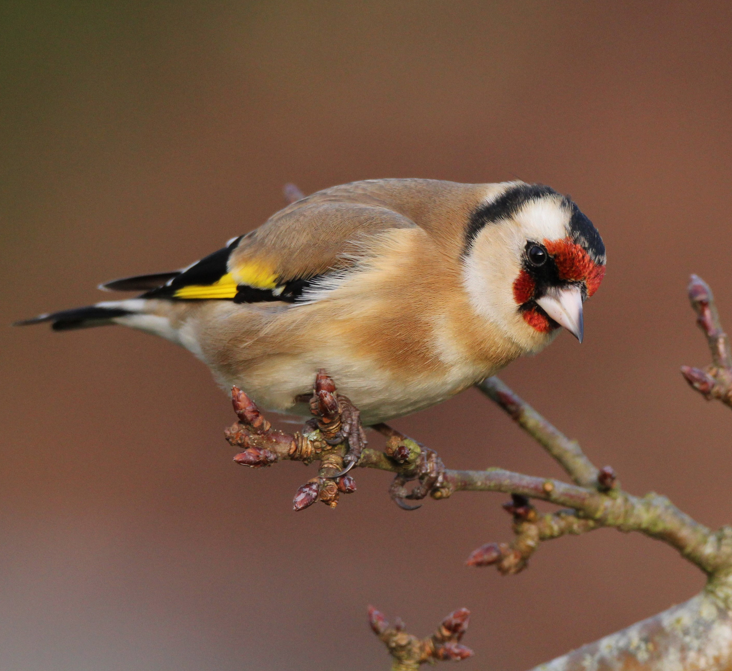

Goldfinch
Lasair Choille
Carduelis carduelis
Goldfinches love to eat wild thistle seed.
In winter, goldfinches visit garden bird feeders. They love both peanuts and niger seeds.

Slide 7
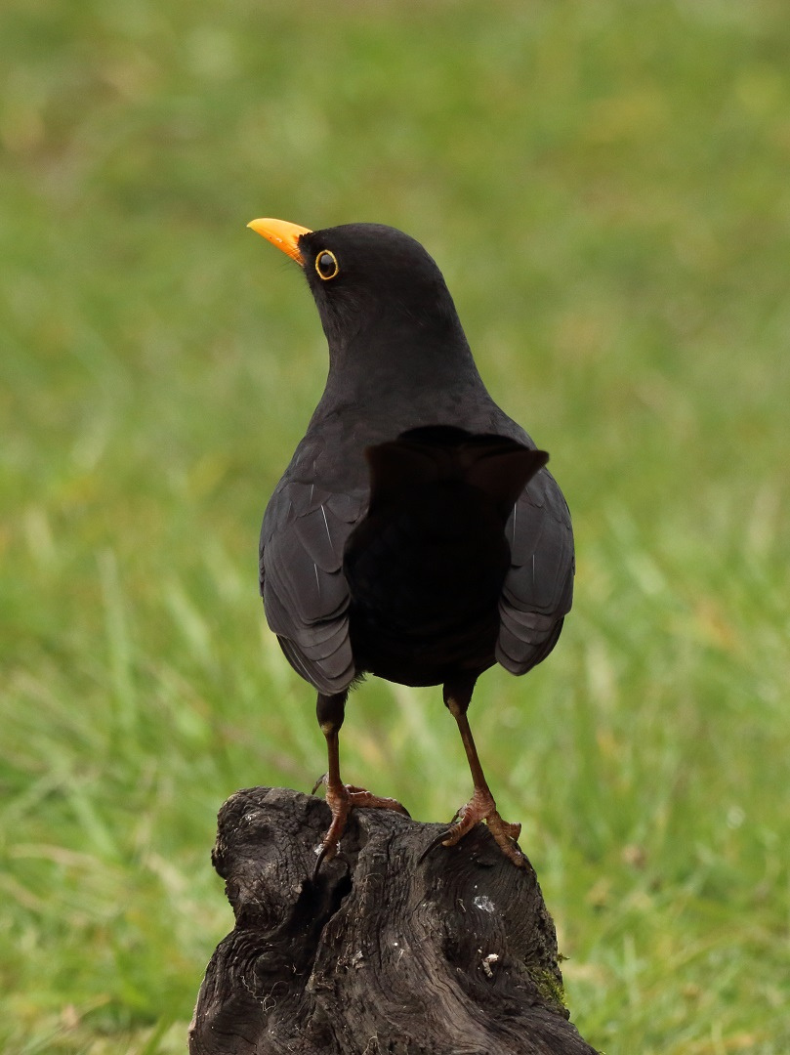
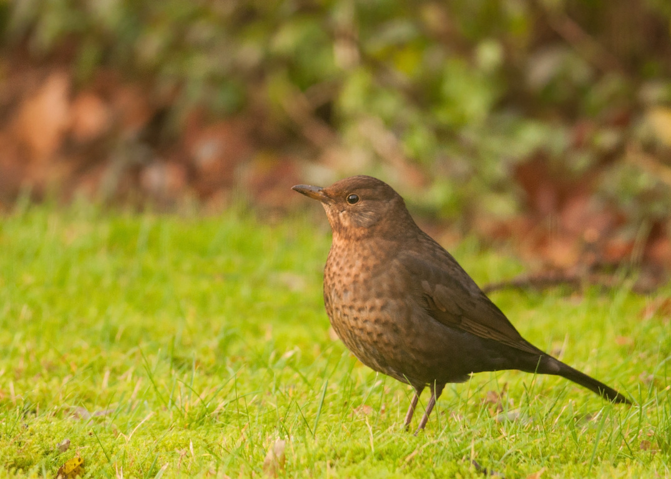

Blackbird
Lon Dubh
Turdus merula
In many birds, the male and female are different colours.
Male blackbirds are black with a yellow beak.
Female blackbirds are brown.

Slide 8
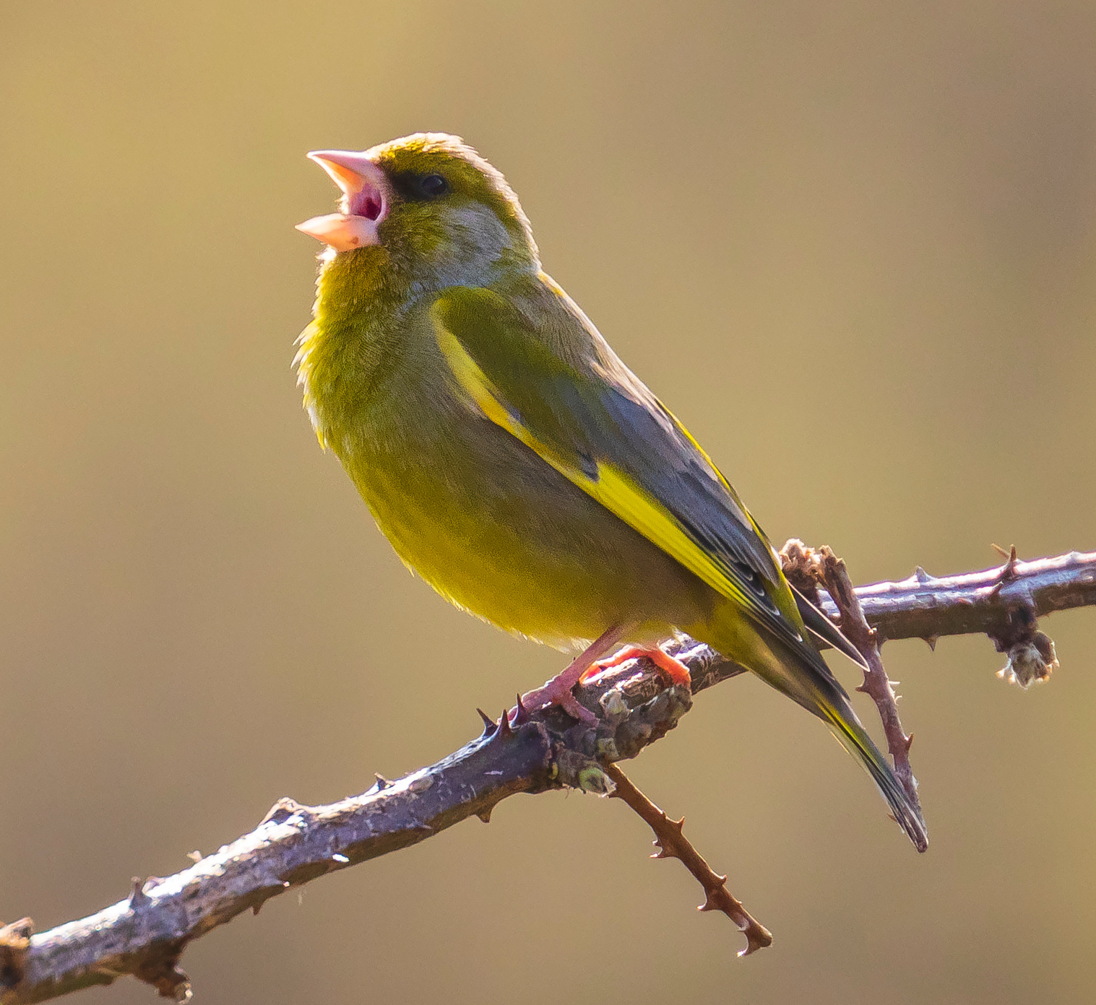

Greenfinch
Glasán Darach
Chloris chloris
Birds sing to attract a mate or to mark their territory.

Slide 9
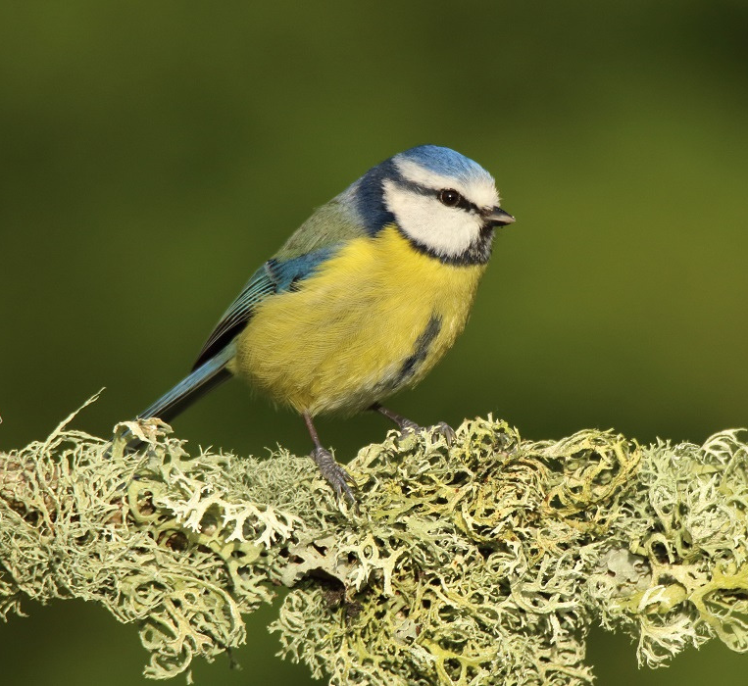

Blue Tit
Meantán Gorm
Cyanistes caeruleus
Blue tits nest in holes in trees.
Tree holes are scarce in gardens. A nestbox gives a bird a safe place to nest.

Slide 10
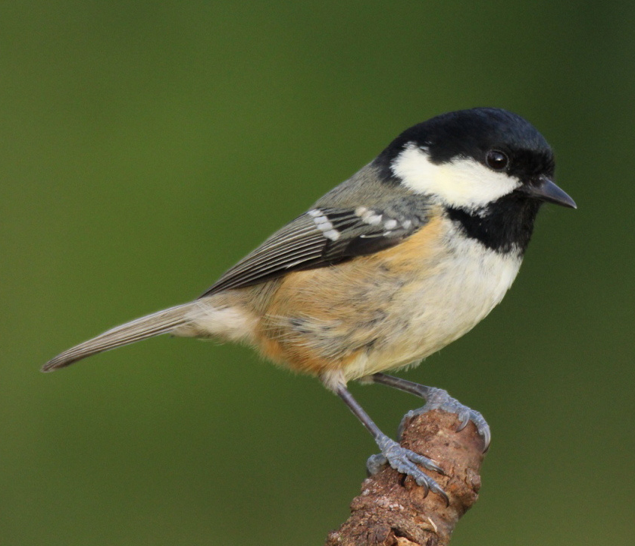

Coal Tit
Meantán Dubh
Periparus ater
Tits are acrobatic birds.
They hunt for insects in trees. They will also eat peanuts at feeders.

Slide 11
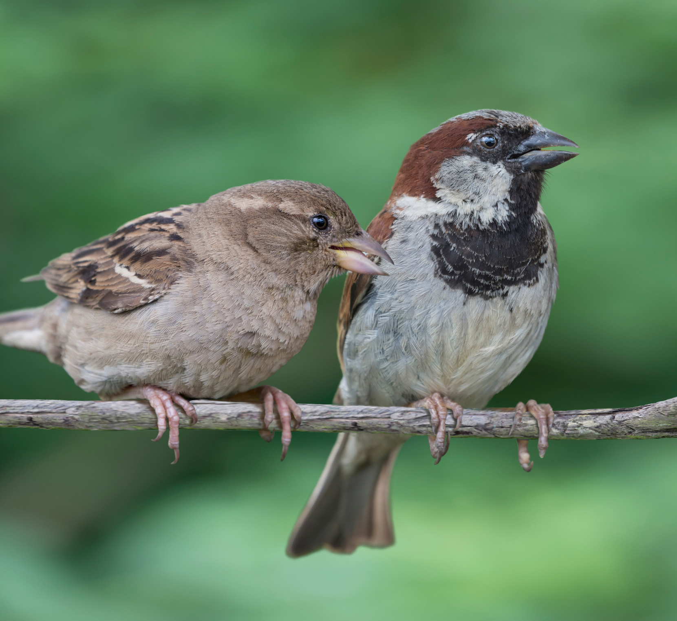

House Sparrow
Gealbhan Binne
Passer domesticus
House Sparrows used to be common everywhere. Now their numbers are low.
They are called House Sparrows because they like to live around our homes.

Slide 12
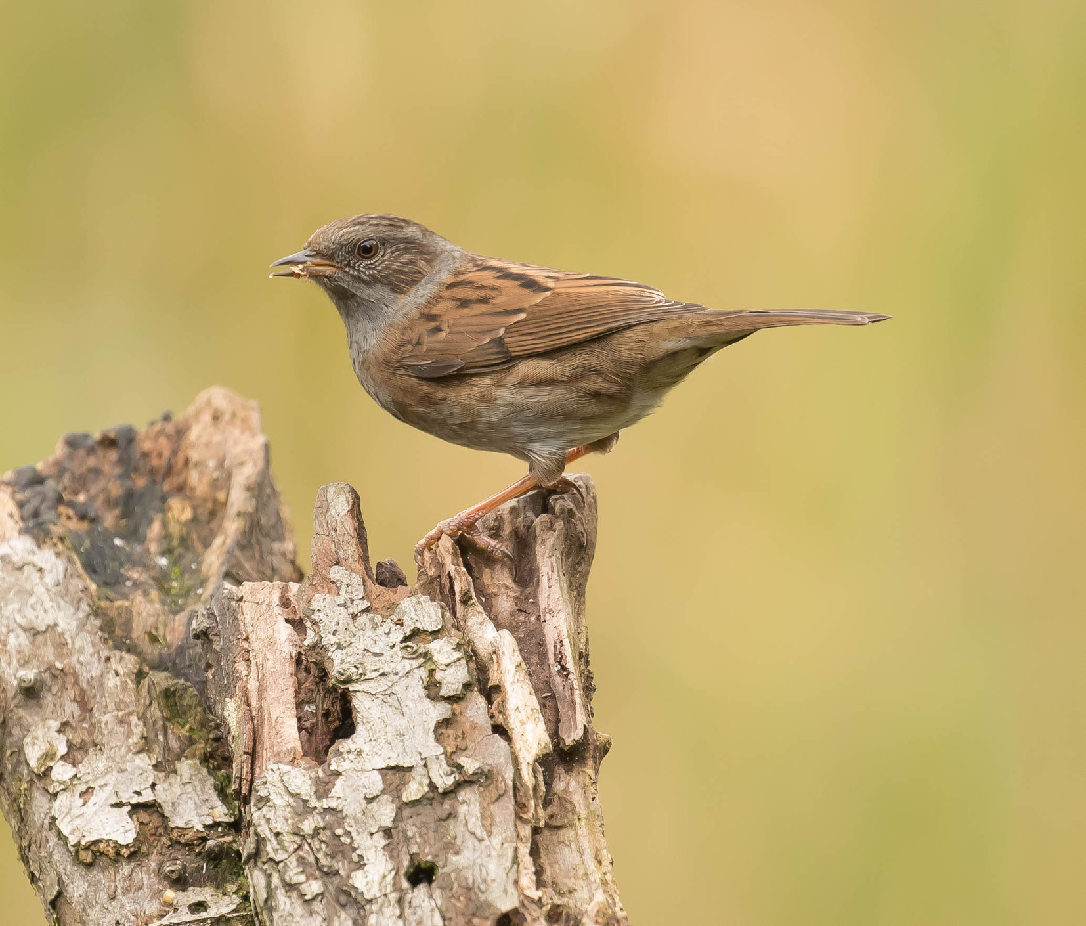

Dunnock
Donnóg
Prunella modularis
Dunnocks are small brown birds. They are easily overlooked in the garden.
They eat insects and worms, and are unlikely to visit bird feeders.

Slide 13
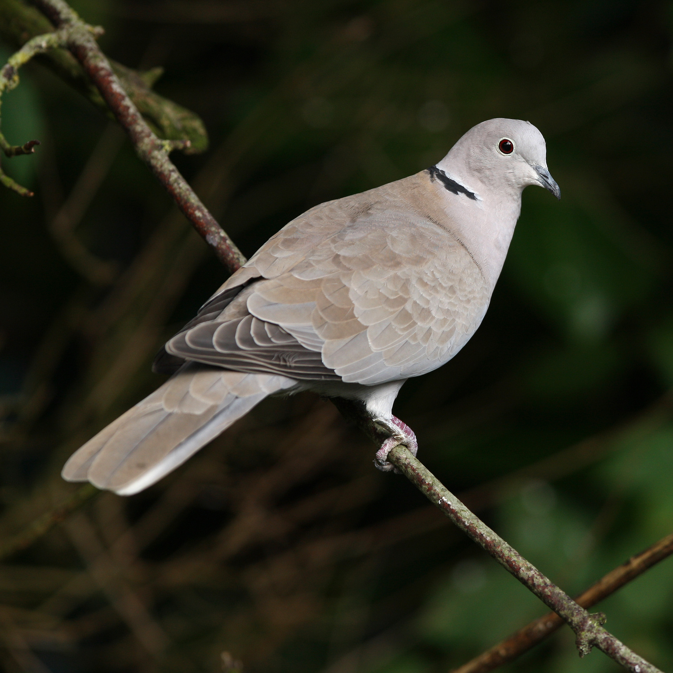

Collared Dove
Fearán Baicdhubh
Streptopelia decaocto
Collared Doves arrived in Ireland in 1959, from Europe. They are now very common throughout the country. They like to nest near people, in gardens and farms.

Slide 14
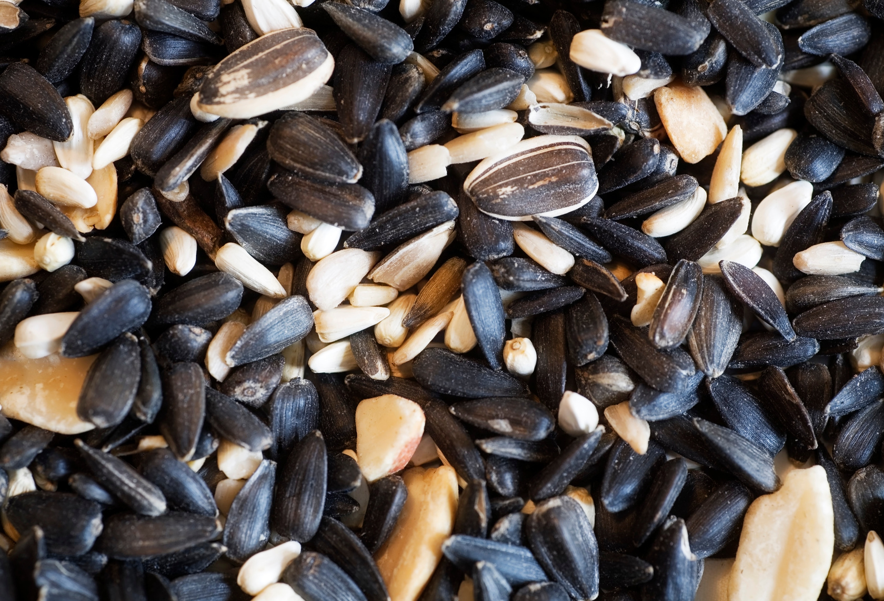
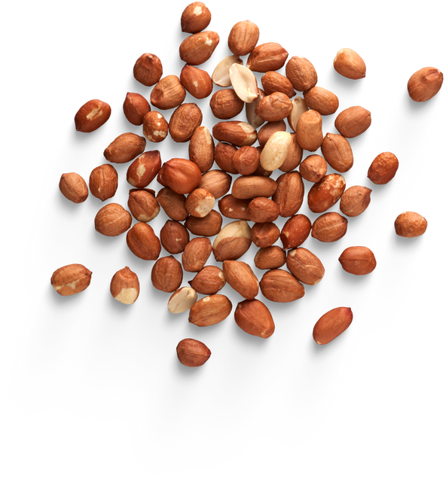
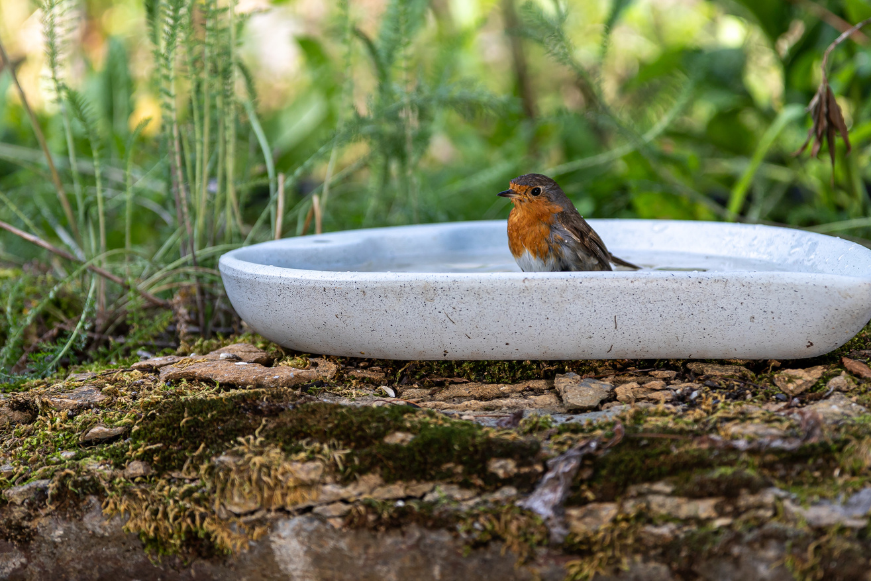
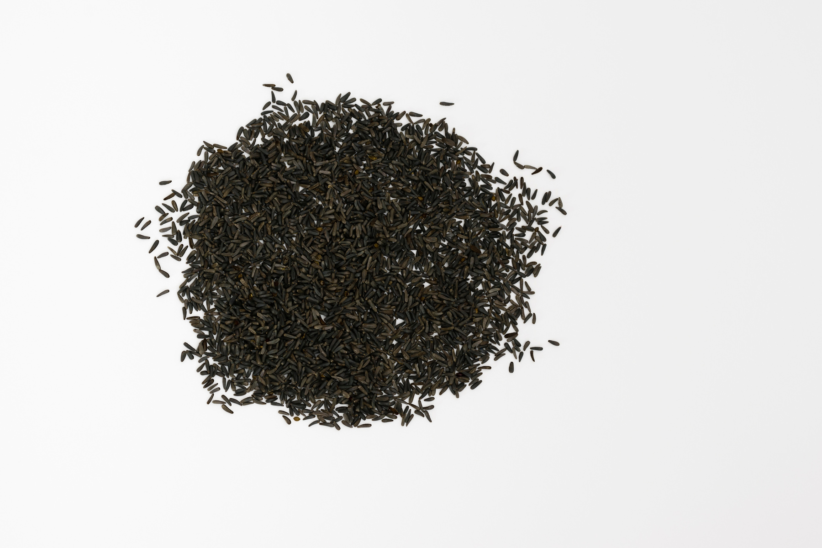
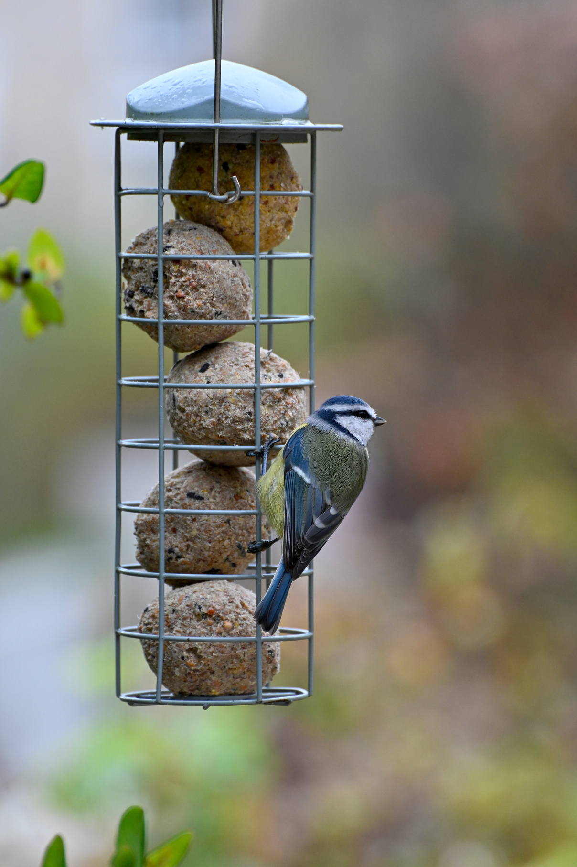
Peanuts
Feeding Birds
Mixed Seed
Water
Niger Seed
Fat Balls

Slide 15
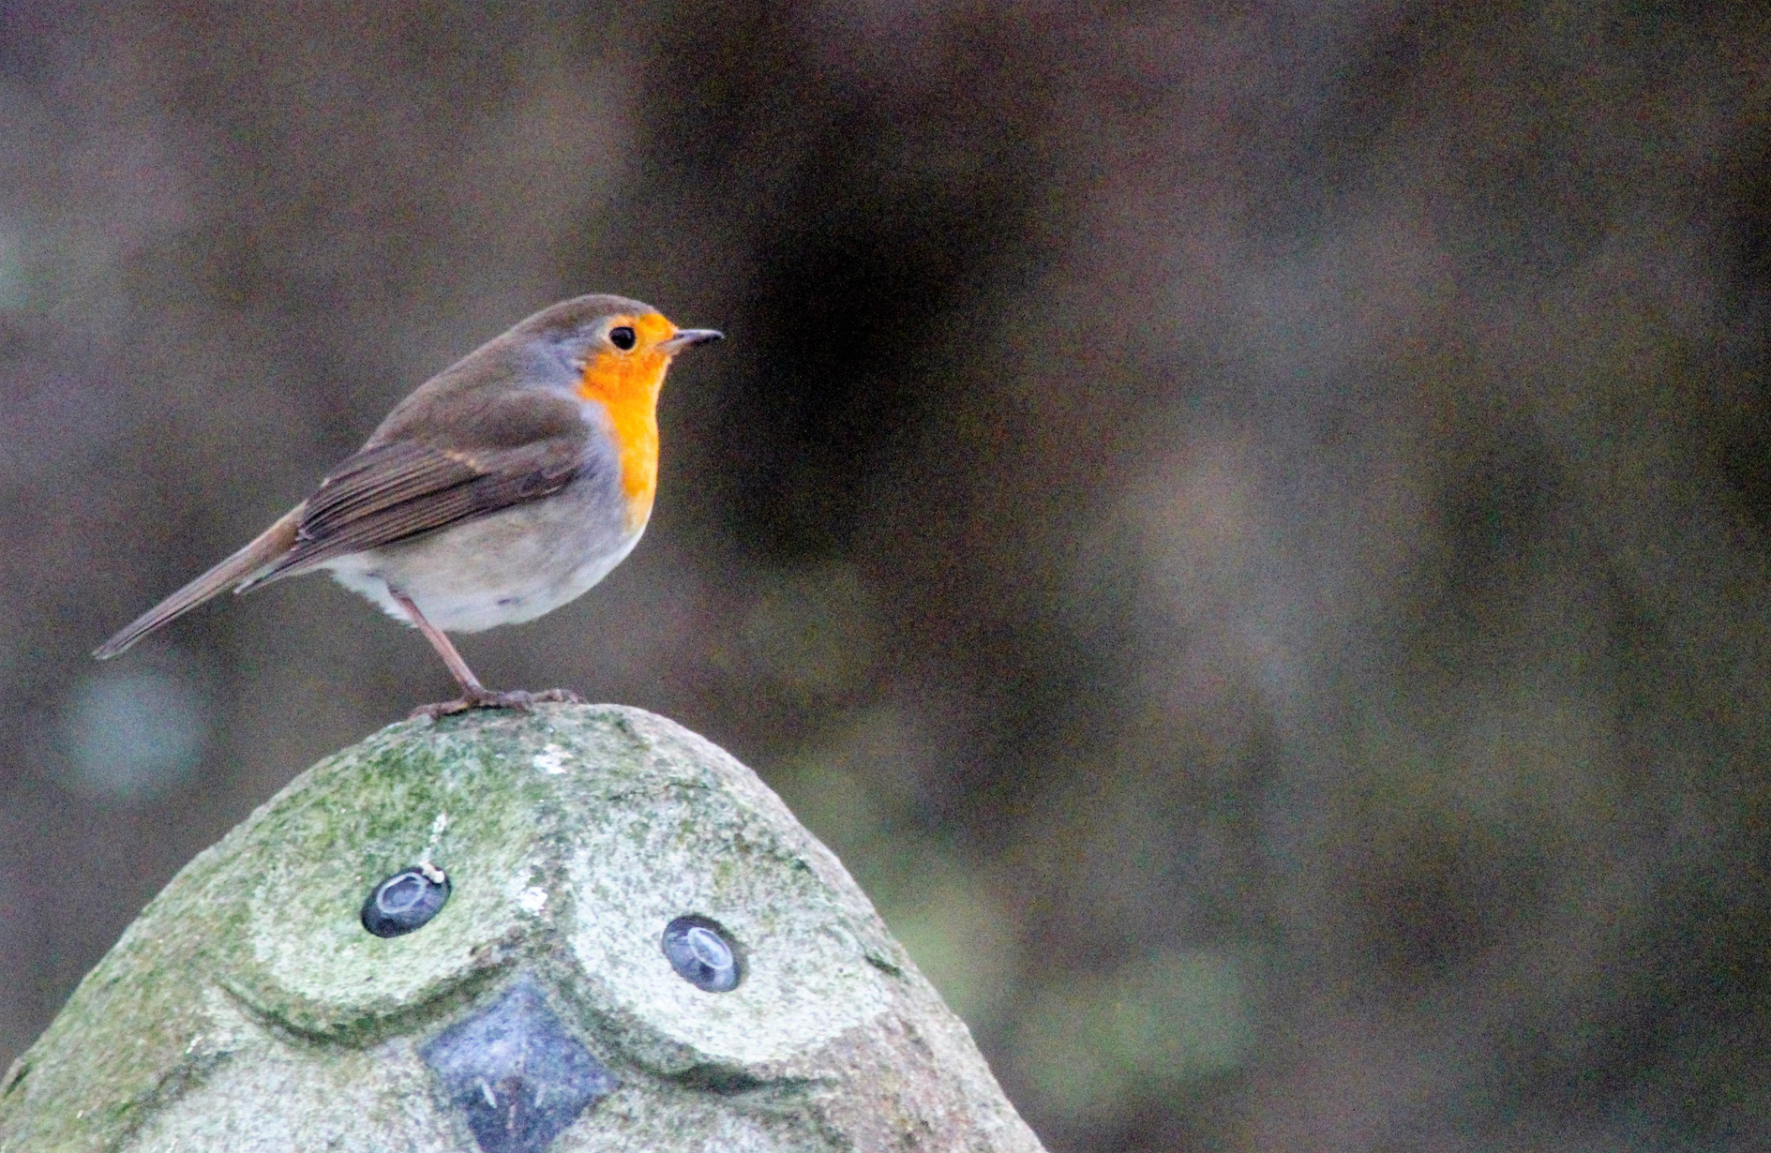
THANK YOU
Learn More On:
More Garden Birds

