Slide 1


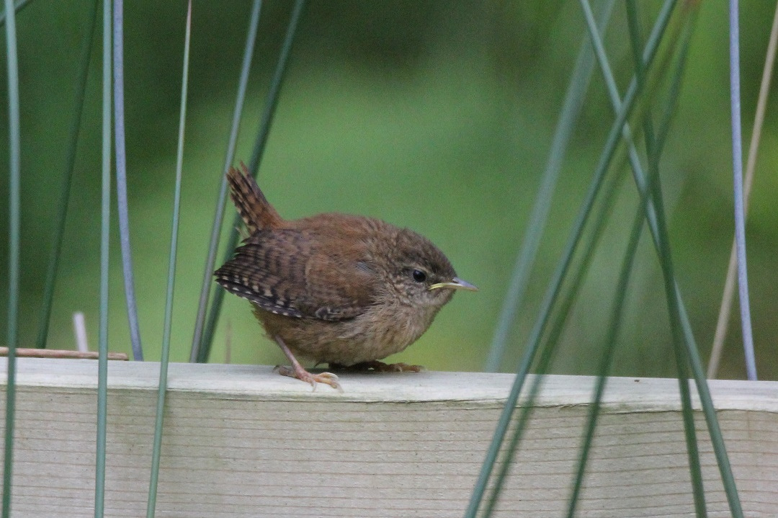
MORE
GARDEN BIRDS
Learn 12 more birds

Slide 2
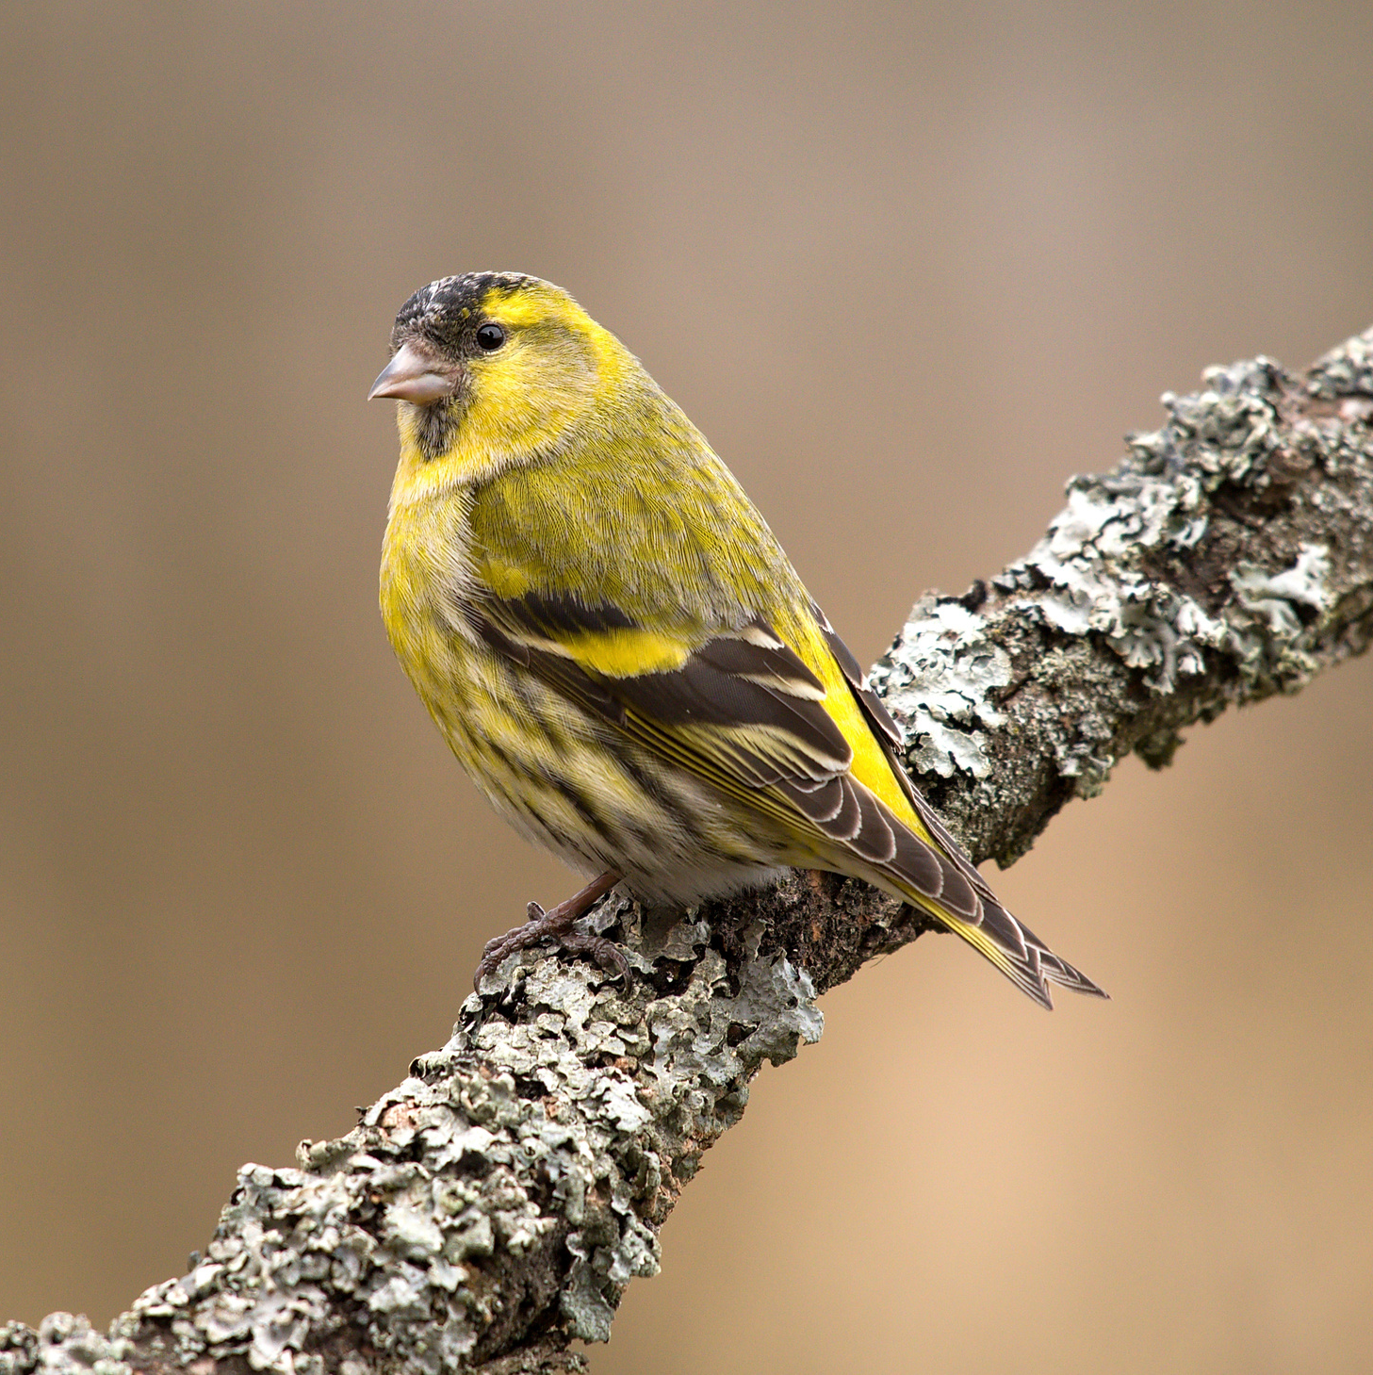
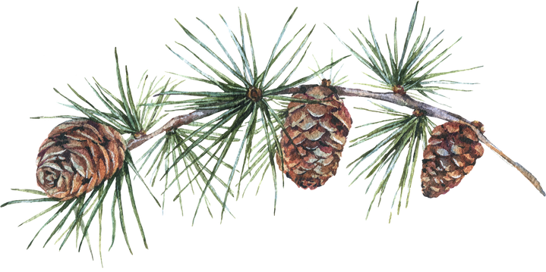
Siskin
Siscín
Spinus spinus
Roboto
Siskins are birds of evergreen woodland, but they have moved into gardens for the bird food. They especially love niger seed.

Slide 3
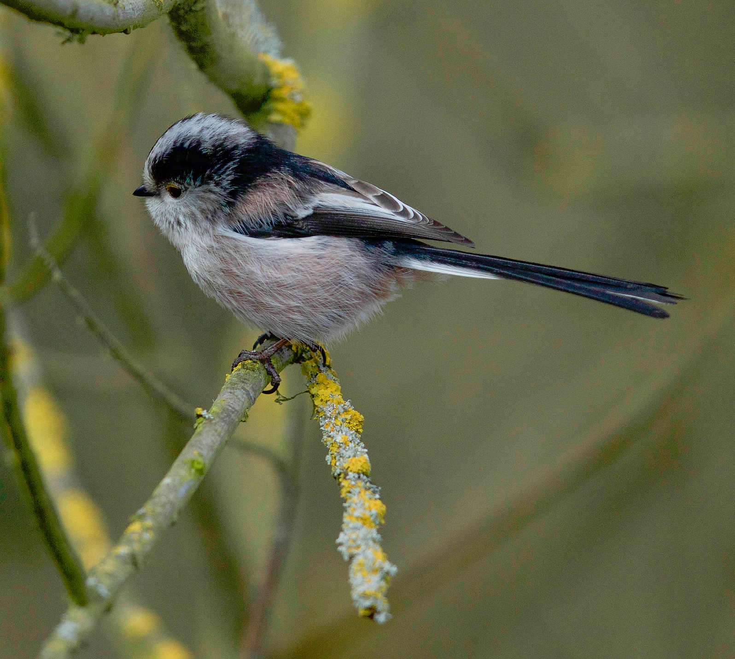

Long-tailed Tit
Meantán Earrfhada
Aegithalus caudatus
Long-tailed Tits have a tiny body and a very long tail. They have been called 'flying teaspoons'.

Slide 4
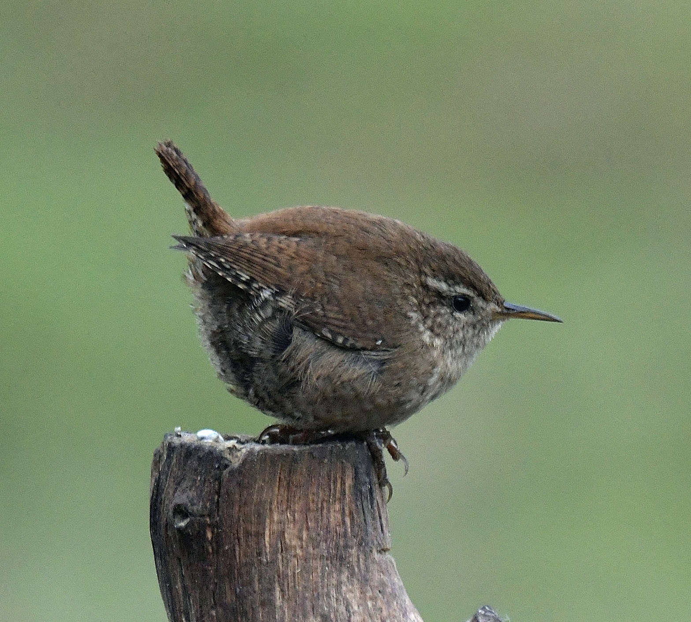
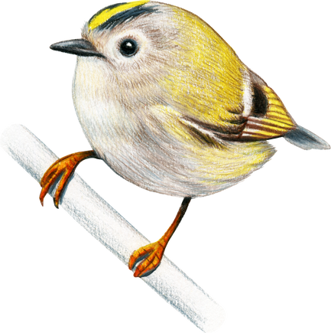
Wren
Dreolín
Troglodytes troglodytes
The wren is very small. However, it is not Ireland's smallest bird.
Our smallest bird is the Goldcrest.

Slide 5
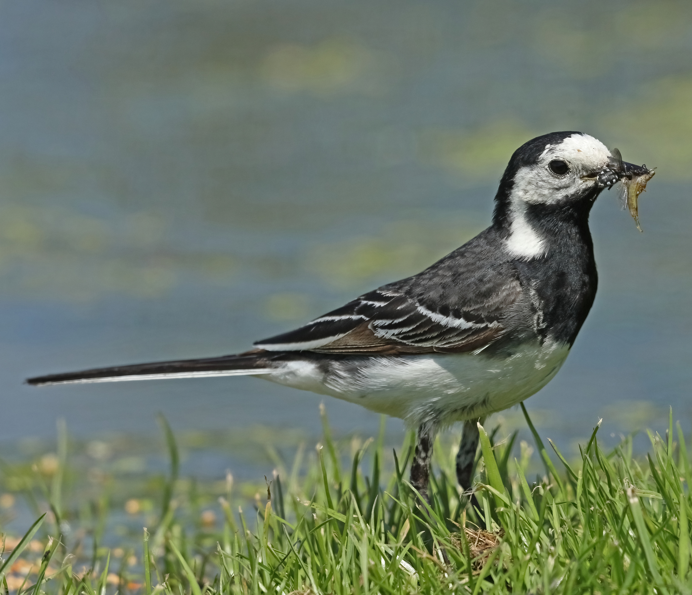
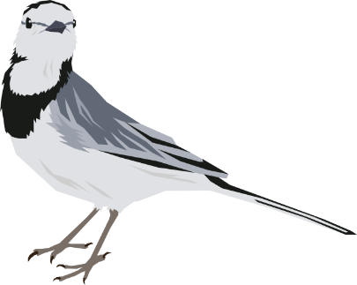
Pied Wagtail
Glasóg Shráide
Motacilla alba
Wagtails bob their tail up and down as they walk.

Slide 6
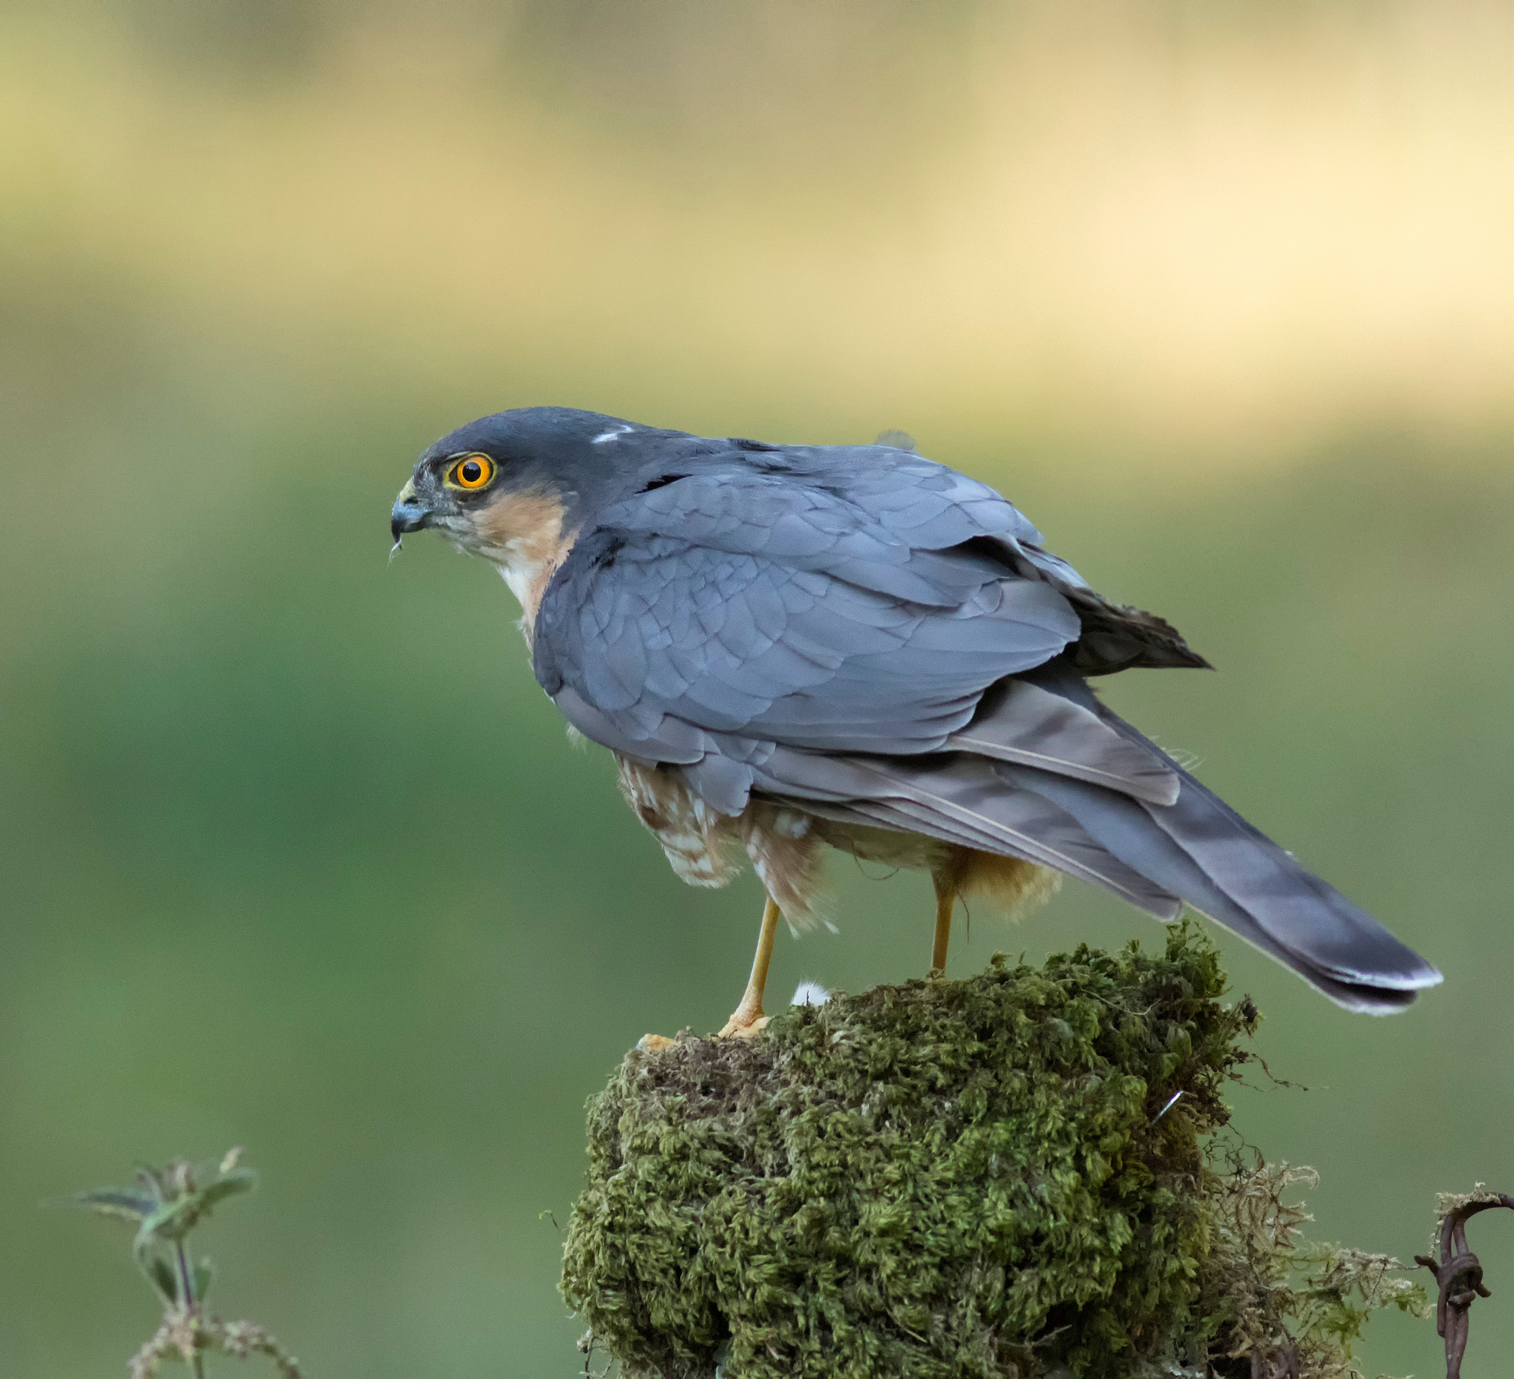

Sparrowhawk
Spioróg
Accipiter nisus
Sparrowhawks are birds of prey. They hunt smaller birds.
Birds of prey have sharp talons and hooked beaks.

Slide 7
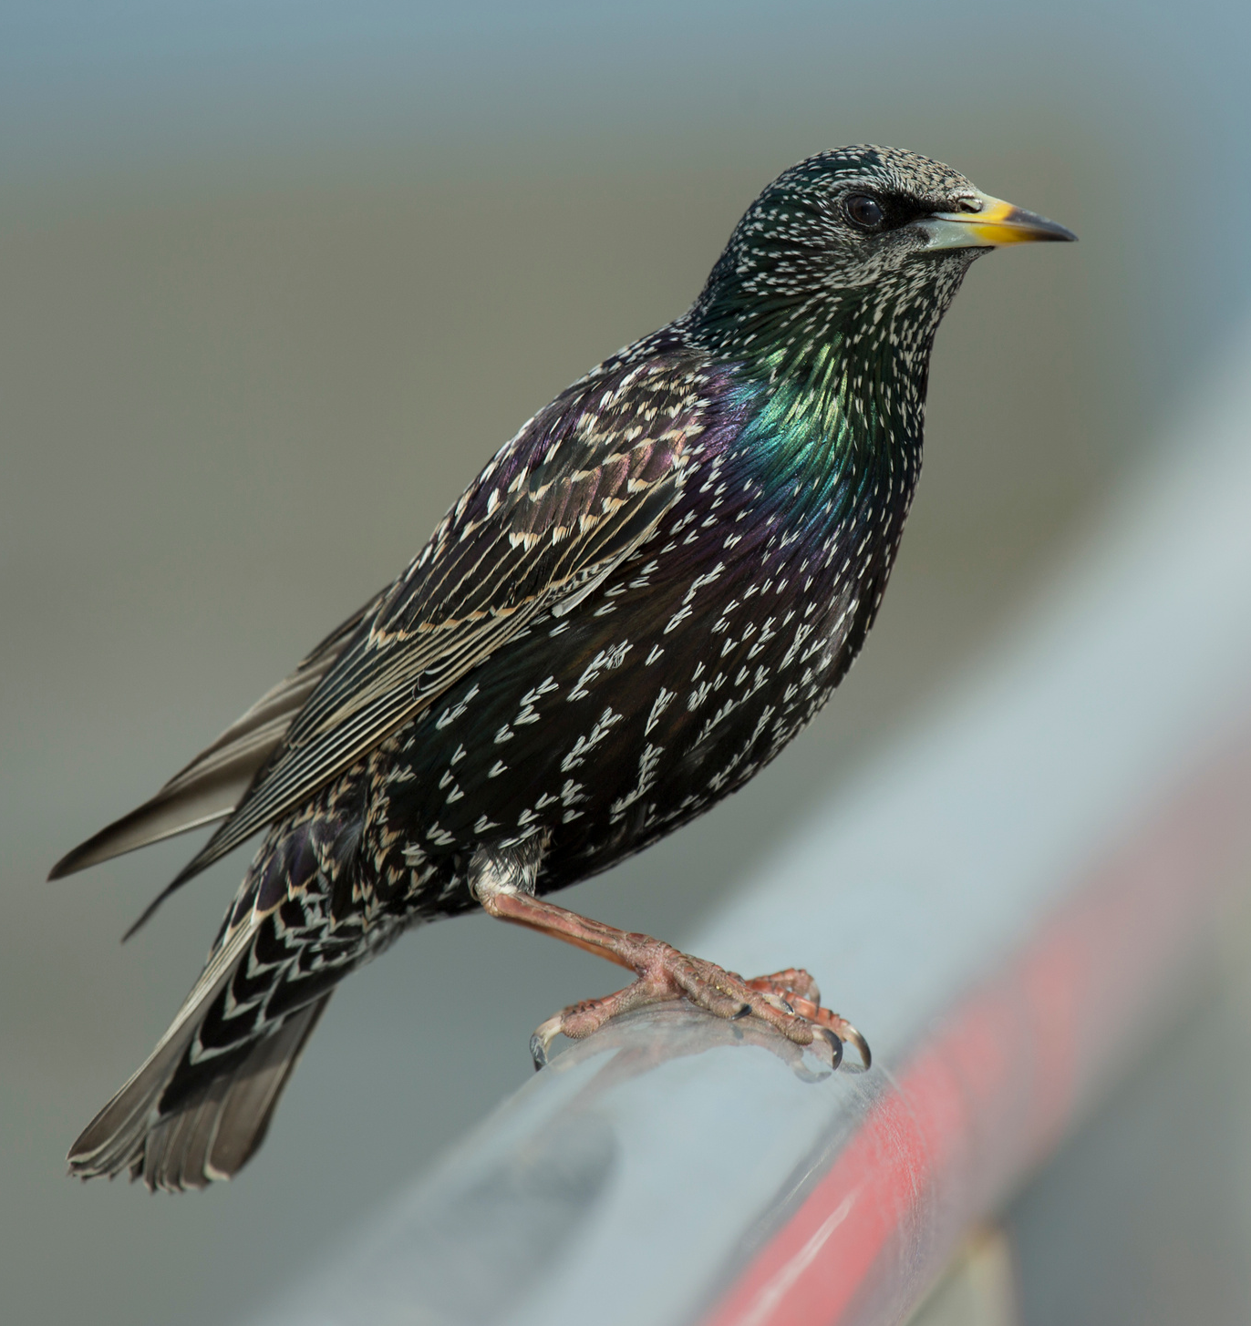

Starling
Druid
Sturnus vulgaris
Starlings form large flocks in winter. Each evening at dusk, before they roost for the night, these large flocks fly in amazing aerial displays called murmurations.

Slide 8
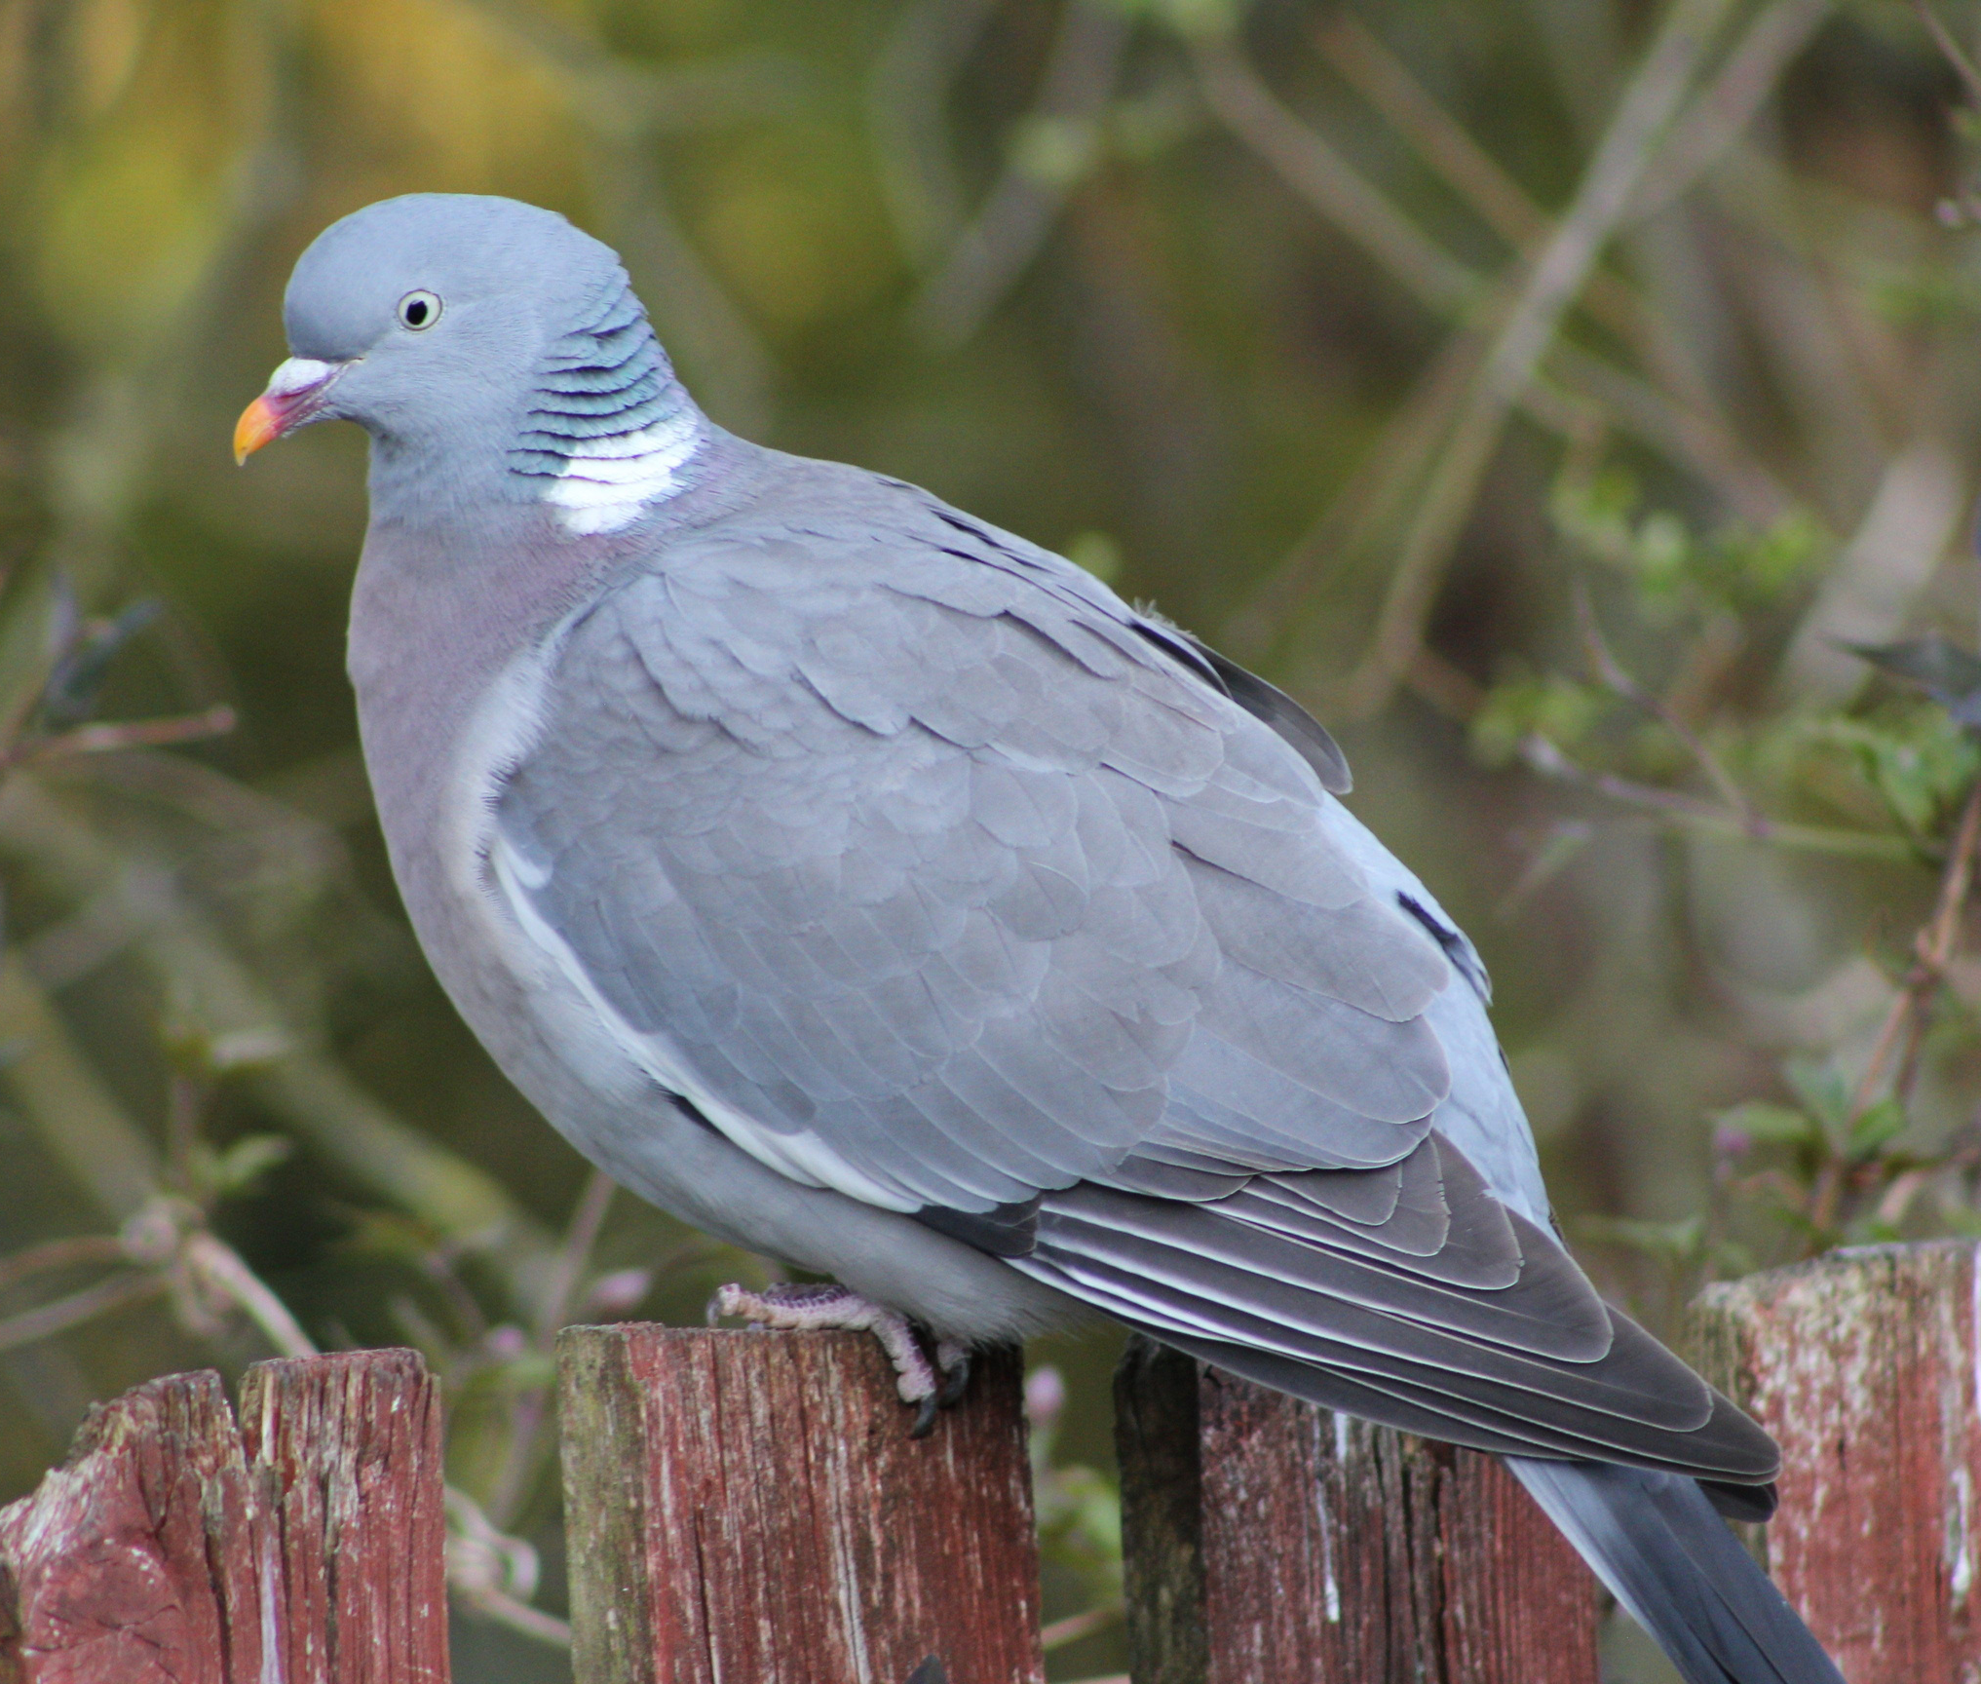
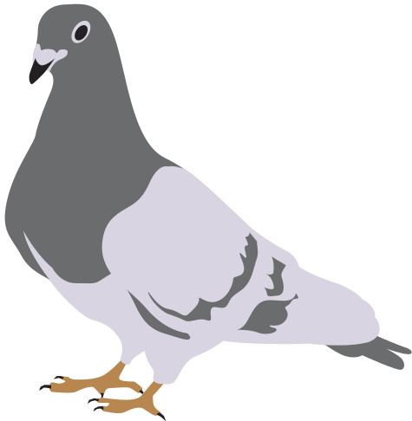
Woodpigeon
Colm Coille
Columba palumbus
Woodpigeons are most often seen in rural areas.
In cities you often see feral pigeons instead.

Slide 9
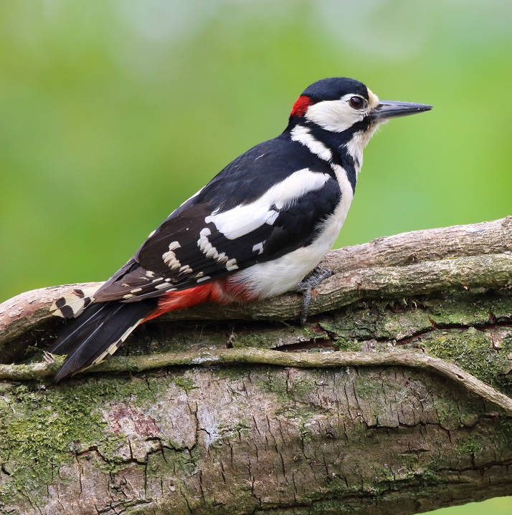

Great Spotted Woodpecker
Mórchnagaire Breac
Dendrocopus major
Woodpeckers returned to Ireland in 2005 (or thereabouts).
They are spreading, but may not yet have reached your garden.

Slide 10
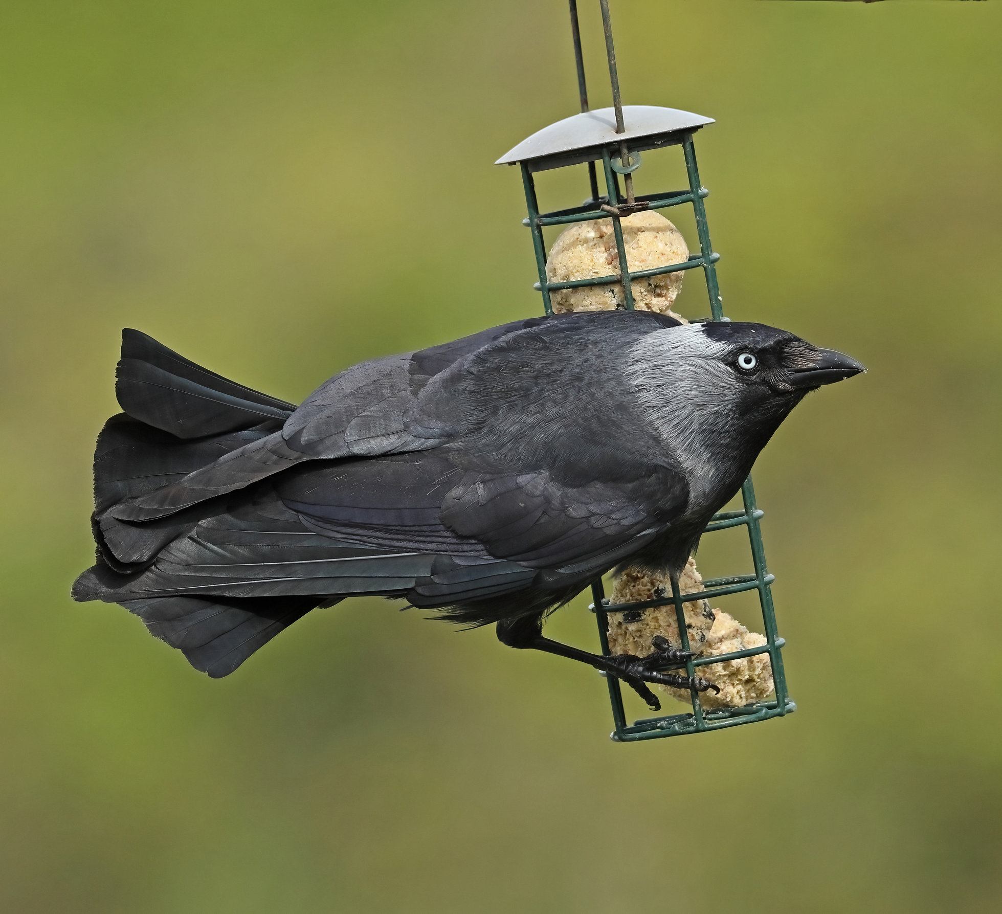

Jackdaw
Cág
Corvus monedula
Jackdaws are a type of crow.
Crows are very clever birds. Ireland's biggest crow is the raven.

Slide 11
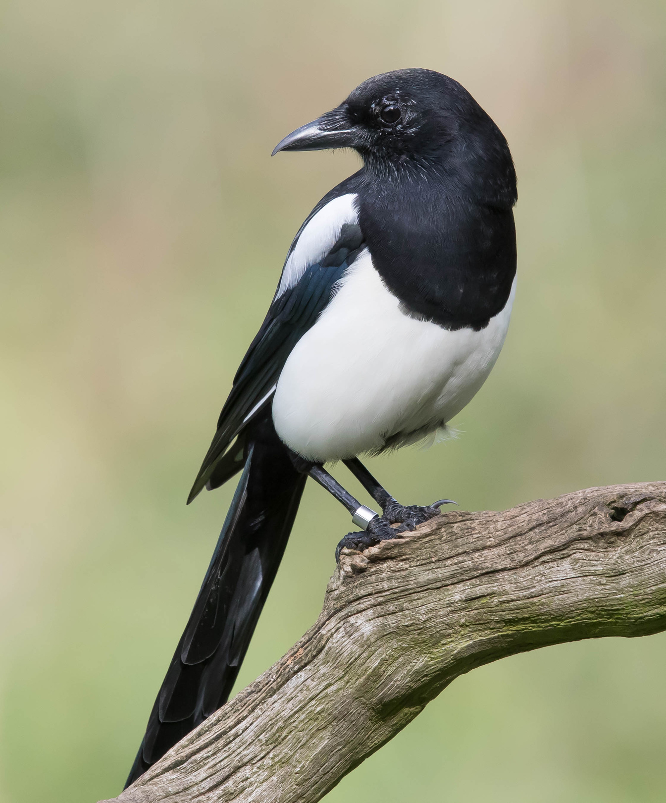

Magpie
Snag Breac
Pica pica
Magpies are also a type of crow.
Do you know the rhyme?
One for sorrow,
Two for joy,
Three for a girl,
Four for a boy,
Five for silver,
Six for gold,
Seven for a secret
Never to be told.

Slide 12
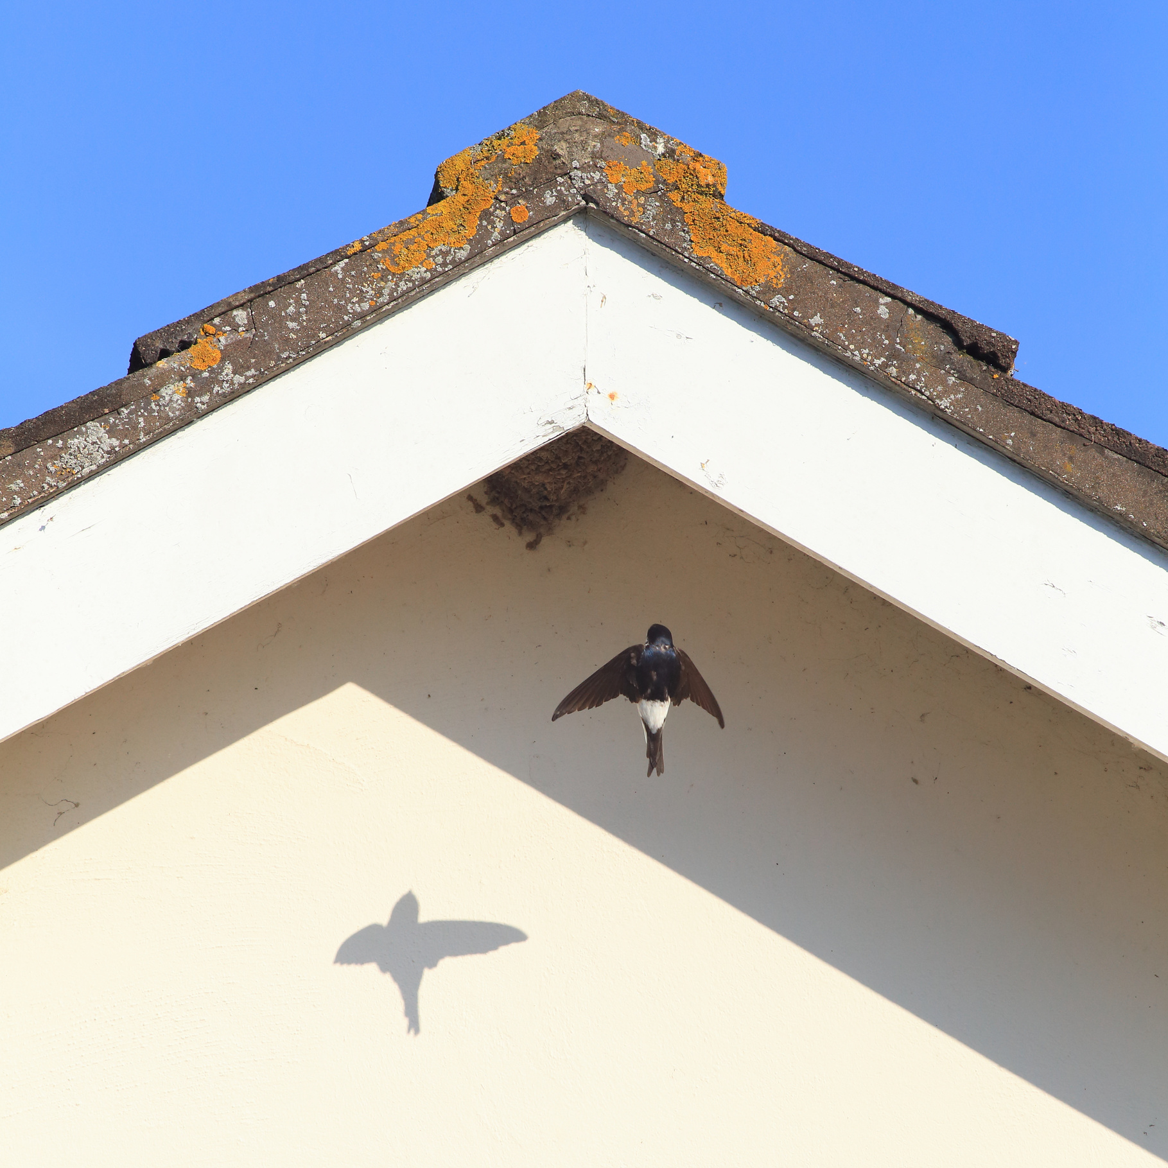

House Martin
Gabhlán Binne
Delichon urbicum
House Martins are summer visitors to Ireland.
They have a white rump.
They make a mud nest on the side of a house.

Slide 13
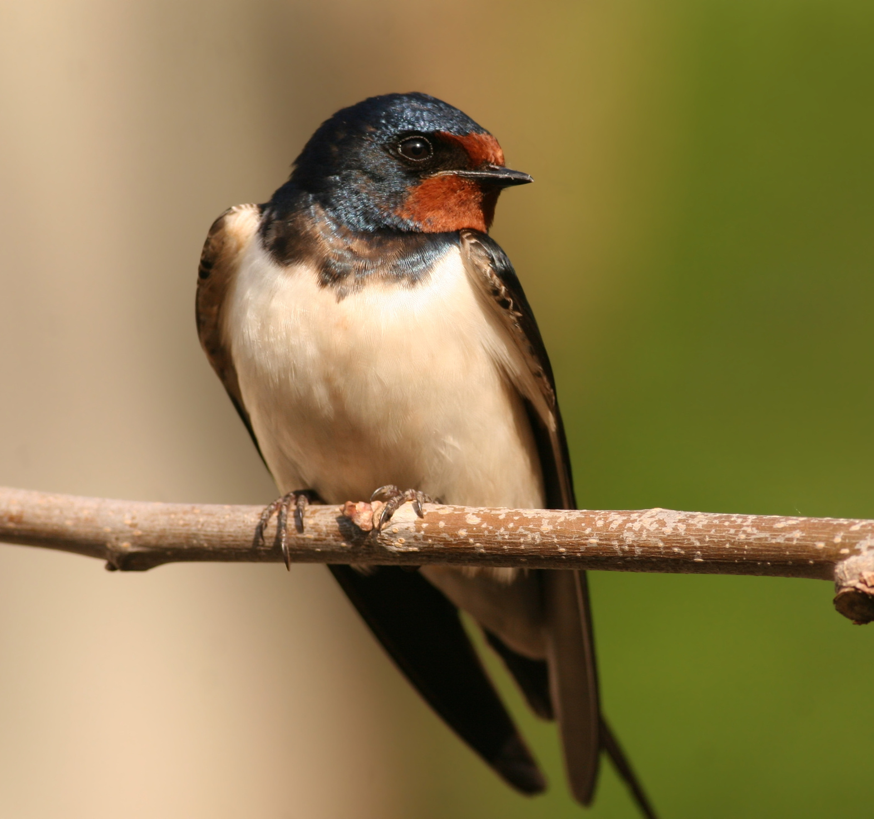

Swallow
Fáinleog
Hirundo rustica
Swallows spend the winter in Africa. They come to Ireland for the summer, to breed.
The first Swallow in spring is a sign that summer is coming.

Slide 14

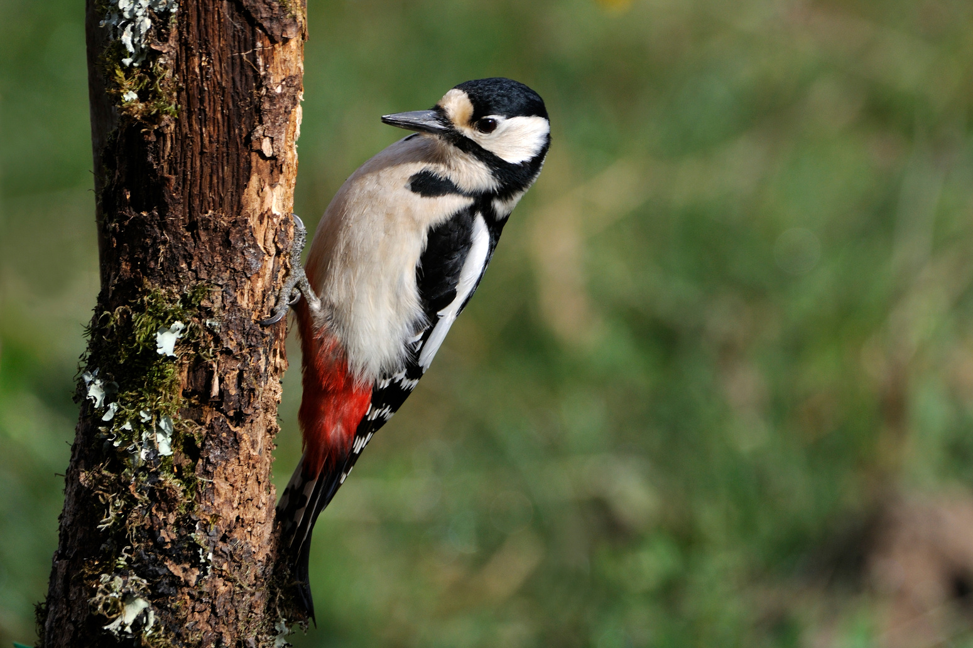
THANK YOU

