Slide 1
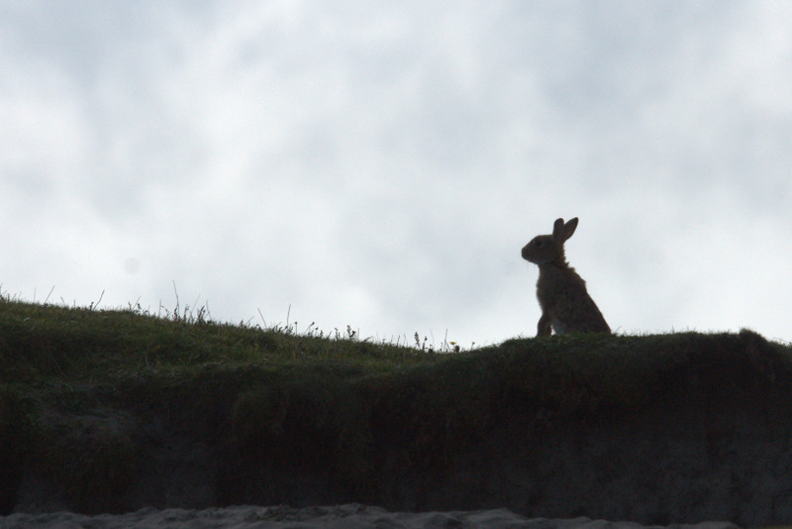

Rabbits & Hares
Wikimedia – Mike Pennington

Slide 2
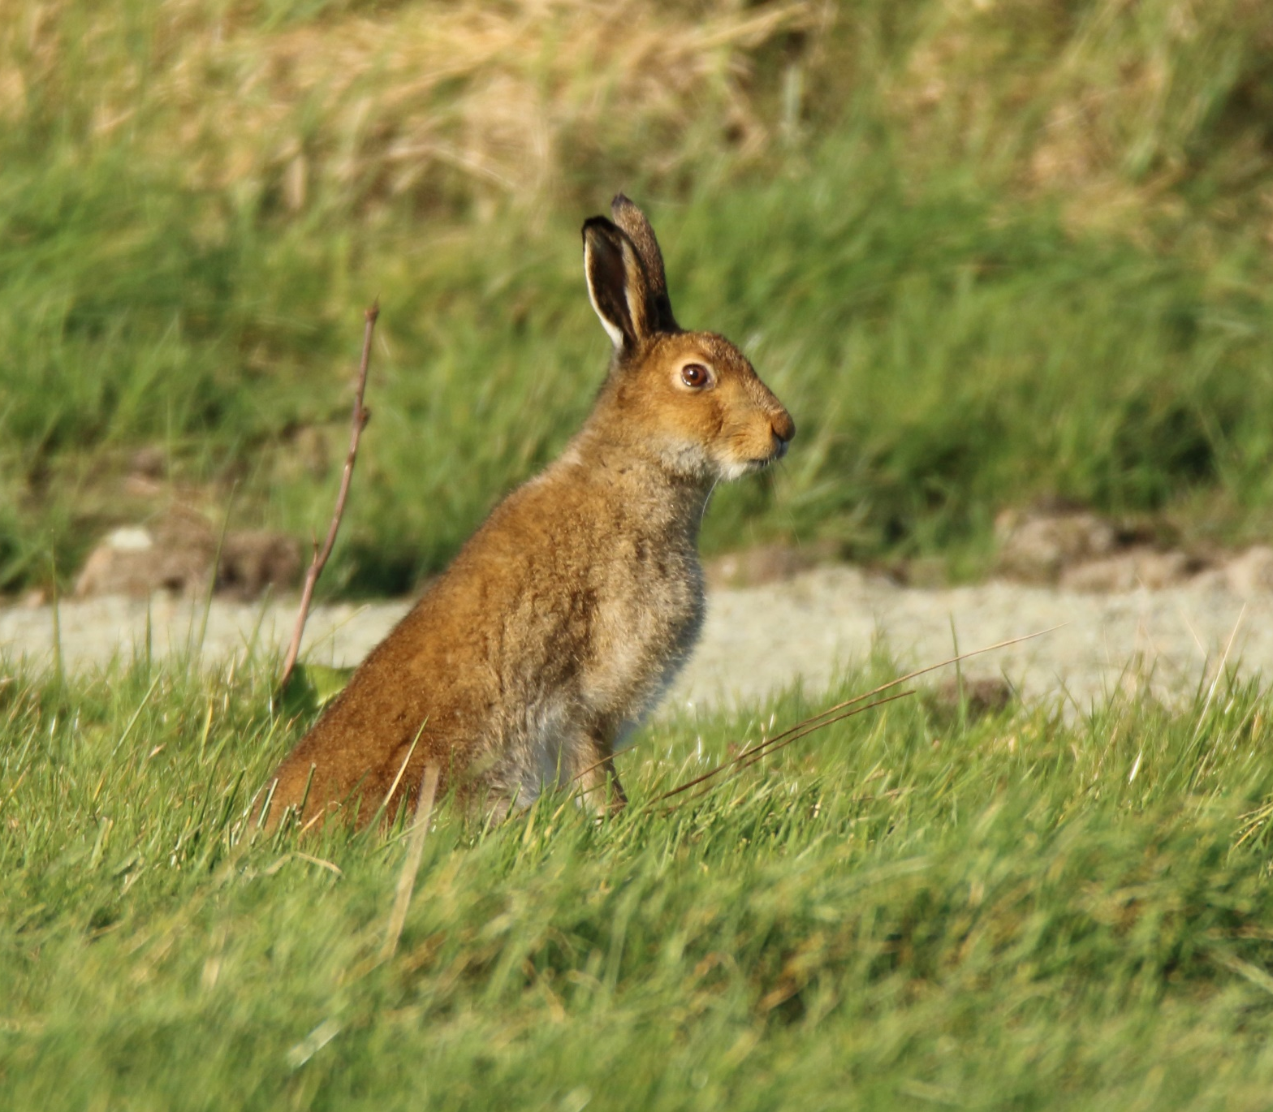
Irish Hare
What’s special about
Rabbits & Hares?
Ears
Eyes
Big back legs
Tail
Teeth
Sense of smell
Very quiet
Lagomorphs
Easter bunny!
NPWS – Gillian Stewart
Notes:
Before we start – we are not talking about pet rabbits here. We’re talking about wild rabbits.
Rabbits and hares have big ears. They have very sharp hearing. They can hear danger all around.
Their eyes are large. They are set in the side of the head, giving them almost 360° vision. Lots of animals want to eat rabbits and hares!
Rabbits and hares have long legs to enable them to run fast and leap far. When evading predators hares constantly change direction as they run. Brown hares can reach speeds of 70kph.
They have a fluffy white tail.
Rabbits and hares eat plants (herbivores). They have large front teeth (incisors) like rodents.
They rarely use their voice although they can scream when in pain or scared. Rabbits can alert other rabbits to danger by thumping their back feet off the ground.
They have a good sense of smell. They use scent glands under the chin to mark their home.
Rabbits and hares are called lagomorphs. (Which are quite similar to rodents in many ways.)

Slide 3
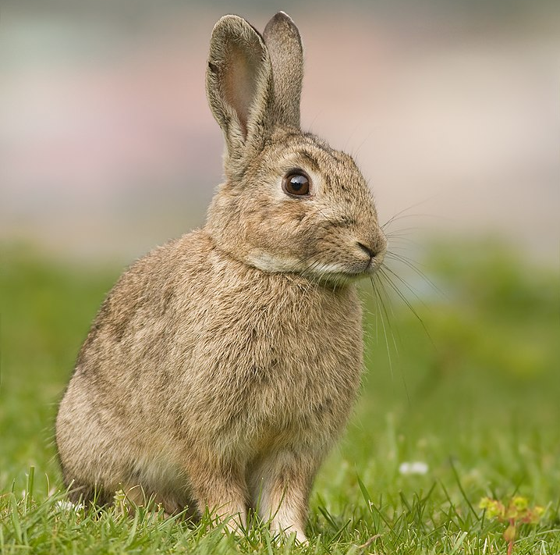
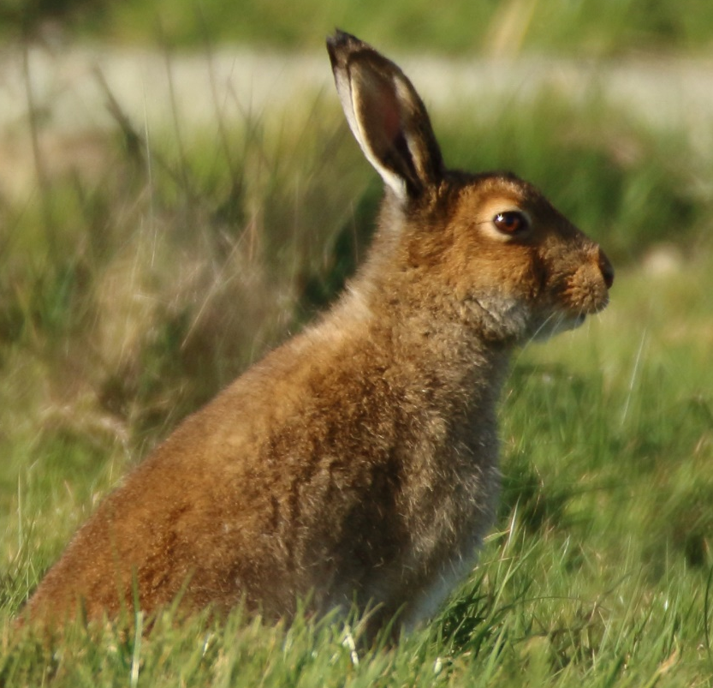
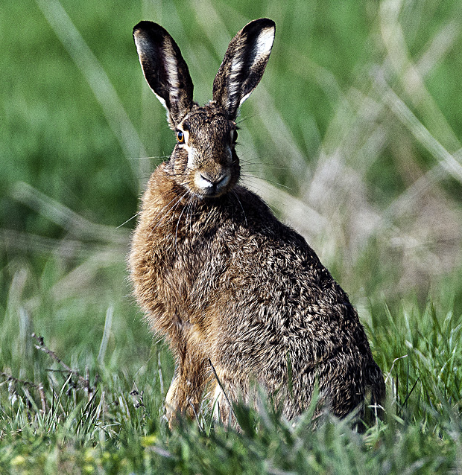
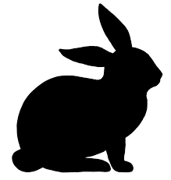
Rabbit or Hare?
Wikimedia
J.J. Harrison
NPWS
Gillian Stewart
Wikimedia
Hans-Dieter Graf
Rabbit
Coinín
Orycolagus cuniculus
Irish / Mountain Hare
Giorria
Lepus timidus hibernicus
Brown Hare
Giorria gallda
Lepus europaeus
Up to 2 kg
Up to 3 kg
Up to 3.5 kg
Notes:
We have 3 species in Ireland.
We have three species in Ireland. How do you tell them apart?
Hares are bigger than rabbits. And hares have longer legs.
Rabbits and Irish hares have shorter ears – their ears are slightly shorter than the length of their head. The Brown hare has the longest ears – they are about the same length as their head.
As we shall see in the next slide, the tail is also a clue.

Slide 4
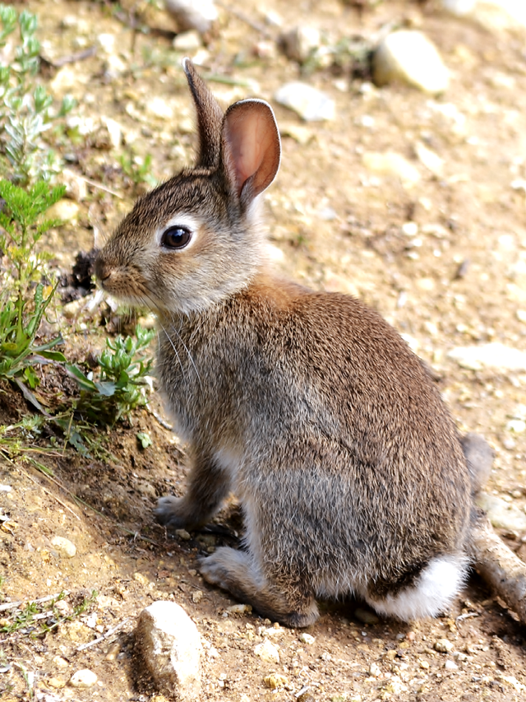
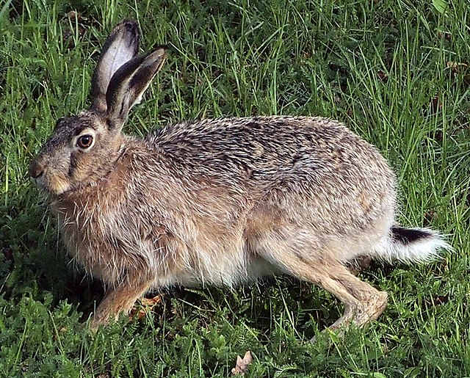
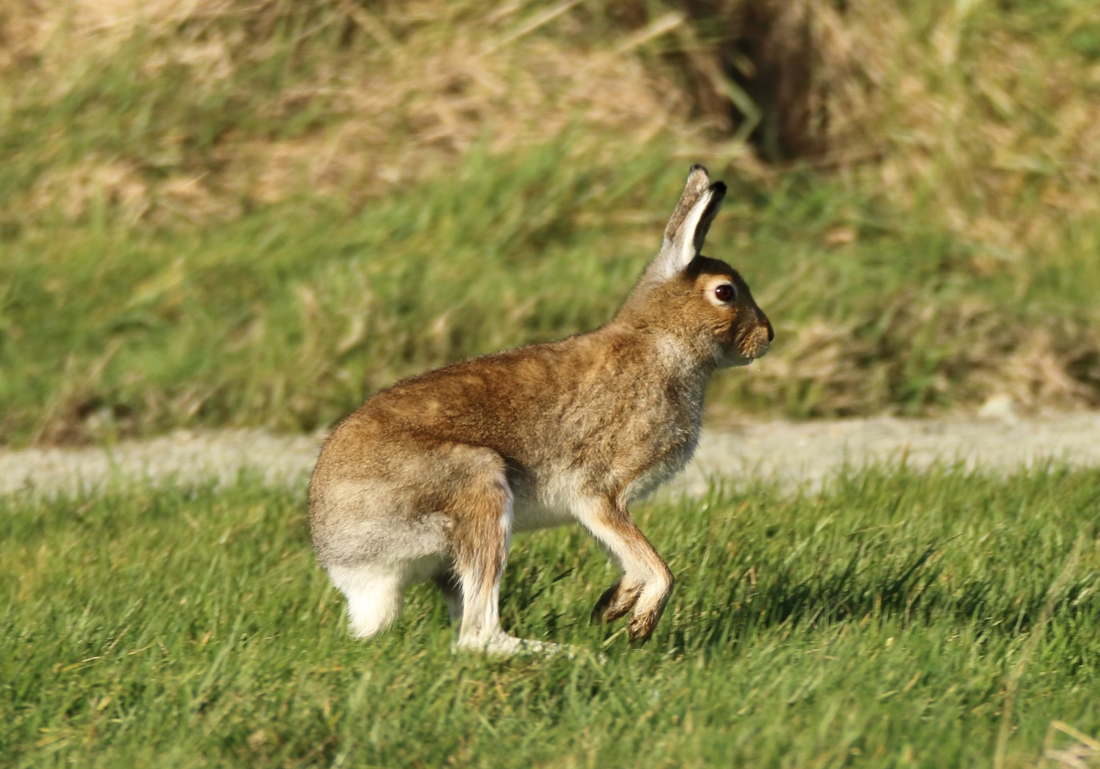
Wikimedia – Tiia Monto
Which one has no black in its tail?
Brown Hare
Wikimedia – Paulo Costa
Rabbit
Irish Hare
NPWS – Gillian Stewart
Notes:
Can you see how the Irish hare has a different colour tail?
All three have white fluffy tails. They are a signal to other rabbits and hares when they run from danger. The white tails says ‘RUN, RUN’!
Both rabbits and Brown hares have a dark upperside to their tail.
But Irish hares are fluffy white all over.

Slide 5
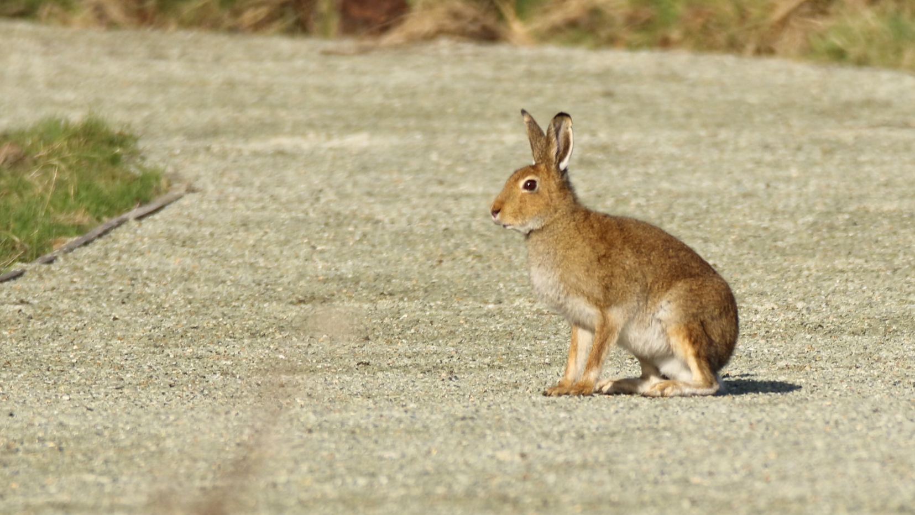

Are they Native to Ireland?
Irish Hare = Native
NPWS – Gillian Stewart
Notes:
Are Rabbits & Hares Native to Ireland?
Native: What does it mean? Most scientists consider an animal native if it has been here since the Ice Age, which is about 10,000 years.
Irish Hare
Irish hares are one of Ireland’s longest established mammals. Scientists have found bones of Irish hares that were over 28,000 years old. They have been in Ireland at least since the Ice Age, and possibly before that. Irish hare bones have been found at Newgrange and other Mesolithic sites.
Ireland has its own special subspecies of Mountain hare – hence the ‘hibernicus’ in the scientific name. This subspecies differs in that it does not normally turn white in winter.
Irish hares are found throughout Ireland. They live in a wide range of open habitats including grasslands, salt-marshes and upland bogs and heaths.

Slide 6
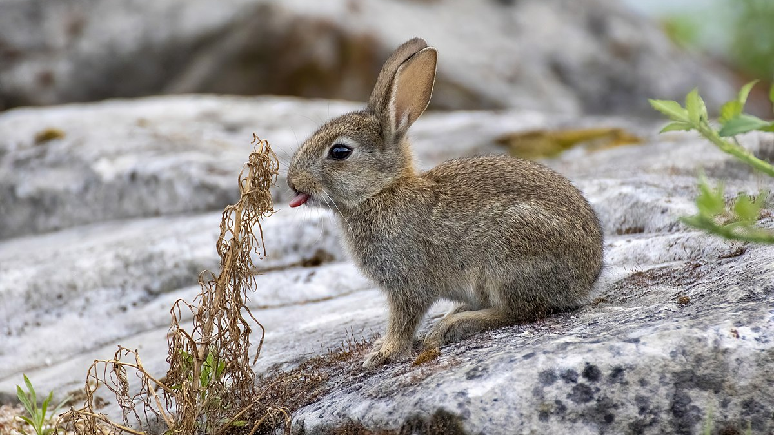
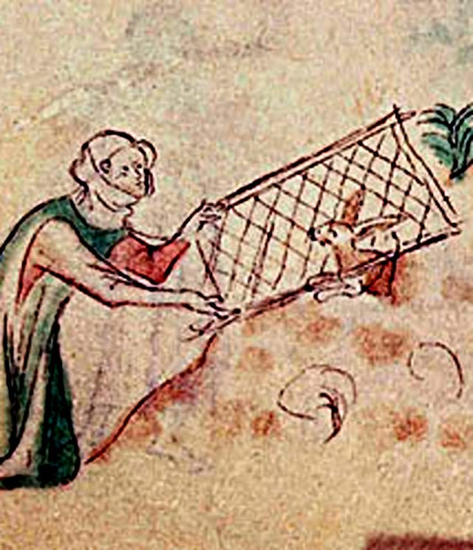
Wikimedia - Alexis Lours
Are they Native to Ireland?
Rabbits = Naturalised
Notes:
Are Rabbits Native to Ireland?
Rabbits are naturalised. This means that they were introduced so long ago that they are now considered to belong here.
Rabbits were introduced to Ireland by the Normans in the 12th century. They were bought here for food. Originally they were kept in enclosures called warrens. The earliest recorded warren in Ireland was on Lambay Island off Co. Dublin, in 1191.
Rabbits soon escaped from these warrens and rapidly spread throughout Ireland. They were hunted for their meat and fur.
Today, rabbits are found throughout Ireland. They live in a wide range of habitats including farmland, sand dunes, and upland areas. They like areas of short grass, especially where there is some cover such as bramble patches, hedgerows, or forest edges.

Slide 7
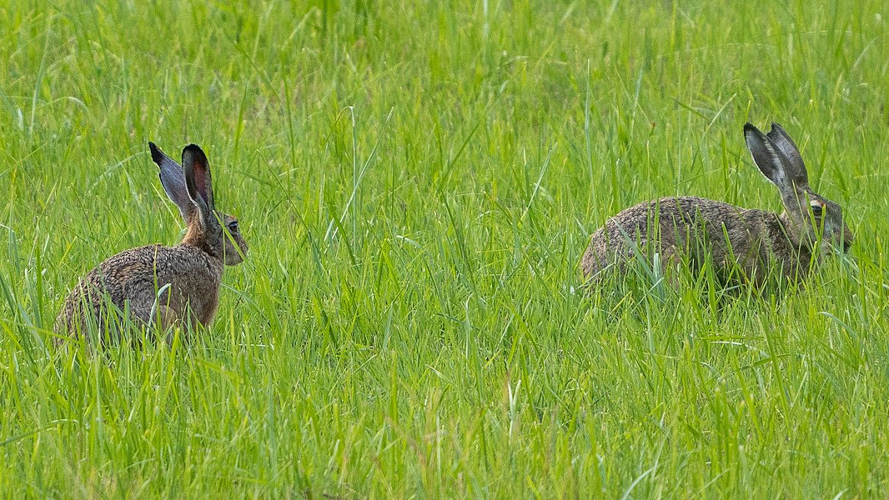
Wikimedia – Bengt Nyman
Are they Native to Ireland?
Brown Hare = Invasive Species
Notes:
Are Brown Hares native to Ireland?
Brown Hares are not native and are classed as an Invasive Species. An Invasive Species is an introduced species that could pose a problem for our native wildlife. There is a fear that Brown hares could adversely affect populations of Irish hares. They could possibly cross breed with our native hares, thereby causing our pure Irish hares to decline or even become extinct. Or they could bring disease to our native hares.
Brown hares were introduced into Ireland (for sport) in several places in the late 1800s and early 1900s. However, Brown hares are not as hardy as our Irish hares, and most of the populations died out. It remains in Northern Ireland. The last sightings in the Republic were in Co. Donegal. It is believed to have died out in the Republic, but you never know….
Brown hares prefer farmland and lowland areas, and are not as tolerant of poor weather as Irish hares. Unlike Irish hares, they don’t like upland bogs and heaths.

Slide 8
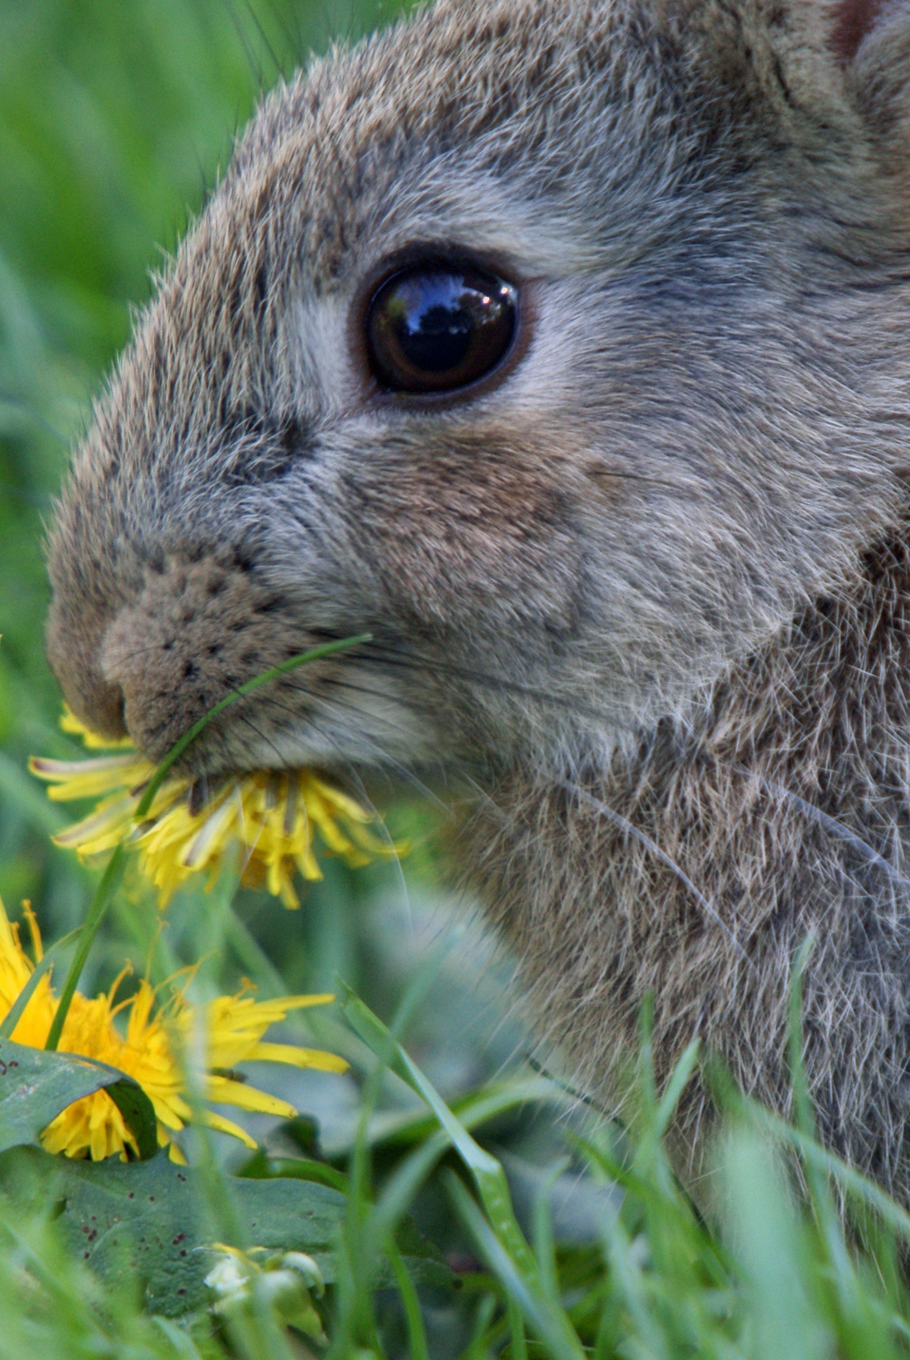
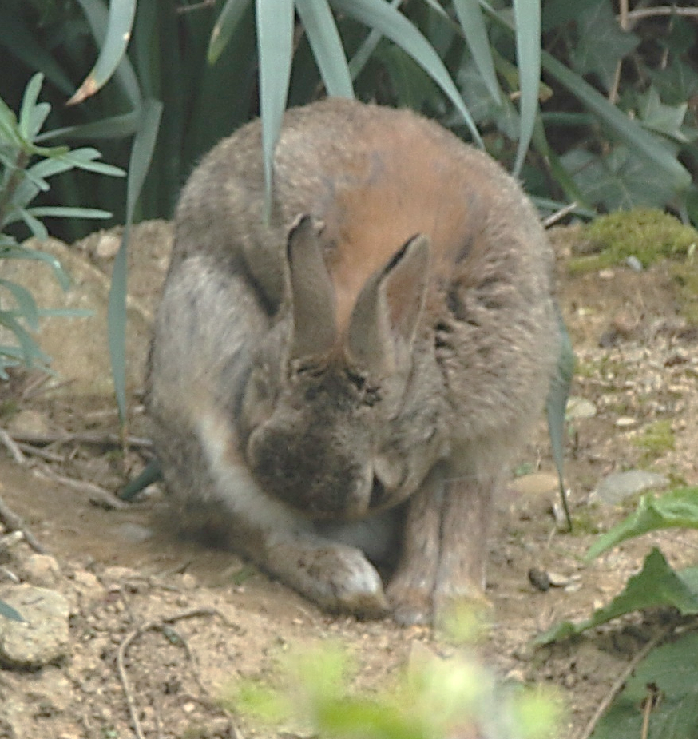
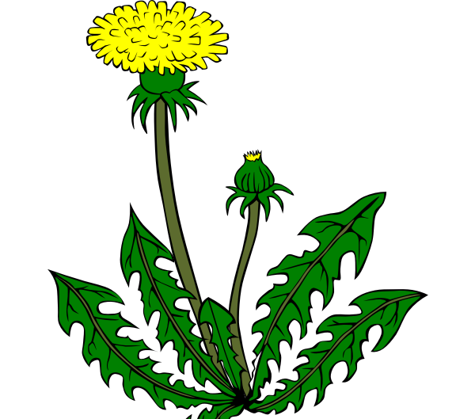

What do rabbits and hares eat?
NPWS
G. Stewart
Wikimedia - Gidzy
Notes:
What Do They Eat?
Lagomorphs are herbivores. They eat plants. They particularly like grass and wildflowers.
What about carrots? Pet rabbits love carrots. But wild rabbits rarely find carrots. They prefer wild plants.
They have large incisors (the front teeth) like rodents.
The teeth of rabbits and hares grow constantly. This means that they do not wear down as they constantly gnaw and chew plants.
Coprophagy: Plants can be difficult to digest. Rabbits and hares get around this problem by eating their food twice. The first time that their food passes through the gut, it is ‘pooped out’ as a half digested pellet which the rabbit or hare eats! The second time that the food gets passed through the gut, it passes out as a regular poop, the sort that you see lying around on the ground.

Slide 9
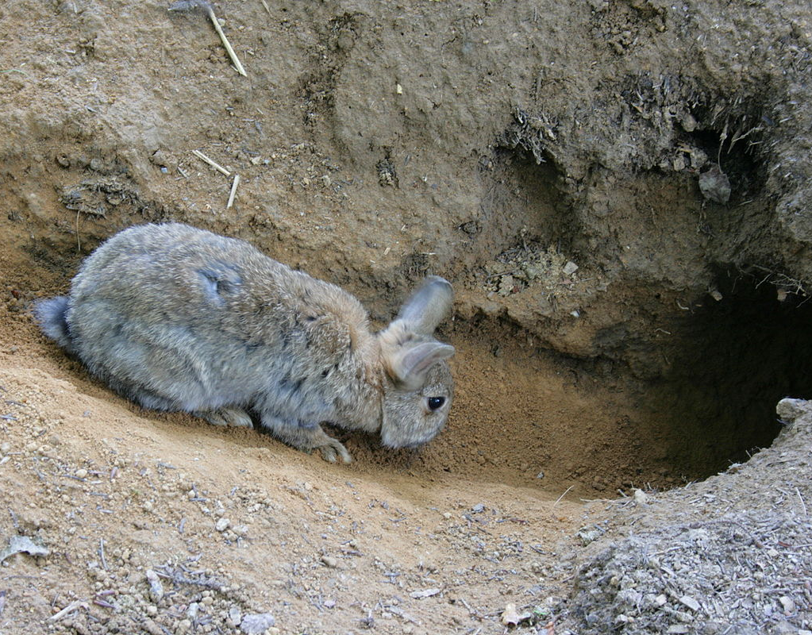
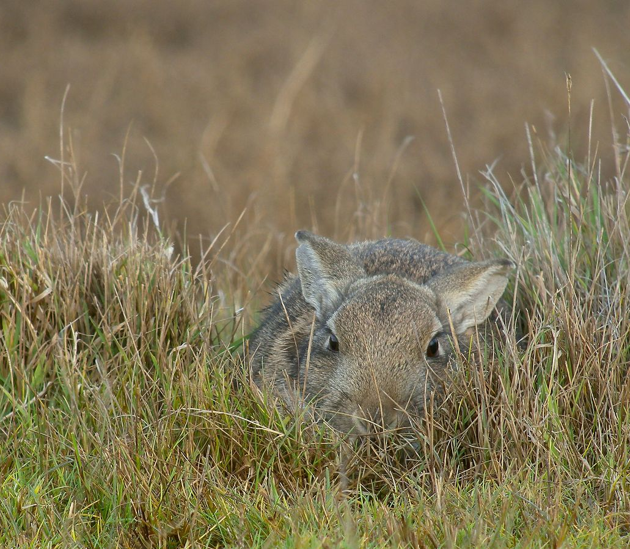
Where do rabbits and hares sleep?
Wikimedia - Frank Vincentz
Wikimedia - Frank Vassen
Rabbit – Burrows in a warren
Hare – Form
Notes:
Where Do They Sleep?
Rabbits live in large burrow systems called warrens. Many rabbits might live in the warren. The rabbits rarely wander too far from their burrows. They need to be able to dash to safety when danger threatens.
Unlike rabbits, hares do not live in burrows. They live above ground. Hares rest in a patch of flattened grass called a form. They usually have different forms throughout their territory - a place to rest by day, and a different place at night for example. A hare’s territory can be very large, especially if the habitat is poor. In rich grassland, they can have much smaller habitats.
Why do you think that hares will live in a bog, but rabbits don’t ever live in a bog? What would happen if a rabbit tried to dig a burrow in the bog?

Slide 10
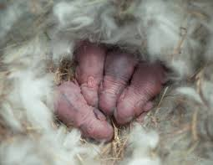
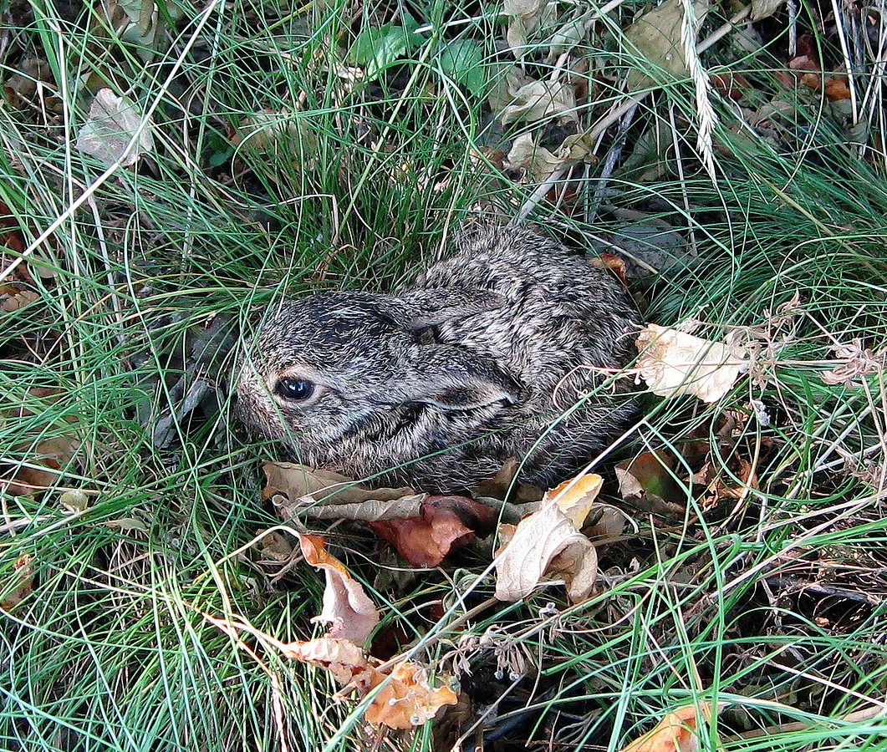
Family Life
Wikimedia - Петроченко В. І.
Rabbit - Kittens
Hare – Leveret
Notes:
Rabbit Family Life:
A male rabbit is called a Buck.
A female rabbit is called a Doe.
Baby rabbits are called Kittens.
A mother rabbit moves away from the main warren and digs a special nest burrow to have her babies in. She lines the nest with her own fur that she pulls from her tummy area.
The kittens are born blind and without fur, but they are kept cosy in their fur-lined nest. The mother rabbit only visits her babies once a day, usually at night, to feed her kittens. They grow fast, and after c.18 days the young bunnies start to explore outside the burrow. This can be a dangerous time for them.
A doe can have several litters in a year, maybe even as many as seven. Most litters have 3 to 5 babies, but they could have up to ten, which means that a doe can produce lots of baby rabbits each year!
Hare Family Life:
A male hare is called a Jack.
A female hare is called a Jill.
Baby hares are called Leverets.
Courtship can include chasing and boxing. Males fight for dominance by boxing and kicking.
The leveret are born in a form above ground, hidden in long grass. A litter usually has two or three leverets. Unlike rabbits, new born leverets are fully furred and have their eyes open. The mother leaves them alone, hidden in their form, for most of the day. She returns once a day to quickly feed them, usually at dusk. After a few days, the leverets start to explore a little. They grow fast and are weaned after 3 weeks.
A female hare can produce two or three litters in a year. The gestation is quite long – around 50 days. Unusually, a female can conceive a second litter while still pregnant with the first. So some female hares can be pregnant with two litters at the same time.

Slide 11
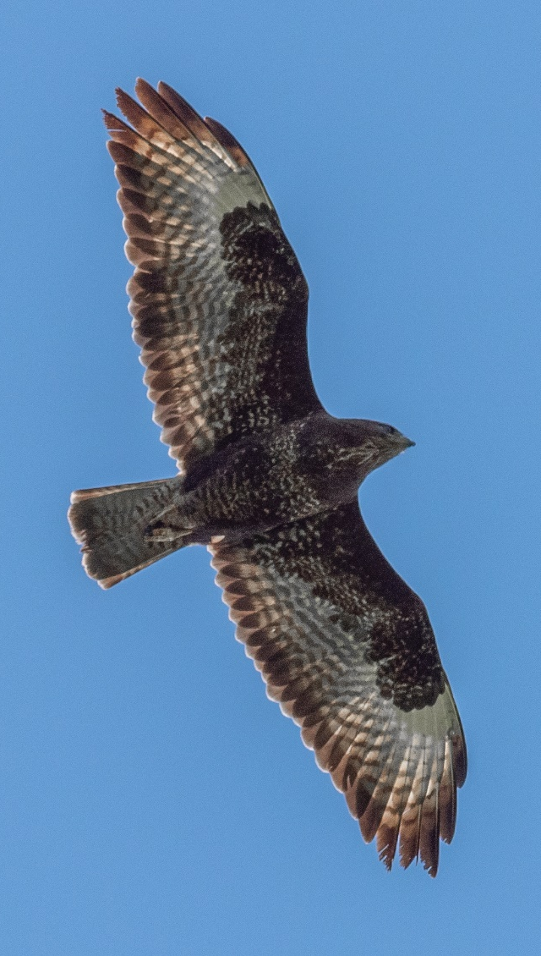
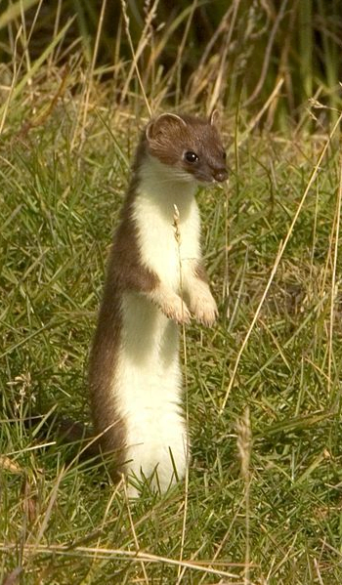
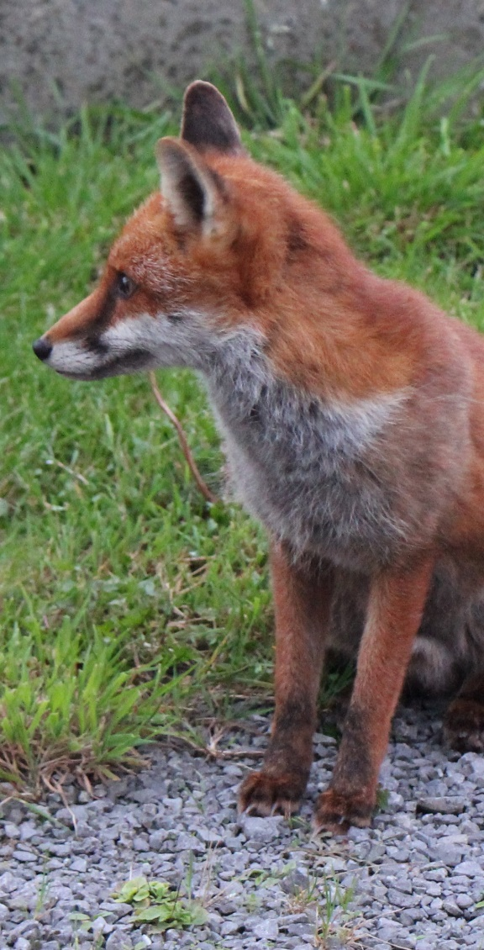
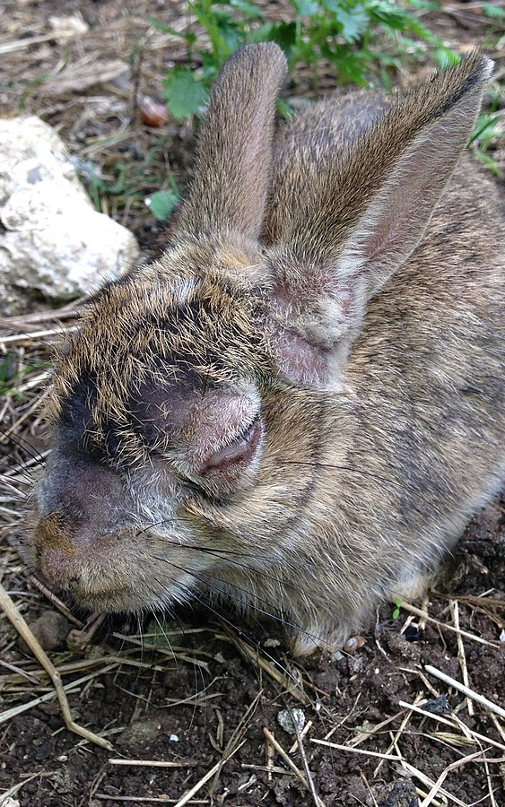
What kills rabbits?
Wikimedia – Bengt Nyman
Wikimedia - Steve Hillebrand
NPWS – Gillian Stewart
Wikimedia – Fletch 2002
Buzzard
Stoat
Fox
Myxomatosis
Notes:
What Kills Rabbits & Hares?
Most rabbits and hares die in their first year.
Few wild rabbits live more than 5 years, and few hares live more than 9 years.
Rabbits and hares are an important part of the food chain. Lots of predators want to eat them, including buzzards and eagles, foxes, stoats and badgers.
In winter, they can also die from cold and hunger.
Myxomatosis is a virus that infects rabbits. It is spread by the rabbit fleas from rabbit to rabbit. Myxomatosis was first discovered in South America. Rabbits are considered to be a pest in farmland. Myxomatosis was introduced to Ireland in the 1950s in an effort to control rabbit populations. It is a horrible disease. Originally an outbreak would kill most of the rabbits in a warren, but over time rabbits have developed some resistance and it is now not so deadly.

Slide 12
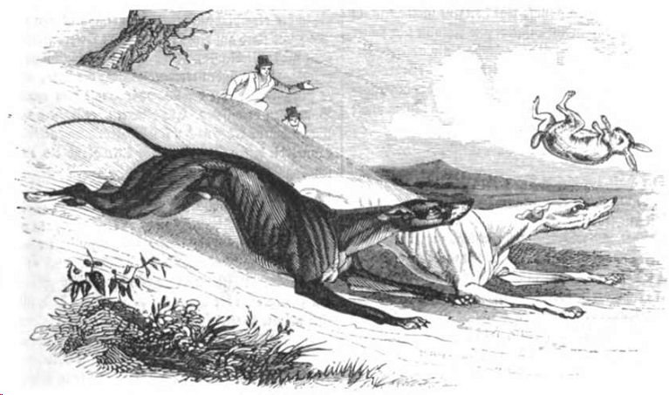
Are rabbits and hares protected in Ireland?
Johann Jacob Weber
Notes:
Are Rabbits & Hares Protected In Ireland?
Rabbits are classified as a pest species in Ireland and are not protected by law. They may be hunted throughout the year.
The Irish hare is a threatened species of international importance, and is a protected species by law. However, it is also classified as a quarry species and may be hunted or coursed under licence, but only during the open season. (Usually the open season runs October to February, but it can vary each year.) Also under licence, some hares are taken alive each year by Coursing Clubs and used for hare coursing competitions with greyhounds.
The Brown hare is classed as an Invasive Species in Ireland.

Slide 13
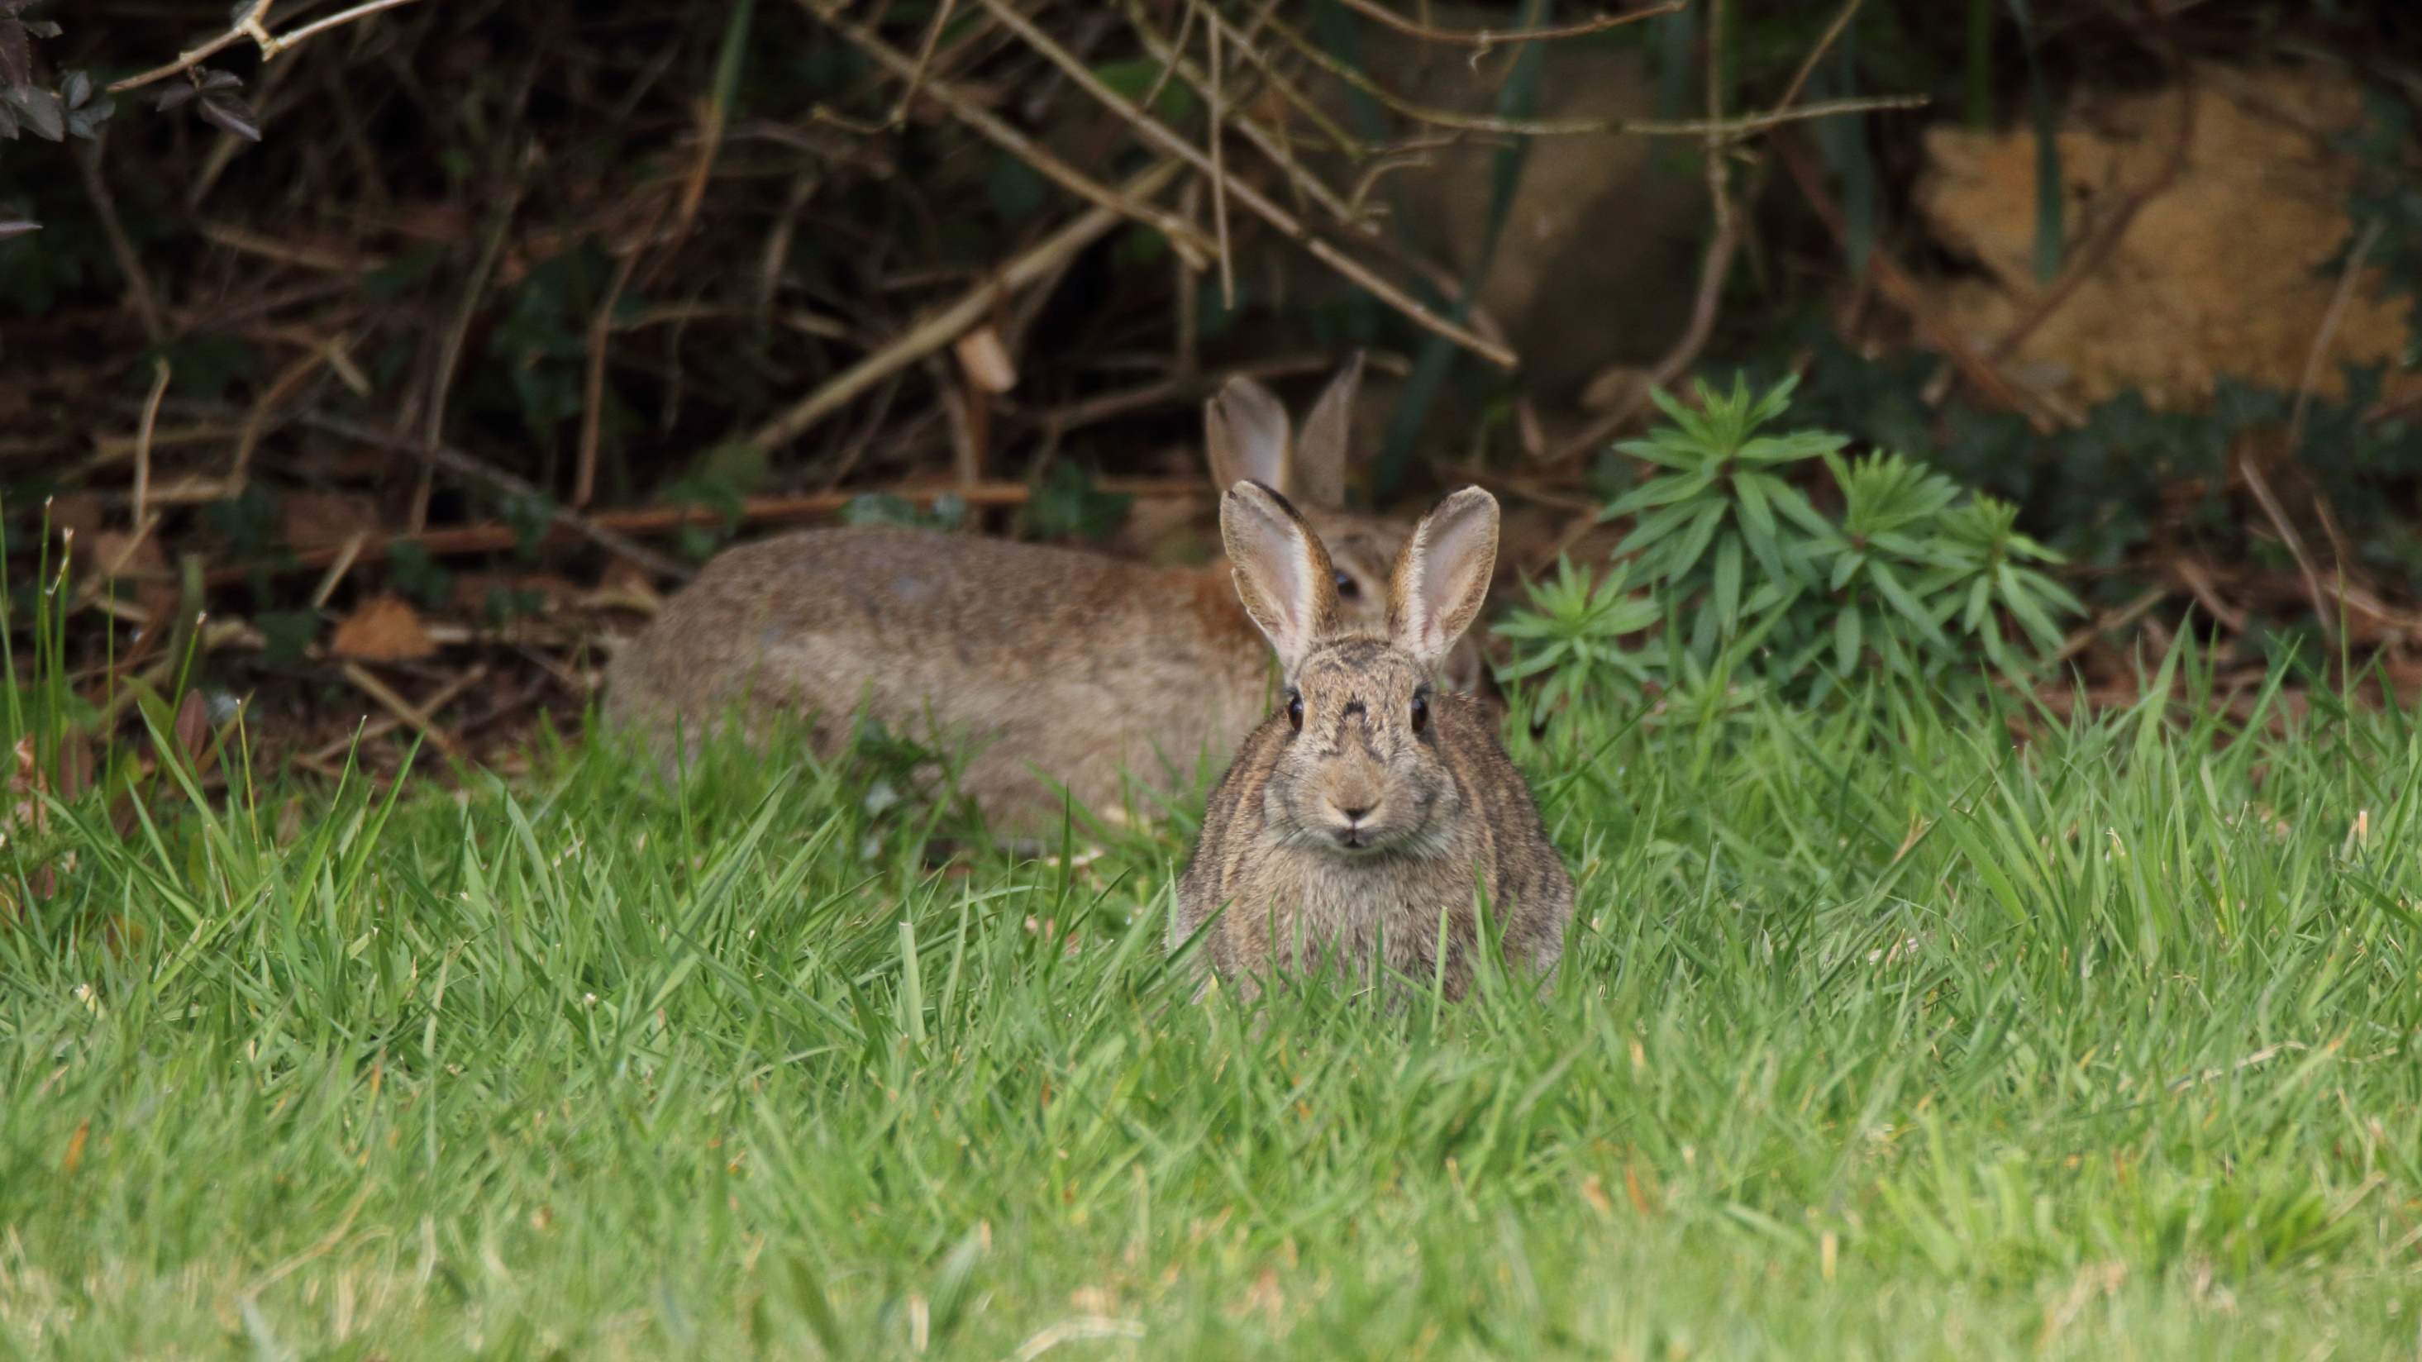
How to see rabbits and hares
Notes:
Rabbits & hares can be found in a variety of habitats including farmland, coastal sand dunes and mountain areas.
Ask local people if there are any in your area.
To watch them, be aware that both rabbits and hares are most active at dawn or dusk. In areas where they are not persecuted, they may also be seen by day.
If you do see rabbits or hares, stay very still and be very quiet. If they know that you are there, they will probably run away.
Watching Rabbits: Their warrens can be identified by
Lots of burrows
Short grass
Lots of rabbit poo!
Hares are much harder to watch than rabbits. They may be spread very thinly over a very large habitat making a sighting of one very dependent on luck. As they have no burrows, it is hard to spot signs of them.
Some areas however are known to have good populations of hares. Strangely, Dublin Airport has several hares. They can often be seen in the car parks there. Bull Island also has a population, but dogs have proven a problem there and the hares may be very elusive. Wexford Wildfowl Reserve is also a hare reserve. In fact, it is Ireland’s only hare reserve. Numbers fluctuate, but if you are lucky you might see one from the tower hide.

Slide 14
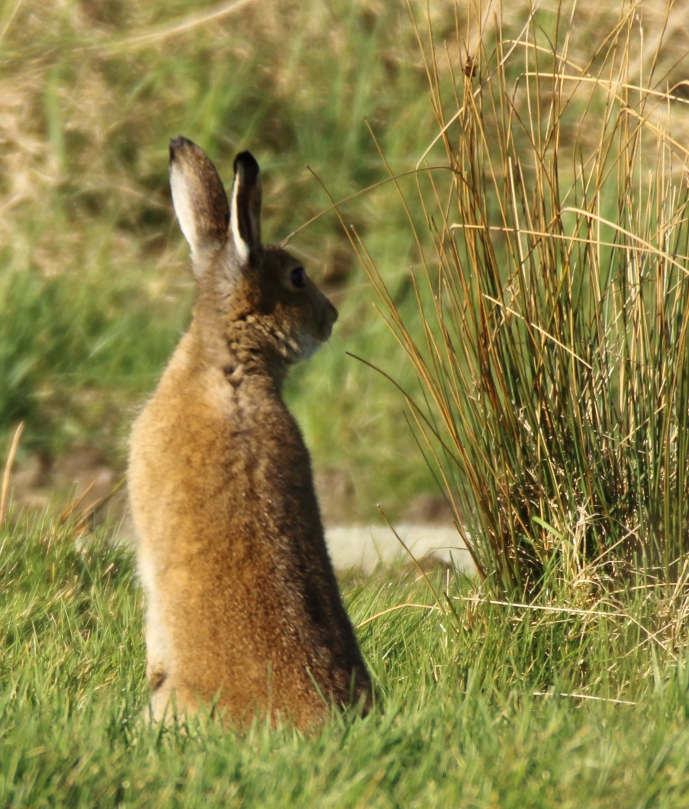

Thank you for Watching
Credits
NPWS:
Gillian Stewart
Wikimedia Commons:
Alexis Lours
Bengt Nyman
Fletch 2002
Frank Vassen
Frank Vincentz
Gidzy
Hans-Dieter Graf
J.J. Harrison
Paulo Costa
Tiia Monto
Mike Pennington
Steve Hilleband
Петроченко В. І.
Artists:
Johann Jacob Weber
Thanks are due to the following photographers and artists:

